Slide 1
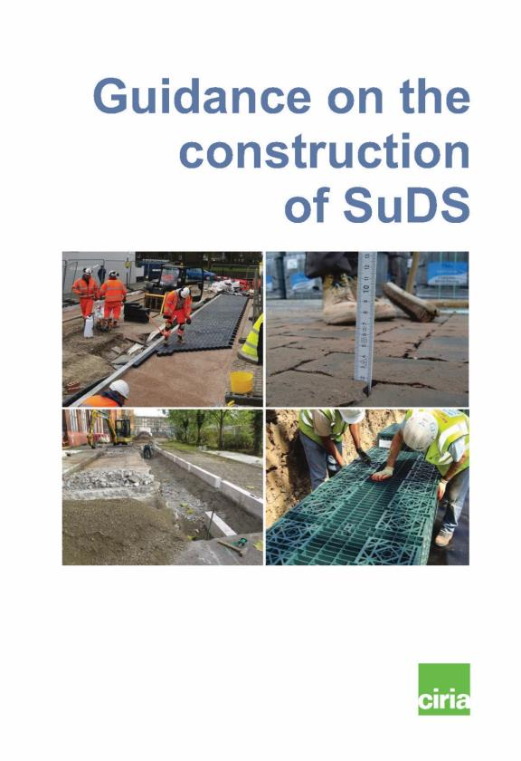
C768 Guidance on the construction of SuDS
The construction of SuDS
Use of presentation and images
Presentation
Please make use of the presentation and feel free to adapt as required. Please also acknowledge its source as CIRIA and susdrain
Images
When using images please acknowledge their source as CIRIA
Notes:
The new SuDS Construction Guidance was launched on 1 November 2017 as document C768, which can be downloaded from the CIRIA and susdrain websites.
Use of presentation and images
Presentation
Please make use of the presentation and feel free to adapt as required. Please also acknowledge its source as CIRIA and susdrain
Images
When using images please acknowledge their source as CIRIA

Slide 2
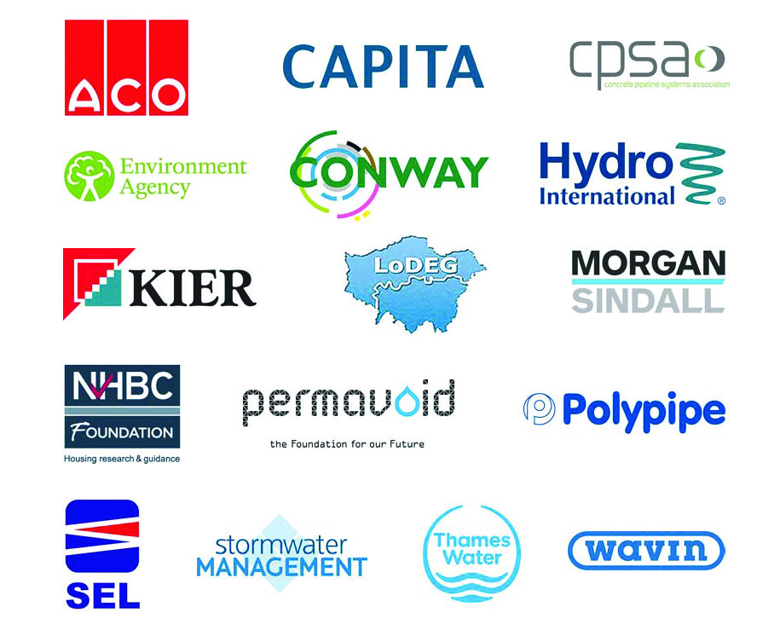
Thanks to the funders
Insert logos / names
Notes:
This document has been supported by the collaborative funding of the companies shown above, without whose backing, it would not have happened.

Slide 3

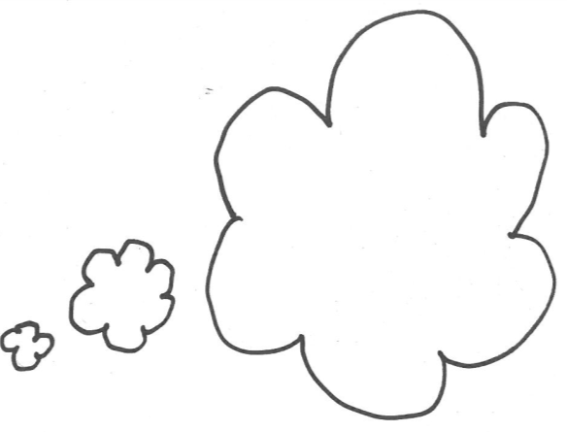




Why it was needed
SuDS knowledge has progressed
Guidance needs to be appropriate for its audience
Companion document to the SuDS Manual
Known inadequacies in SuDS construction
Site handbook for the
construction
of SuDS
CIRIA 698 June,2007
C768
Notes:
Whilst the original handbook for SuDS Construction (C698) has been around for a long time, the understanding of SuDS design and construction has moved on, and is now much more comprehensive and robust, reflected in the new SuDS Construction Manual, published in 2015.
This guidance is intended to be a companion document to the SuDS Manual.
It was also felt that to be effective, then the guidance needed to be appropriate for the audience who would get most benefit from it, and is therefore written explicitly for all those likely to be directly involved in their construction.
The need for this guidance has also been acknowledged widely in the industry, as it is understood that many instances of poor construction have occurred.

Slide 4
Why it was needed
  MAIN CHALLENGES
  Level changes
  Cut or fill
  Conflicts with services
  COMMON PROBLEMS
  Inadequacies in design drawings
  Recording of existing site information
  Additional hard surfaces
  Changes of materials
  Changes on site/poor construction
  Inexperienced contractors
Notes:
To ensure that the new guidance fulfilled the knowledge gap in the construction industry, a detailed questionnaire was circulated. The responses showed a very high level of consistency throughout, and a great sense of frustration from those involved in the construction process.
The main challenges arose from 3 causes:
level changes (from the design drawings),
cut and fill issues not be resolved prior to construction,
conflicts with services once the works started on site.
Other problems frequently cited included
inadequacies in the design drawings (full details of levels throughout the system, capacity, flow controls etc not provided),
existing site information not comprehensively recorded, and the implications of that information included within the drawings,
the need for additional hard surfaces being added during the contract, but their drainage requirements not addressed,
changes of materials (which did not have the same functionality),
changes on site or poor construction arising from a lack of knowledge of the implications of change.
Many projects are still undertaken by contractors who may never have built a SuDS previously, and therefore do not understand either what it is crucial to get right, or how to do it.

Slide 5
Why it was needed
  Conflicts with areas of ecological importance
  Conflicts with tree root protection zones
      AND GENERALLY WITH
  Visual quality
  Physical construction
  Functionality
Notes:
Interestingly challenges around building SuDS in areas of ecological importance or in proximity to existing trees did not arise frequently.
Overall, the consequence of these various issues resulted in either poor visual quality, physical construction or their functionality, or a combination of those factors.

Slide 6
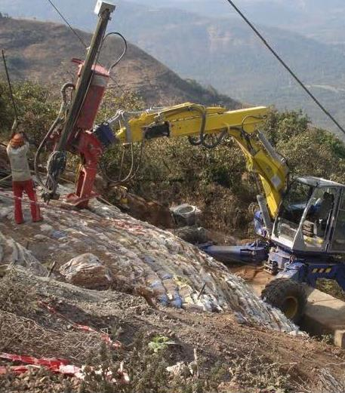
Challenging sites
SPECIFIC PROBLEMS DURING CONSTRUCTION
Groundwater (and groundwater source protection areas)
Unstable fill
Contaminated land
Steep slopes
Flat sites
Notes:
Many people had not encountered these specific problems, or only very occasionally, with the most common being contaminated land.

Slide 7
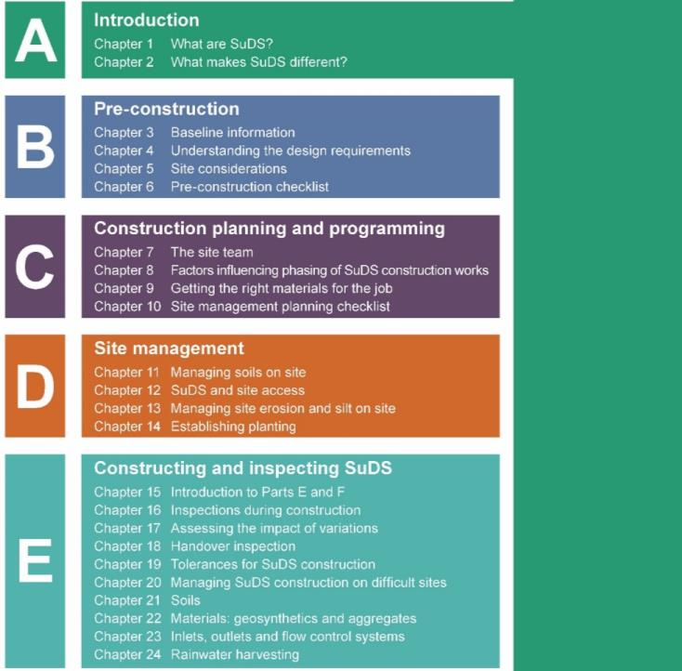
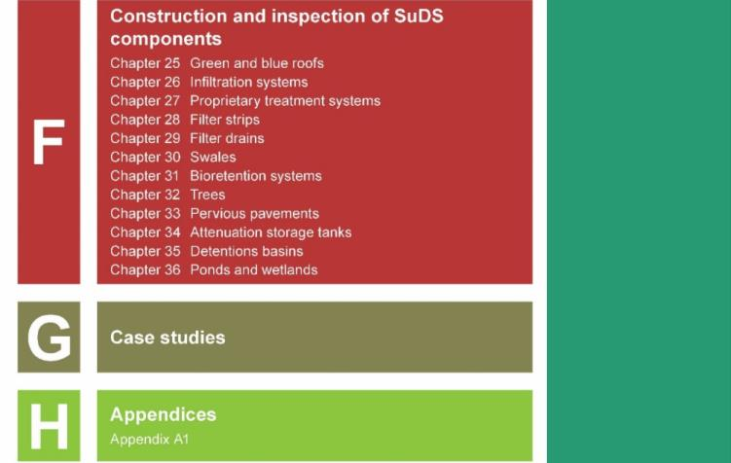
The guidance
Free to download from
the CIRIA and susdrain websites
www.susdrain.org/resources
Notes:
As this document is seen as a companion to the SuDS Manual, it has been laid out and styled in a similar manner, and the contents reflect the way that information has been provided in the Manual in terms of the list of SuDS components, how they are constructed, and what needs to be checked to ensure they are built to fulfil their design purpose.
However, its approach is entirely different, as it does not deal with design and is not presented in a highly technical manner.

Slide 8
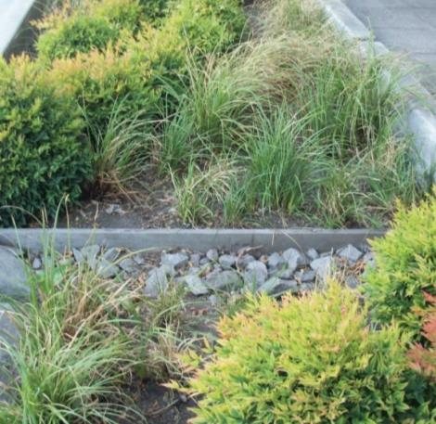
simple English – few words – image rich
use of symbols – sharing knowledge – little jargon
Notes:
The guidance is written to make it as easy to understand as possible, by anyone regardless of their prior knowledge of SuDS.
It deliberately uses simple English, text is kept to a minimum, with pictures used wherever possible to illustrate and explain the issues being discussed. Symbols are also used to show whether the images are illustrating good or bad practice.
Knowledge that has been developed in the industry through building SuDS is also shared to help the readers, and technical jargon avoided.

Slide 9
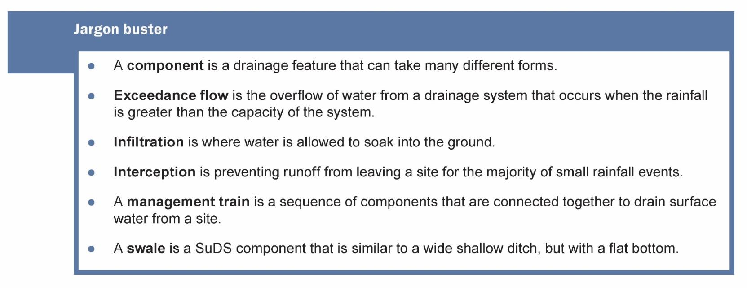
Jargon busters
Notes:
Where jargon has to be used, the words are explained in a ‘jargon buster’ at the end of each chapter. In the main this amounts to around 3 or 4 terms in any chapter.
The word that occurs most frequently is ‘component’, and is repeated in almost every chapter.
Dealing with jargon in this way ensures that readers can ‘dip into’ any chapter without needing to read introductory chapters first.

Slide 10
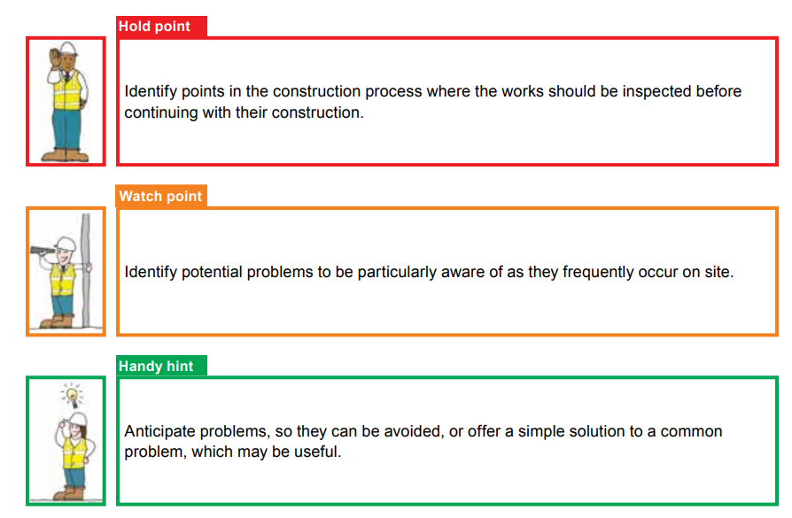
Sharing helpful hints
Notes:
As part of the initial industry survey and through the Project Steering Group a wide range of ‘good advice’ was received. This is presented through a ‘traffic light system’ relevant to the chapter in which it is found.
Handy Hints anticipate problems, so they can be avoided, or offer a simple solution to a common problem, which may be useful.
Watch points identify potential problems to be particularly aware of, as they frequently occur on site.
Hold points identify points in the construction process where the works must be inspected prior to continuing with their construction.

Slide 11
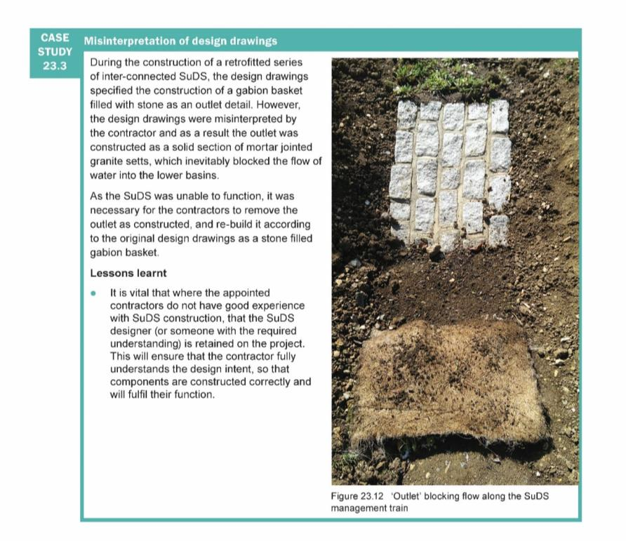
Learning from other’s experience
CASE STUDIES
Mini-case studies within chapters
Major case studies chapter
Notes:
Industry experience is also shared through a wide range of case studies. Most chapters have ‘mini-case studies’ at the end, which explore a specific issue that has occurred on site.
Towards the end of the Guidance there are five major case studies that explore an entire project. In both types of case study, the range of problems that have arisen on site are reviewed to identify what lessons can be learnt from them, and how these challenges can be avoided in the future.

Slide 12
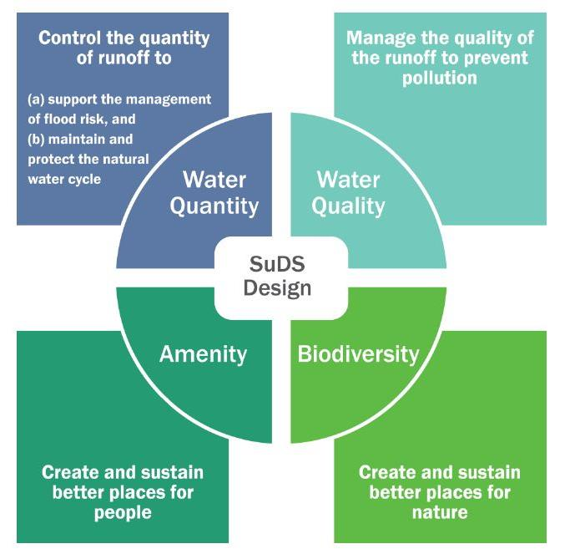
Delivering SuDS objectives
THE 4 PILLARS OF SUDS
Maintenance of soil structure
Maintenance of infiltration capacity
Prevention of compaction, erosion, pollution, silt or sediments
Difficulty of reinstating damaged soils
Maintenance of existing vegetation/ecology
Notes:
Whilst the 4 pillars of SuDS should underpin every SuDS project, unless the practical requirements of successfully constructing SuDS are understood these principles can easily be undermined.
The key lies in understanding the ways in which SuDS construction requires a different approach to ensure that the soils are maintained in good condition, so their structure will still sustain plant life, will drain effectively, and does not become polluted with silts or sediments, as trying to reinstate damaged soils can be very difficult to do.
Similarly, protecting and maintaining the existing trees and vegetation resource and/or specific habitats must be understood and planned, as they are very difficult to replace.

Slide 13
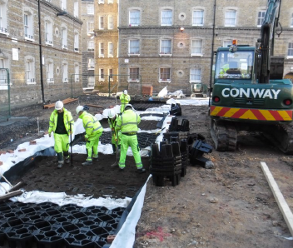
What’s different about SuDS
HOW TO GET IT RIGHT
Being properly prepared before starting – the site and the scheme
Planning the works to get it right
Planning to avoid potential site problems
Managing the site and works during construction
The typical challenges of specific SuDS components
Notes:
The guidance has therefore sought to address these constructional challenges by working through the typical construction contract from the early planning stages through to completion and handover, but reconsidering it to understand what need to be done differently to enable the SuDS to be constructed successfully.

Slide 14

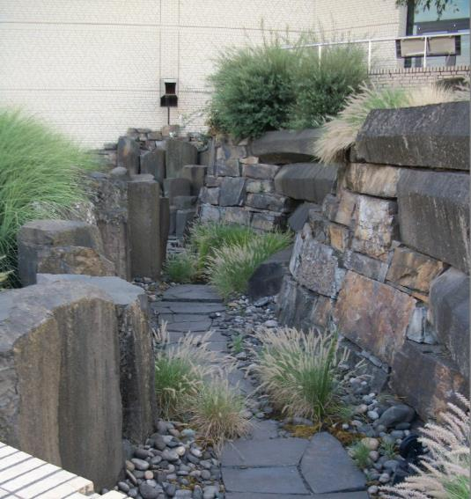
Drainage Vs SuDS – the differences
Hard and soft
Multiple benefits
Need for care in construction
Why SuDS can affect construction planning
Notes:
The initial chapters briefly explain what SuDS are, and what makes them different to traditional drainage. The fact that soft SuDS can use vegetation to deliver surface water drainage can be a challenge to those only familiar with laying pipes and manhole chambers.
The need for care in their construction is explained alongside the way that they may affect the construction planning process, especially when the weather conditions and seasons affect their completion.

Slide 15

The site and the scheme
How to get it right
Notes:
The second chapter considers the information that needs to be gathered and the issues that need to be understood prior to construction.

Slide 16
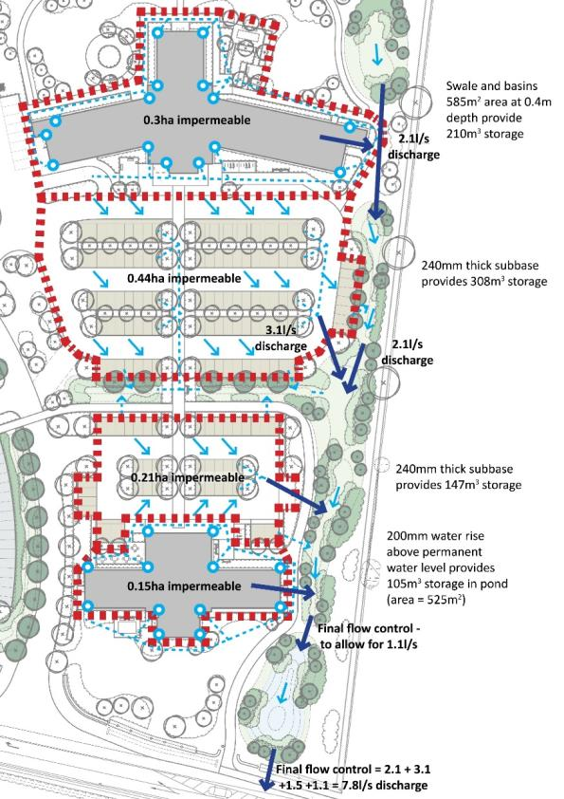
Pre-construction
BEING PROPERLY PREPARED
Baseline information - the site
Understand the scheme requirements
Checking how the design works and the specification requirements
On and off site considerations
Pre-construction checklist
Notes:
Being properly prepared means assembling and understanding all the relevant information about the site that may affect the construction of the SuDS. Then understanding how the scheme design works as a whole and how each part of the system relates to each other. This is particularly relevant to levels and regarding. The scheme design should then be cross-referenced to the specification to ensure that the materials used will deliver the volumes, storage and control flows as designed.
Consideration should also be given to the land, vegetation, habitats or other factors on the surrounding land, as these could affect the construction work either directly (through flooding/overland flows or services) or through constraints such as the timing of the works due to protected species.

Slide 17
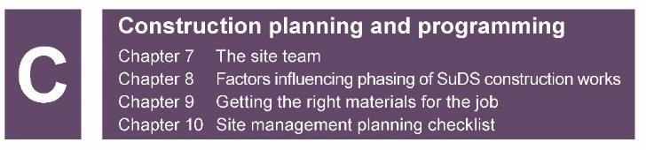
The team approach
How to get it right
Notes:
Chapter C considers the ‘who does what and when’ of SuDS construction planning, and why getting the right materials is so important.
Team work between various professionals is important and also between the designer and contractor.

Slide 18
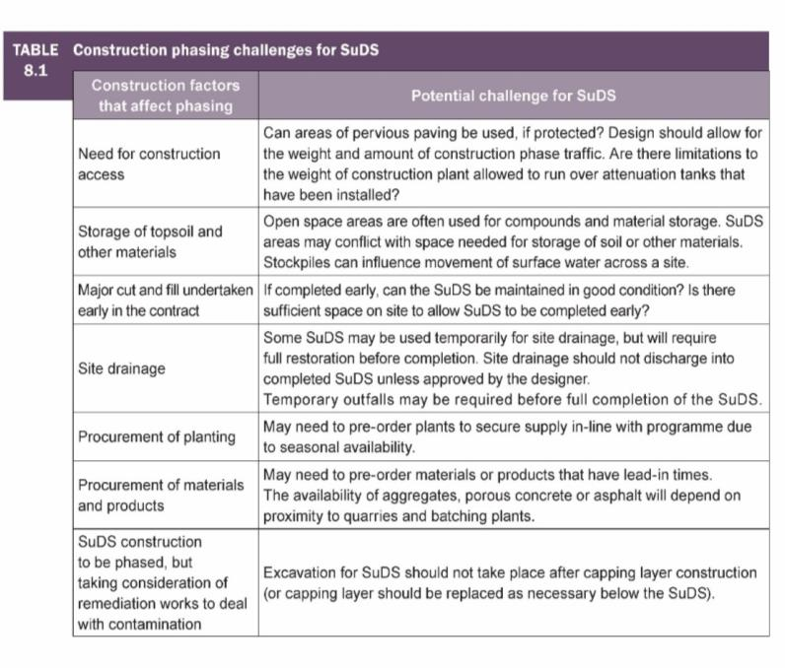
Construction planning and programming
PLANNING THE WORKS TO GET IT RIGHT
The site team
Understand the phasing requirements
Getting the right materials for the job
Site management planning checklist
Notes:
This considers the ‘who does what, why and when’ of SuDS construction planning, and why getting the right materials is so important.

Slide 19
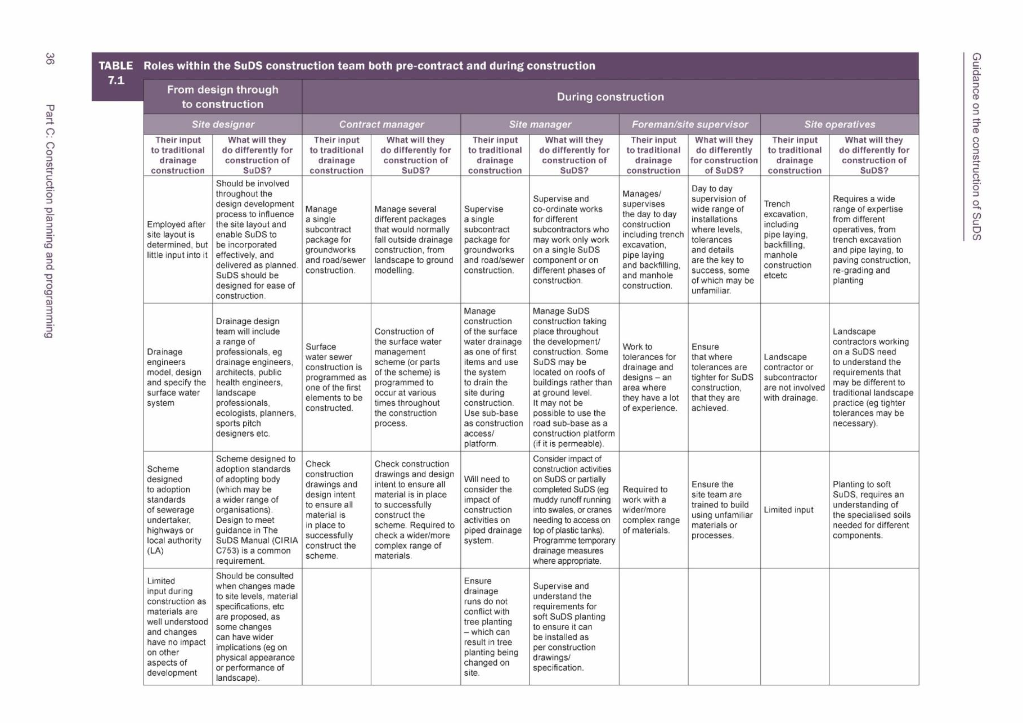
Detailed contents
PLANNING THE WORKS TO GET IT RIGHT
Part 3 Construction planning and programming
Section A The site team – who needs to know what and when
Section B Factors influencing phasing of the works
Section C Ensuring the right materials supply
Section D Anticipating problems of sediments, pollution and erosion
control
Section E Typical problems and handy hints (potential case study)
Section F Site management/planning checklist
Rationale for the Scoping report
Notes:
The typical roles of both the design team and site construction team are analysed to explain their roles in a traditional contract and SuDS contract to explain how they differ.

Slide 20
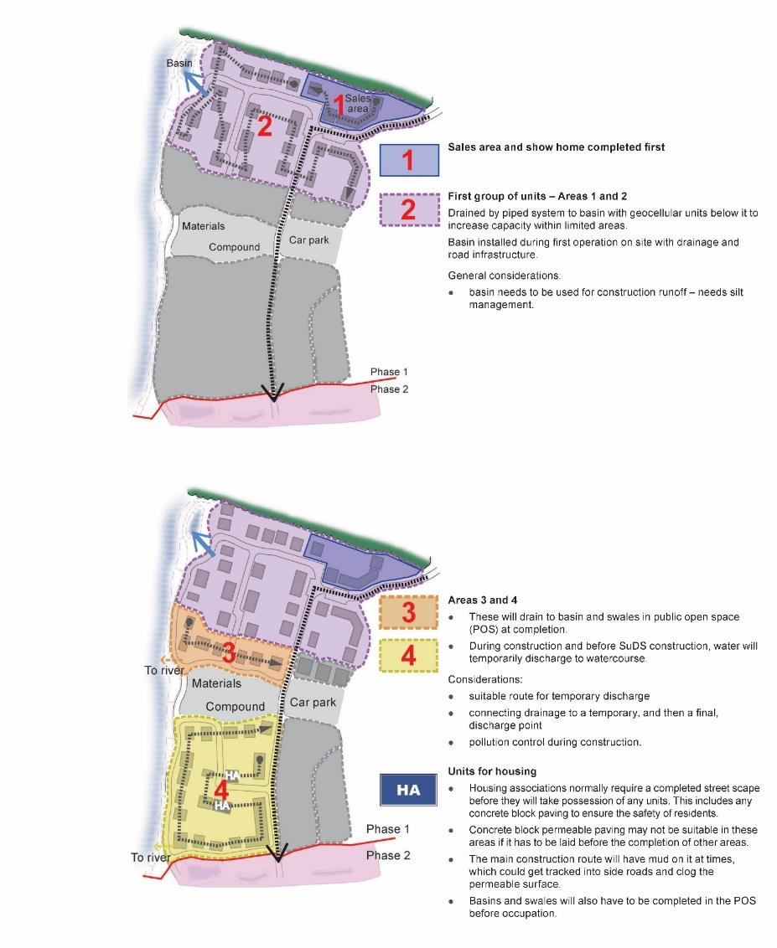
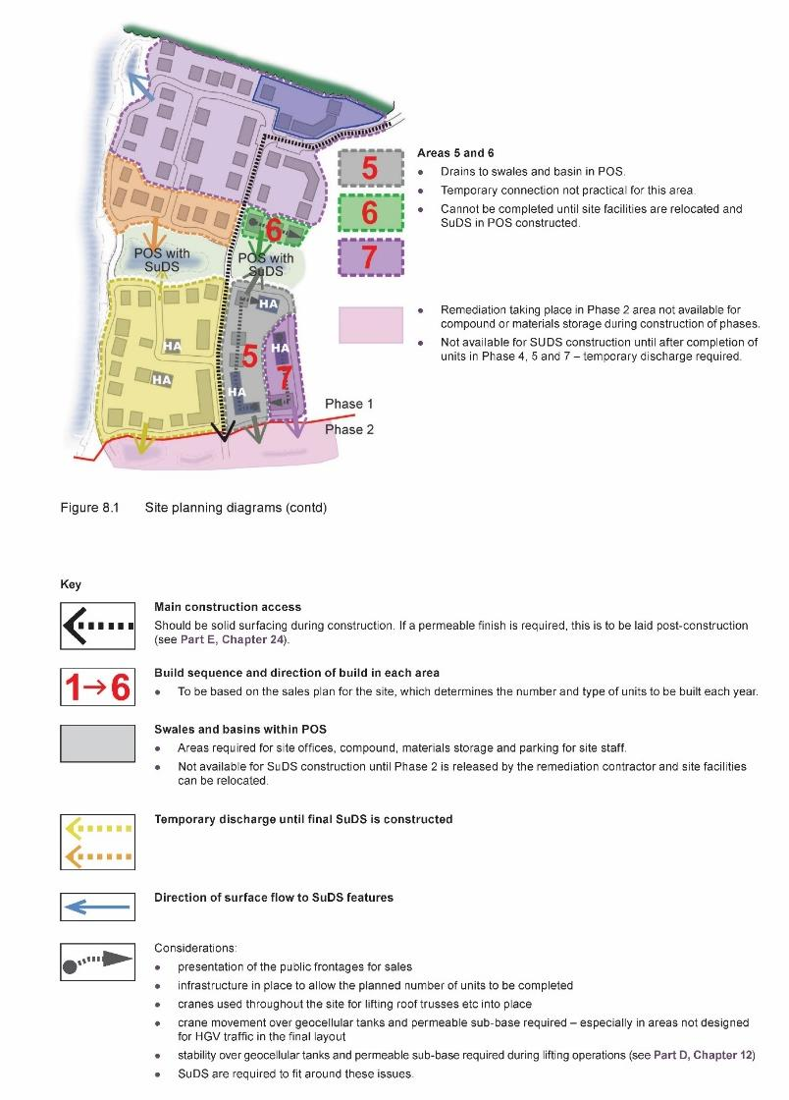
Notes:
Phasing of the works is one of the most important factors in site planning, and is influenced by a wide range of factors. A housing site in particular is used to demonstrate the issues involved, many of which are not SuDS related (such as the desire to have the show homes at the front entrance), but the way in which they influence the deliver of the SuDS.
The example shows (for example) how the final SuDS retention ponds are used for materials storage and parking during all phases of the works, and are only able to be constructed, and therefore used, in the final phase, requiring temporary surface water measures to be put in place in the meantime.

Slide 21
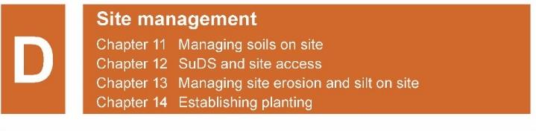
Managing the site
How to get it right
Notes:
Chapter 4 considers how a number of key site issues need to be managed to enable the SuDS to be delivered successfully.

Slide 22
Managing the site
AVOIDING PROBLEMS
Managing soils
SuDS and site access
Managing soil erosion and site silt
Establishing planting
Notes:
These are the four key problems that arise on site and can ultimately affect the ability of the site to deliver the designed scheme.

Slide 23
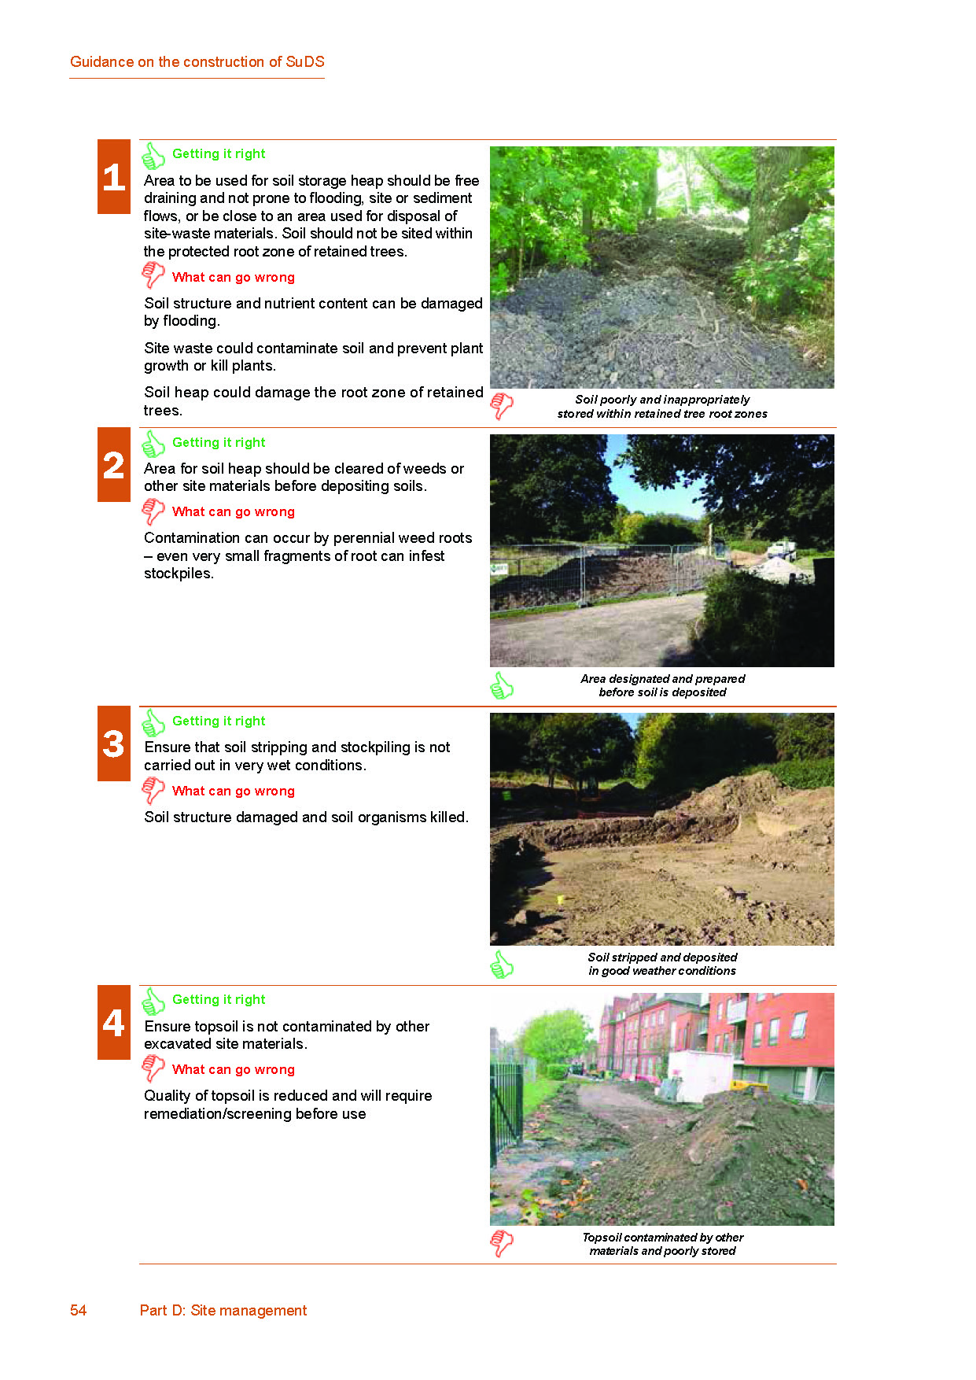
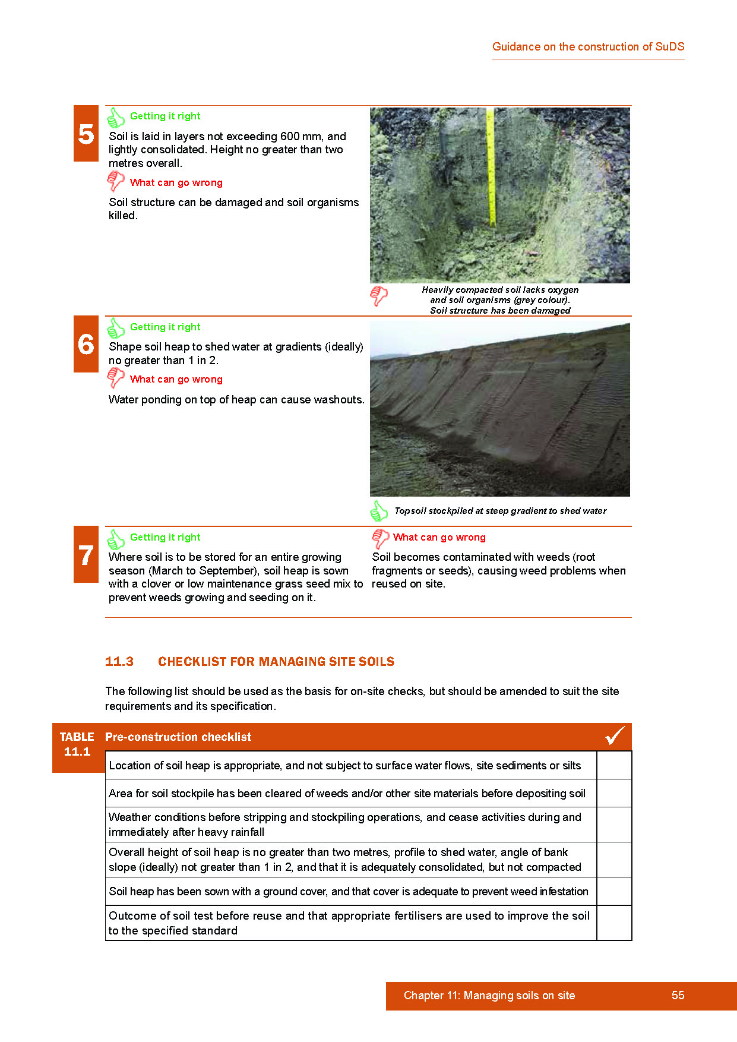
P54/55
Managing soils on site
Notes:
This style of presentation about soils is typical of the way the document is arranged, and uses the universal ‘thumbs up’ (in green) and ‘thumbs down’ (in red) to explain what ‘getting it right’ means, and if not ‘what can go wrong’. Ideally, each of the identified problems are illustrated by either an example of things being done incorrectly, or if not, an example of good practice.

Slide 24
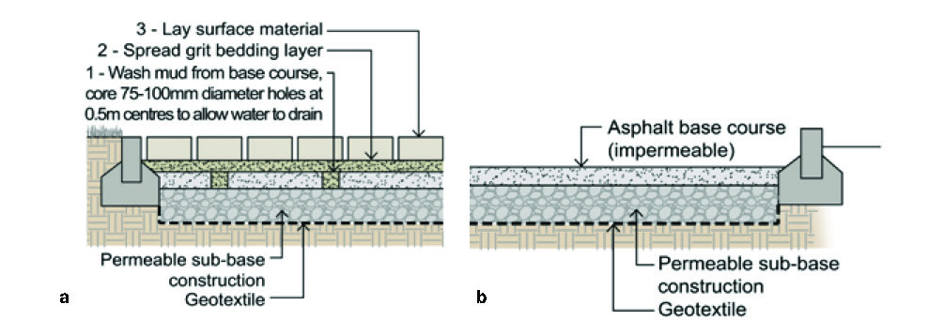
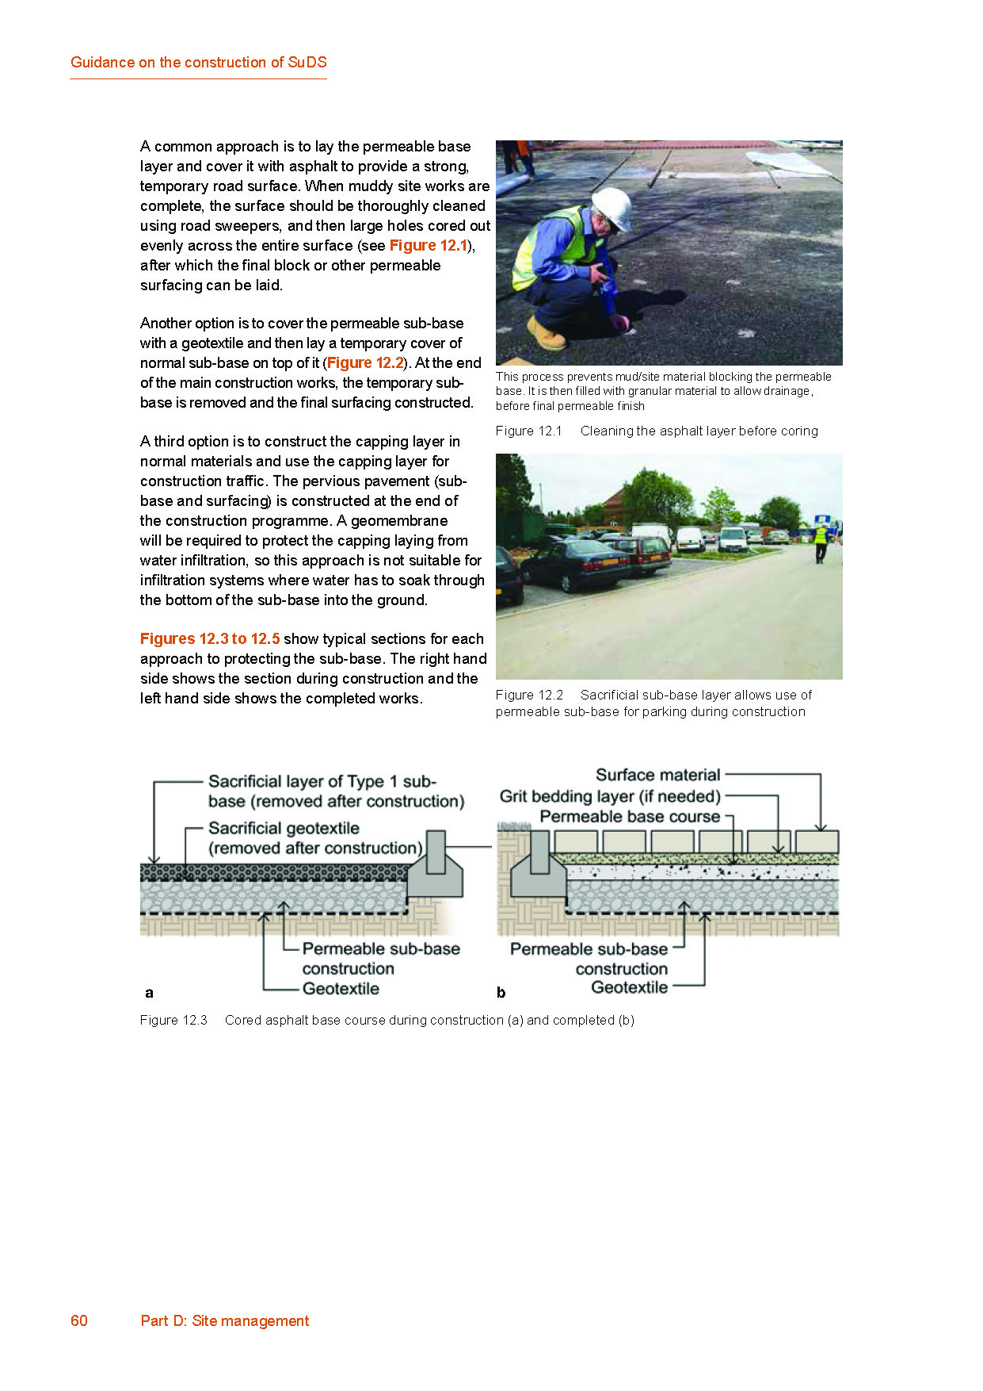
SuDS and site access
Notes:
Site access is known to be a major problem on site, and is seen as a factor as to why pervious paving can’t be used due to the mud and silt that will be deposited on site roads. This sections therefore explains how this can be done effectively.

Slide 25
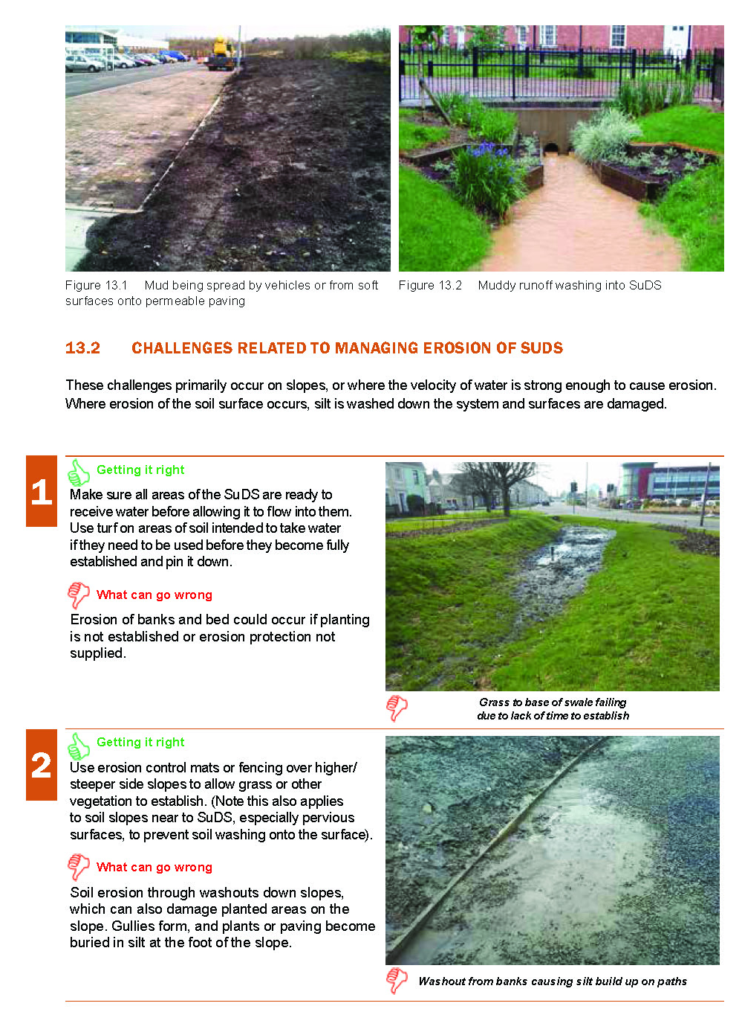
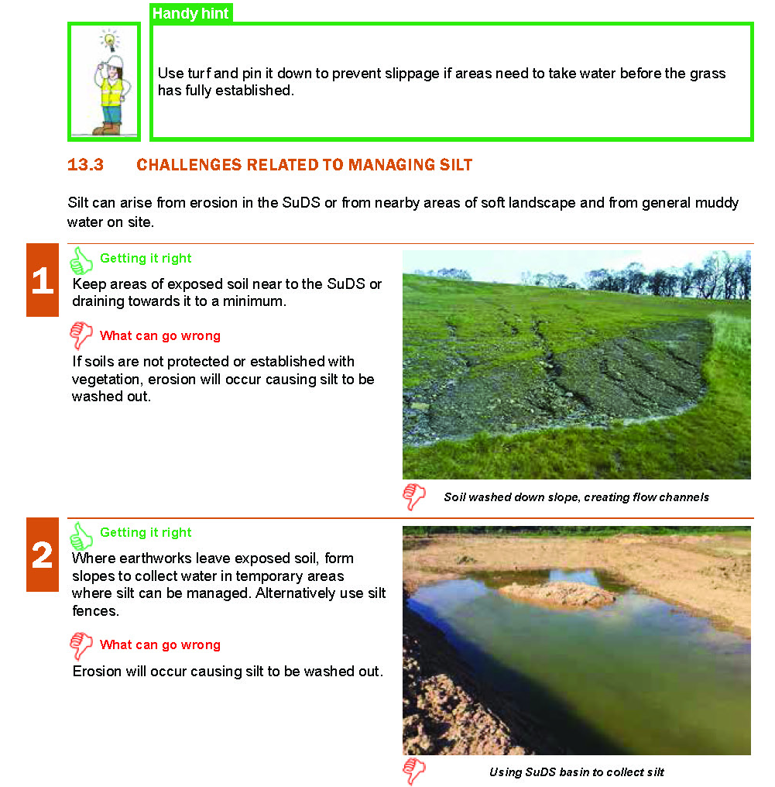
Managing soil erosion and silt
Notes:
Managing soil erosion and silt is also seen as fundamental to the successful delivery of SuDS due to their potential to block or damage systems if not properly managed, resulting in both delays and additional costs to reinstate the works properly.

Slide 26
Establishing planting
Why you should plant early
How plants/grass contributes
Why plants die
The 5 stages to planting
Notes:
Establishing planting within soft SuDS was also seen as a challenge by many, mainly due to a lack of understanding of their needs in terms of soil condition. Knowing that the right plants are being delivered and used in the right place (for their functionality and their appearance) and that they are to the right specification also presented challenges.

Slide 27
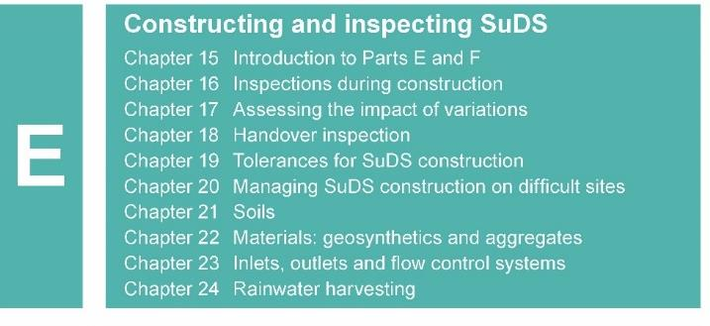
How to get it right
Key factors
Notes:
Section E then considers the factors around constructing SuDS and the issues that need to be managed to ensure their successful delivery.

Slide 28
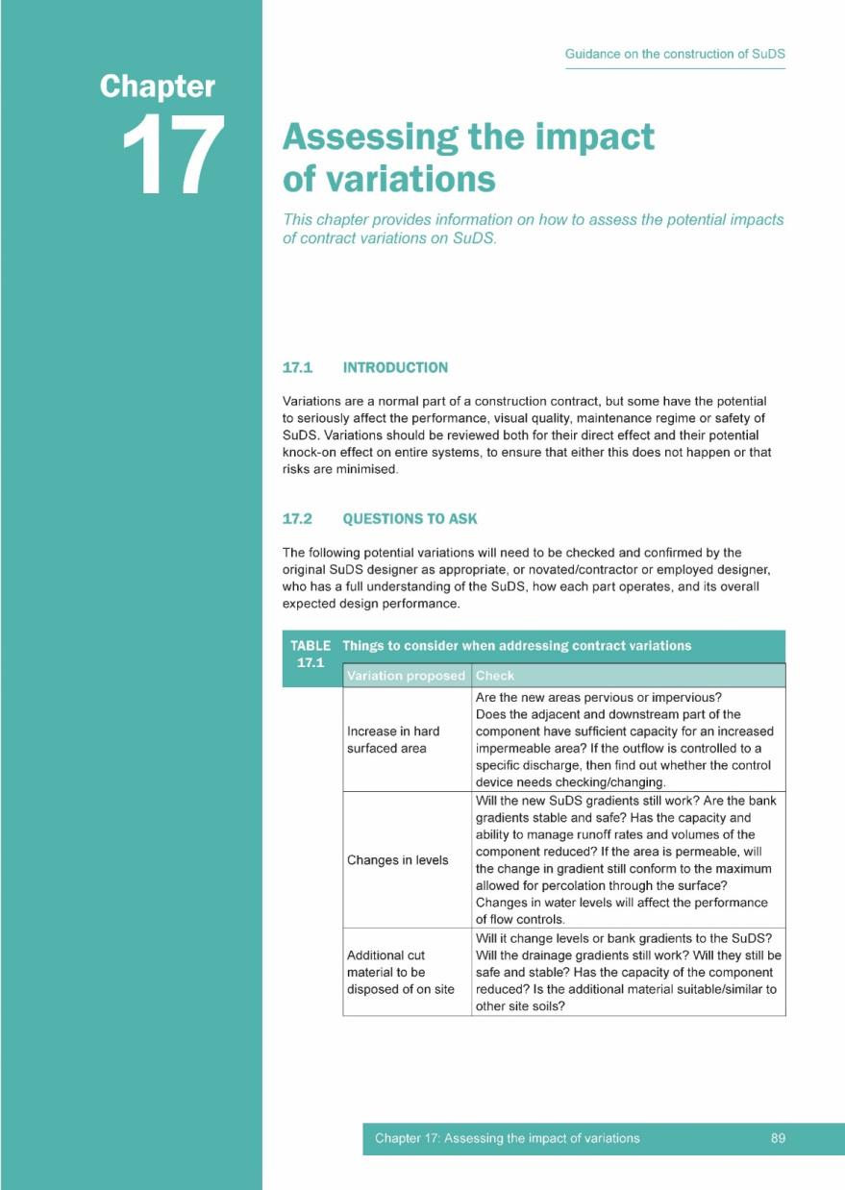
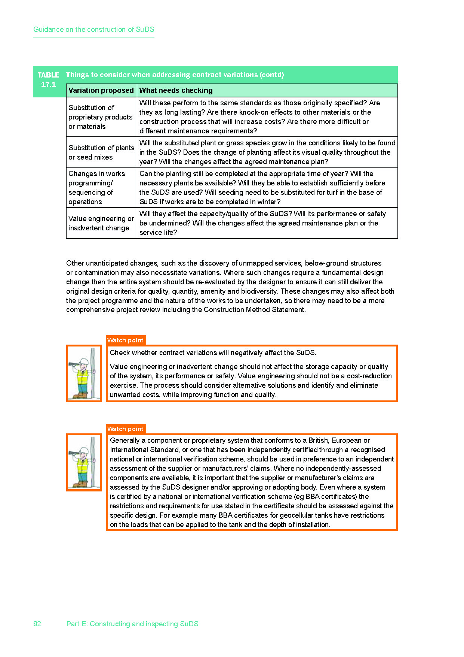
Notes:
Variations that are not considered for potential impact on the SuDS can make a significant change to the ability of the scheme to deliver its intended design function (whether quantity, quality, amenity or biodiversity).
Additional areas of hard surfaces, changes to cut and fill volumes or specification changes to materials were frequent examples of where problems arose.

Slide 29
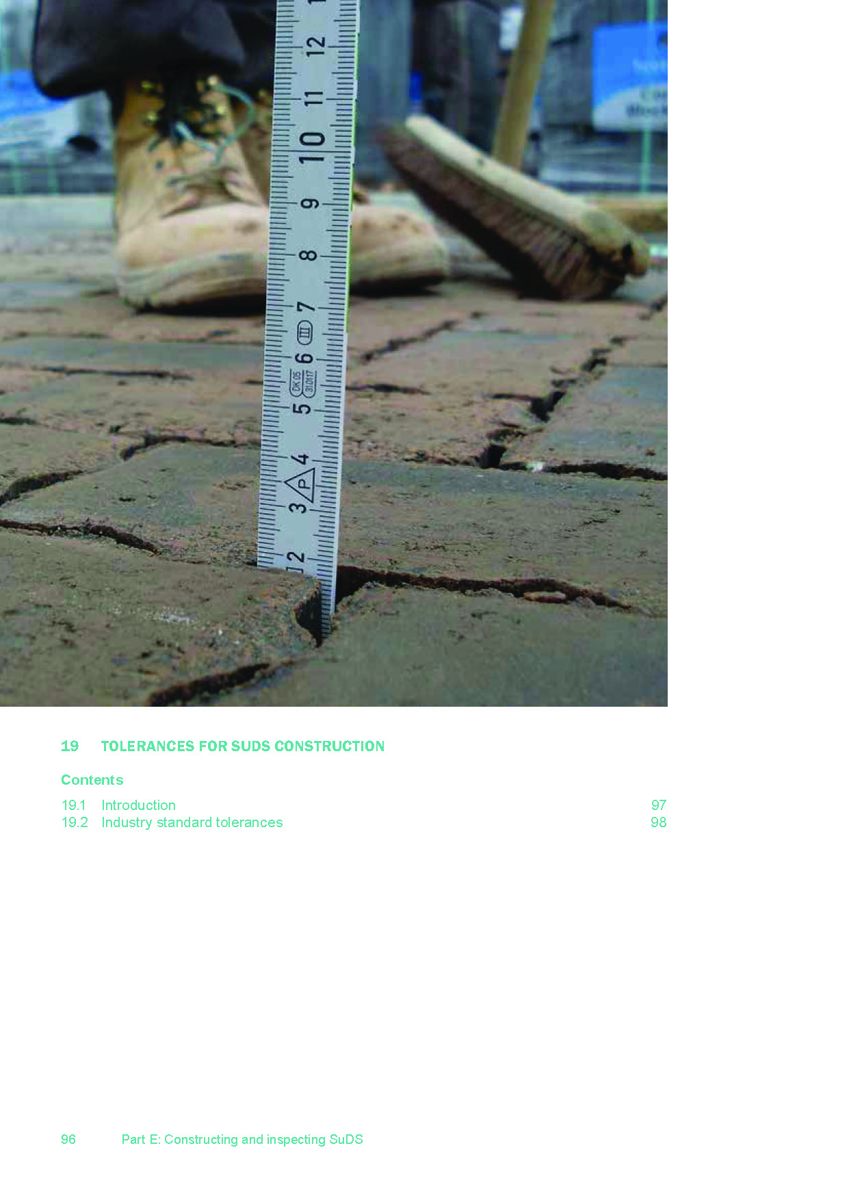
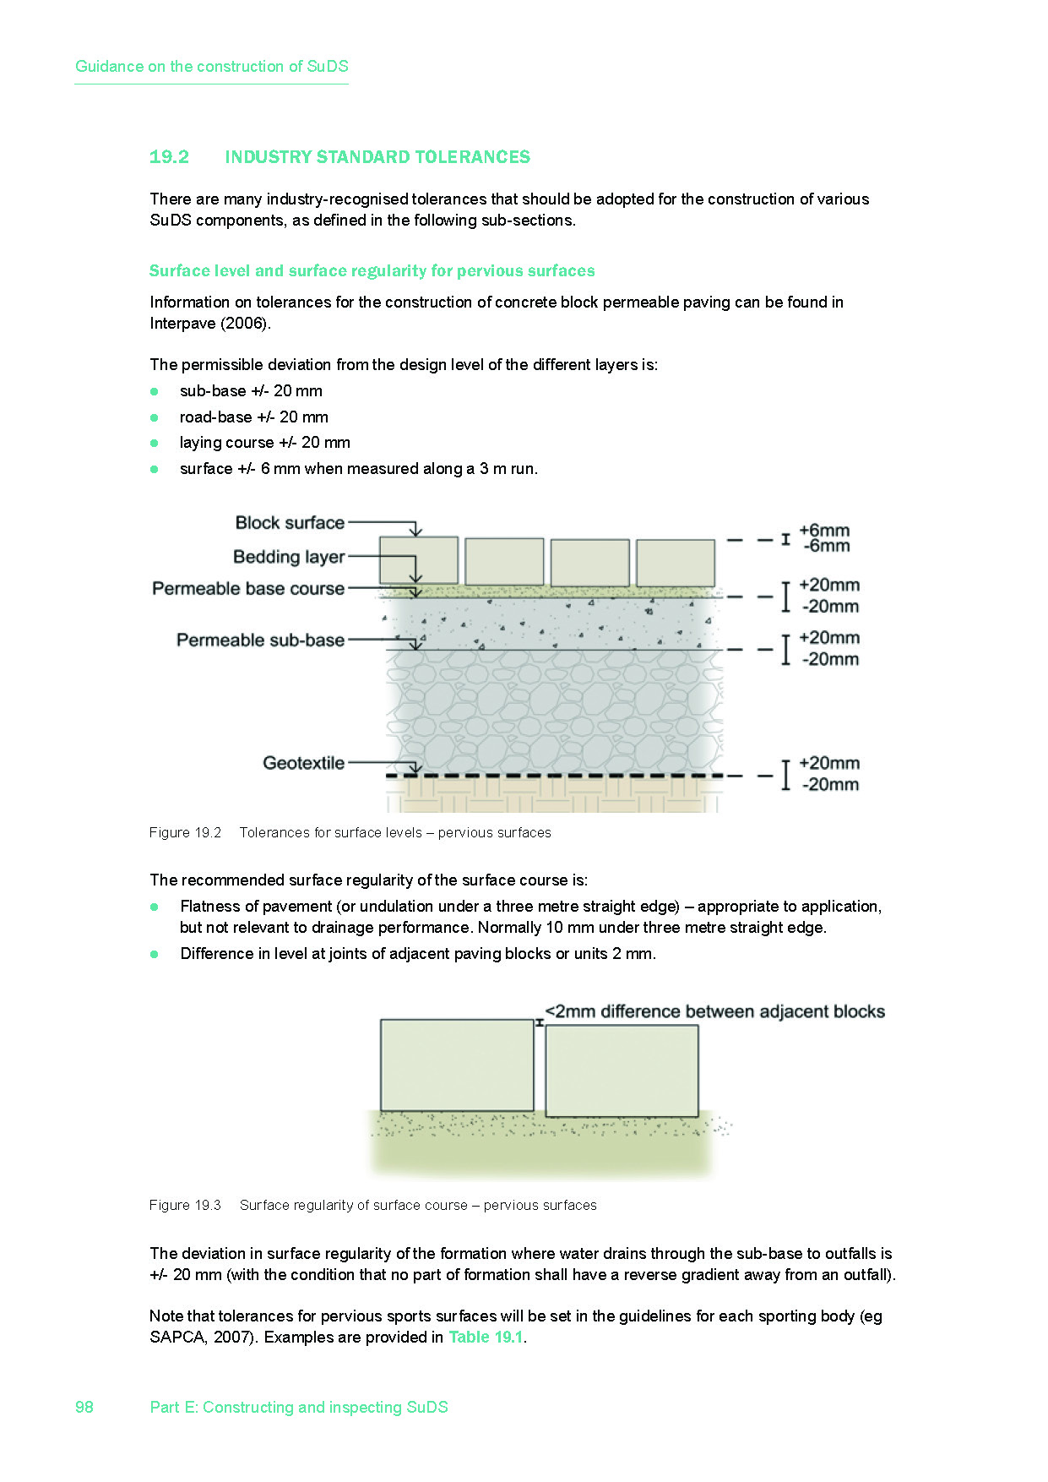
Use of presentation and images
Presentation
Please make use of the presentation and feel free to adapt as required. Please also acknowledge its source as CIRIA and susdrain
Images
When using images please acknowledge their source as CIRIA
Notes:
Industry standard tolerances particularly relevant to SuDS are identified.

Slide 30
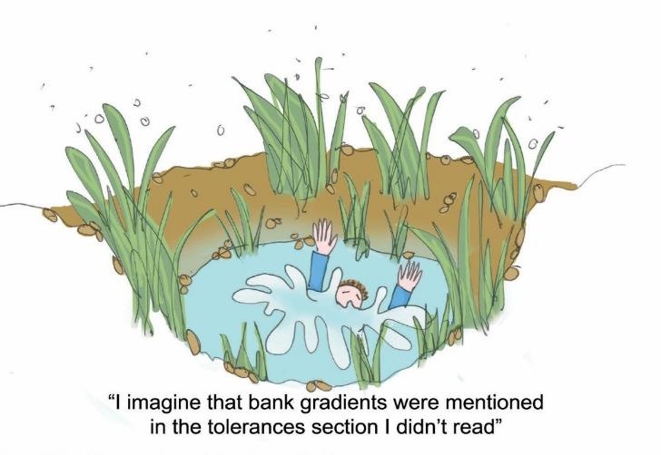
Tolerances
The appropriate specification and tolerances
Paving falls/levels
Materials – aggregates/ geomembranes etc
Porosity/infiltration
Notes:
The standards generally relate to paving falls and levels, materials, such as aggregate sizes, and the geomembranes, or the porosity values/infiltration rates for geotextiles or soils.

Slide 31
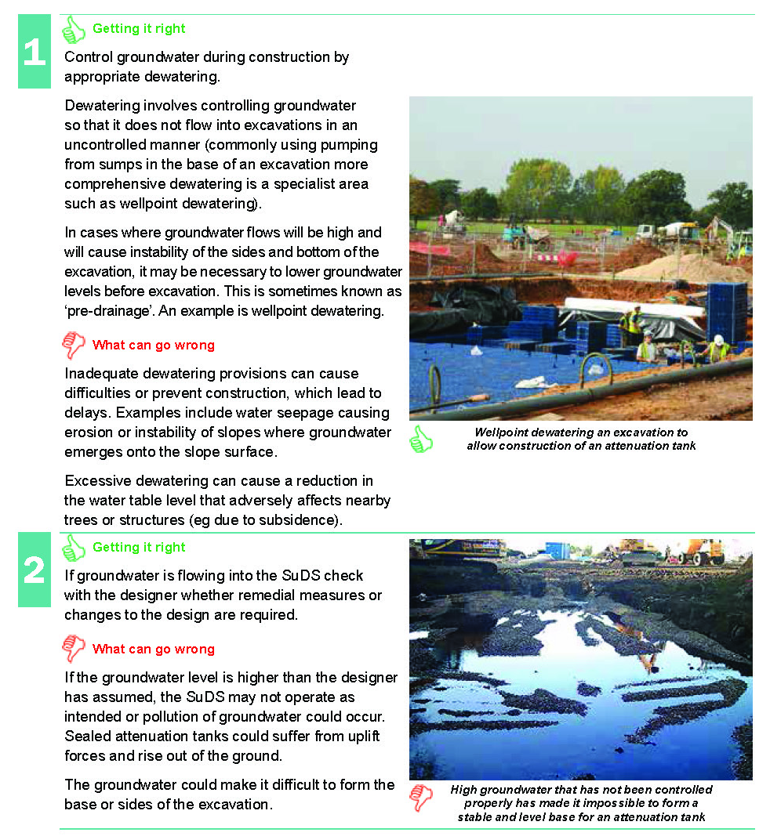
Challenging sites – high groundwater
Need for forward planning
Appropriate scheme
Managing water flows into the excavations
Notes:
Various factors that could make construction of SuDS difficult are discussed. One example is high groundwater. This requires adequate forward planning to manage water inflows to excavations.

Slide 32
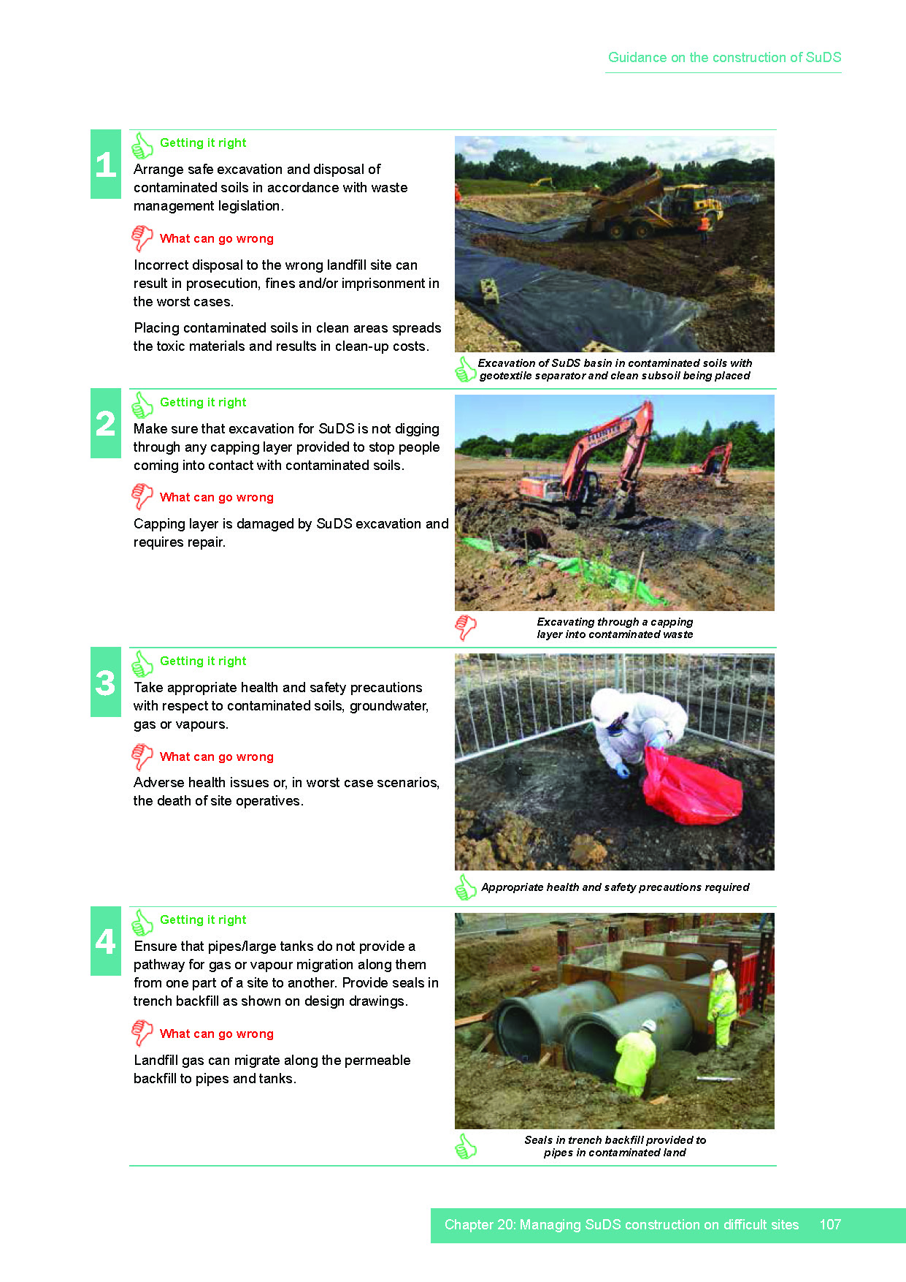
Challenging sites – contaminated land
Appropriate scheme
Management of contamination if excavated
Record keeping
Notes:
The presence of contamination will also require forward planning to avoid adverse impacts on remediation schemes and management of excavated soils that are contaminated.

Slide 33
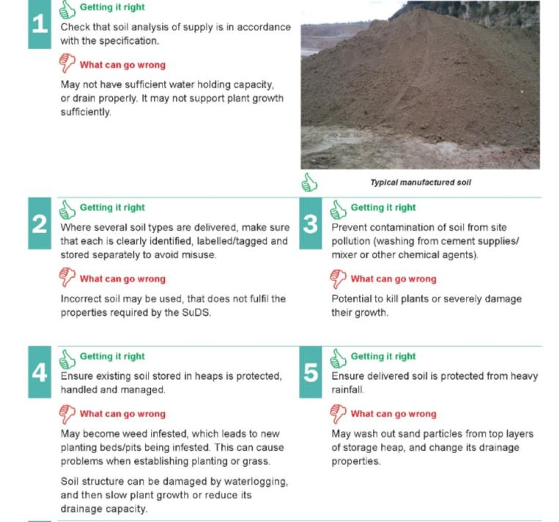
Soils
UNDERSTANDING THE DIFFERENT TYPES
Natural
Specialist
Manufactured
Bioretention or filter media
Structural
Engineered
…and why and where to use them!
Notes:
There are a wide range of different soils that can be used in SuDS, and the choice of soil relates to their function within the system. Using the wrong type of soil or soil mix will affect its ability to either drain freely or retain moisture, affecting the ability of plants to thrive within the system and their ability to improve water quality.

Slide 34
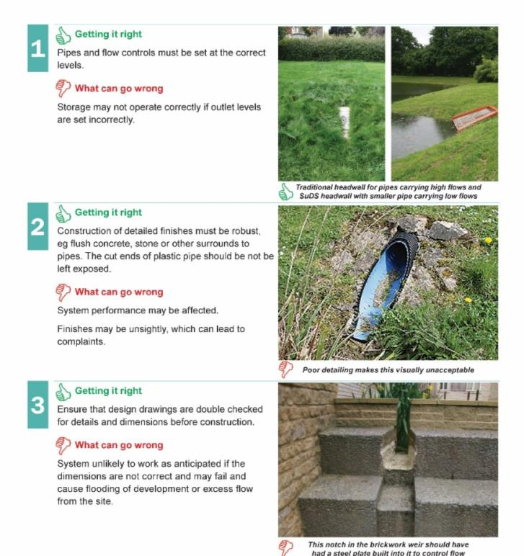
Inlets and outlets
MANAGING THE SYSTEM
Pipe sizes
Headwalls, weirs and flow controls
VISUAL AND MANAGEMENT ISSUES
Visible and maintainable
Aesthetically pleasing
Notes:
Inlets and outlets should be constructed exactly as shown on the design drawings. The specified size of flow control should be provided. They should be finished in an aesthetically pleasing manner.

Slide 35
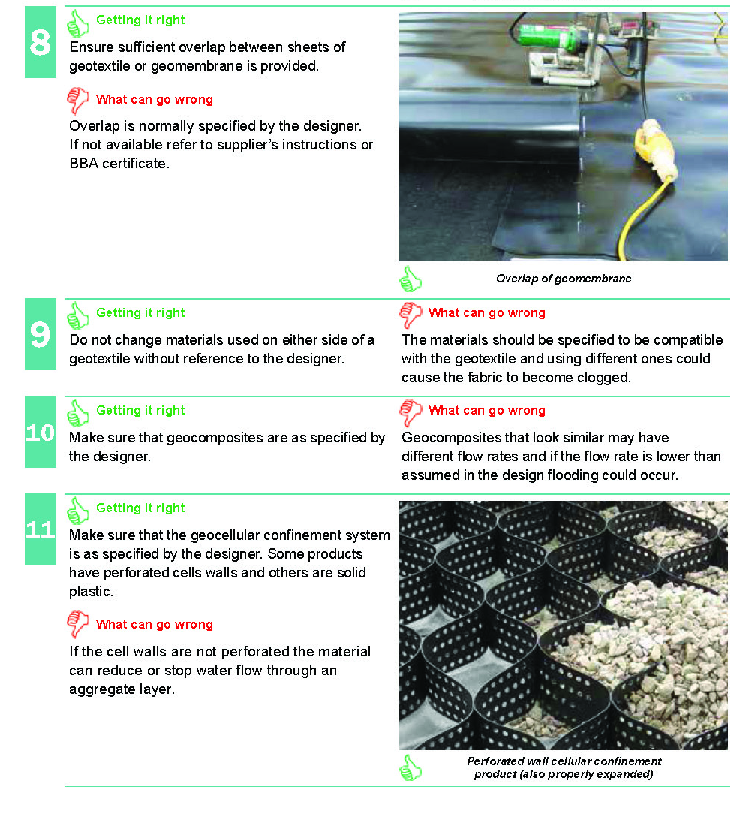
Materials: geosynthetics and geomembranes
UNDERSTANDING THEIR USE
Right product right place
Specification and substitution
PERFORMANCE ISSUES
Sequencing during construction
Potential for damage
Protection
Notes:
Geosynthetics are complex materials. Many appear to be similar on visual inspection but could have widely varying performance.
Substitution of products should only be done with the agreement of the designer. Some geosynthetics are prone to damage during construction if not protected (eg geomembrane liners).

Slide 36
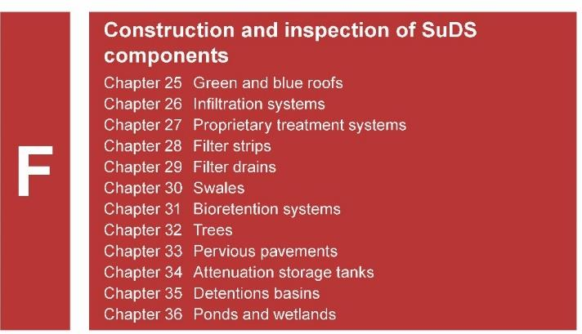
How to get it right
SuDS components
Notes:
Chapter F then deals with the specific challenges for each individual SuDS component. The component list is the same as the SuDS Manual.

Slide 37
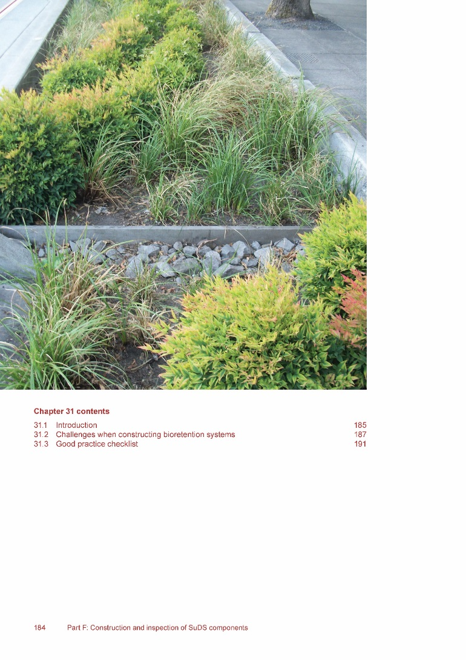
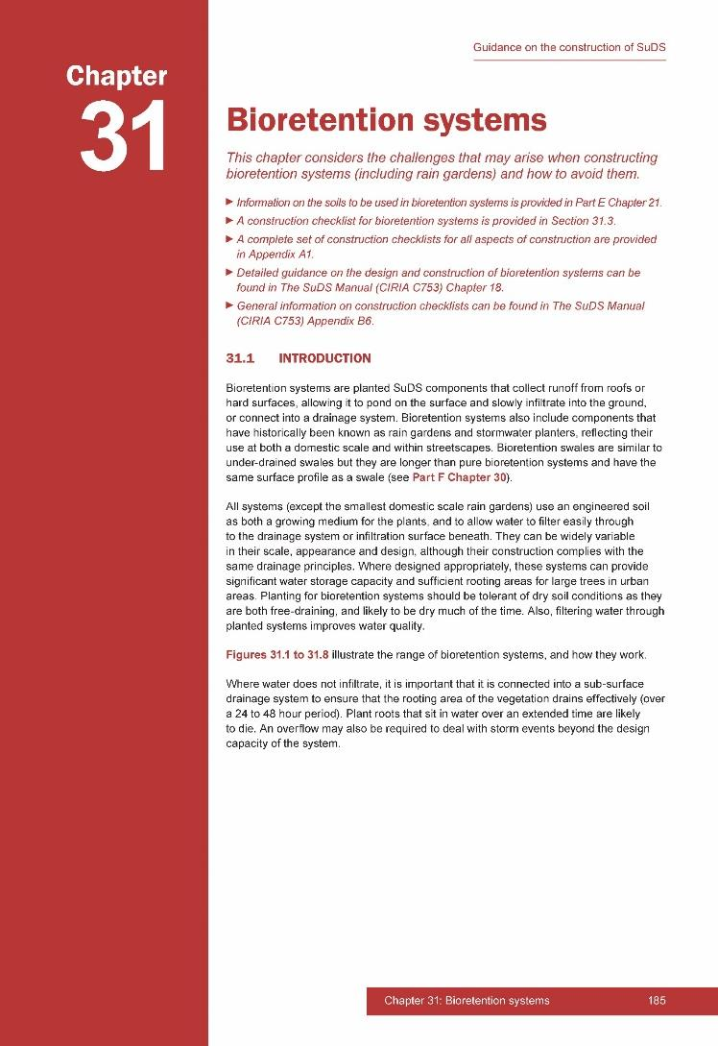
Notes:
Biorentention systems have been used to illustrate the way that the construction of each component is dealt with in the individual chapters.
The introduction explains what the component is, how it functions, and the different ways that the component can be designed.

Slide 38
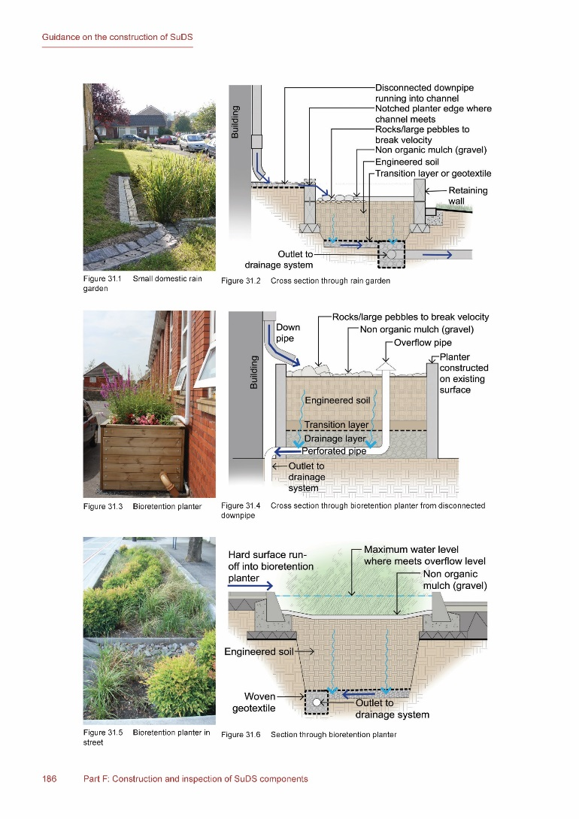
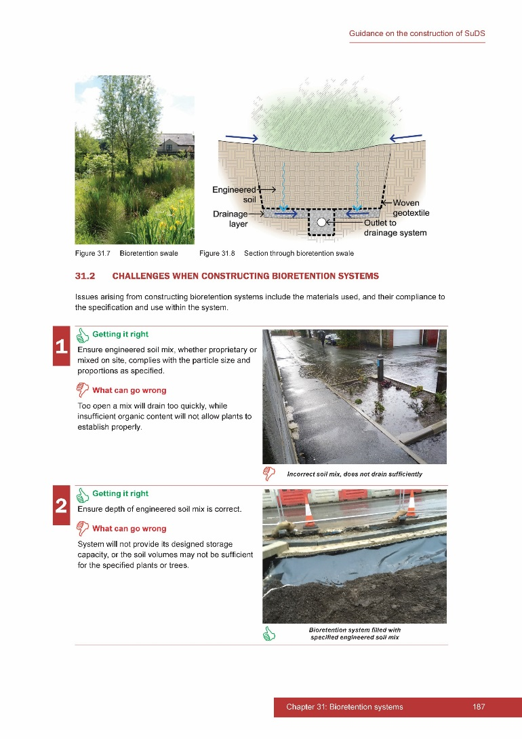
Notes:
Here the different types of bioretention system are illustrated to show the wide variety of application, with disconnected downpipes draining to in-ground systems or raised planters, road drainage systems adjacent to the highway or more simple trenched components within an overall green system.
The diagrams explain the key parts of each system and how it connects back into the drainage network.

Slide 39
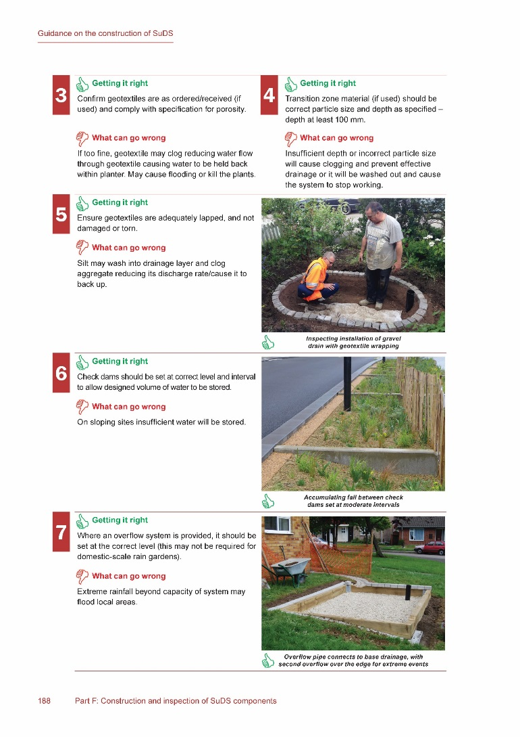
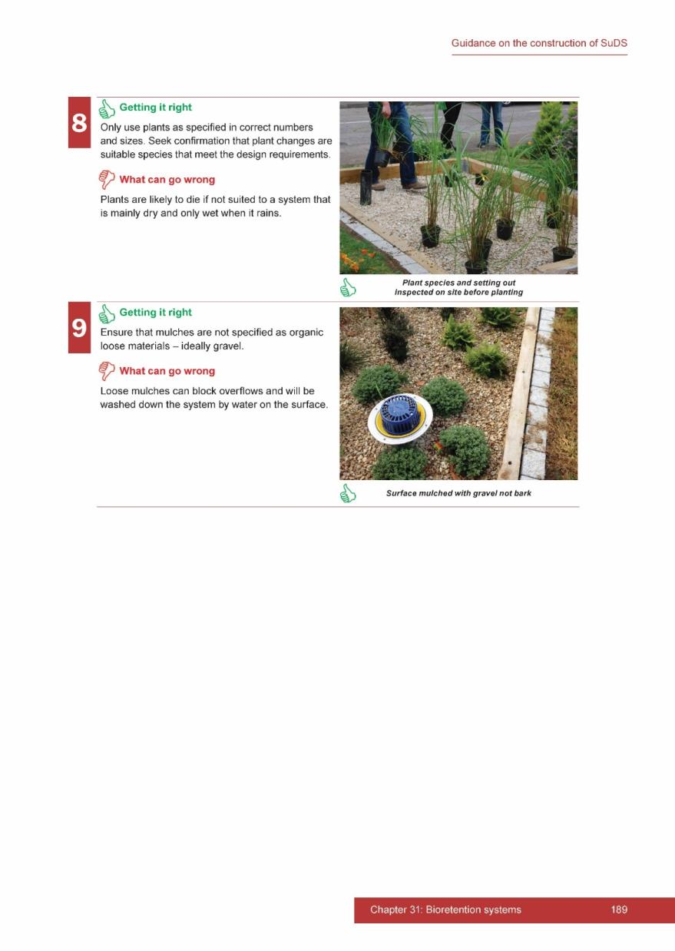
Notes:
The next section then identifies the challenges that typically arise in constructing bioretention planters with the images of either good practice or what can go wrong.

Slide 40
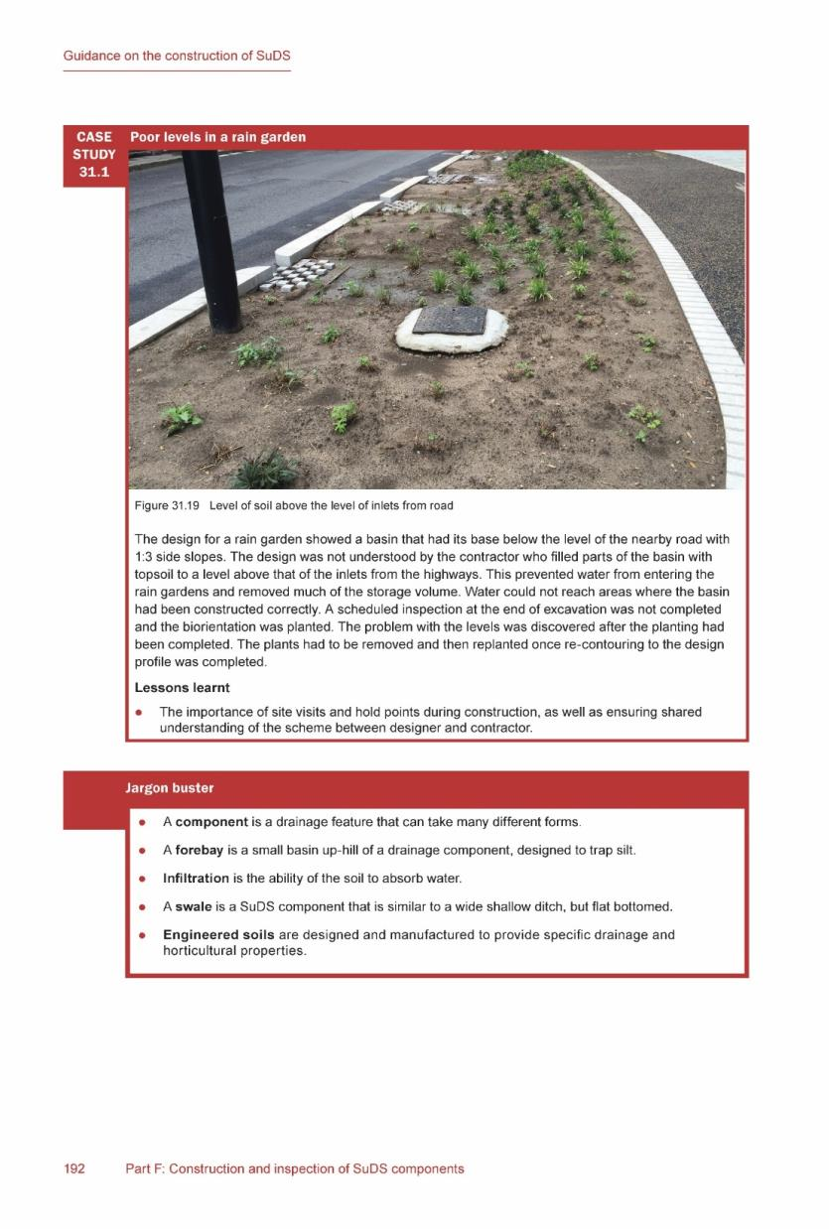
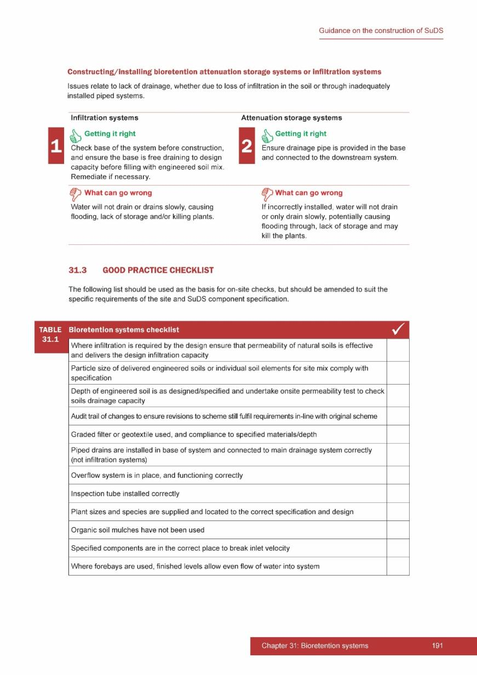
Notes:
The end section contains a ‘mini-case study’ related that each particular component and the lessons learned from the challenges that arose in building it.
The chapter ends with a checklist for its construction. The checklists are not intended to be exhaustive, but to identify the key issues. It is expected that people will use these as the basis for compiling their own checklists that are related to their own particular project. All the checklists provided within the guidance are collected as individually downloadable Word files at the end of the document.

Slide 41
Summary
Informs design
Improves communications
Requires team working
Helps overcome problems
Achieves better outcomes
Delivers good water management
Helps reduce flooding
Use of presentation and images
Presentation
Please make use of the presentation and feel free to adapt as required. Please also acknowledge its source as CIRIA and susdrain
Images
When using images please acknowledge their source as CIRIA
Notes:
In summary, the guidance seeks to help deliver better quality construction for SuDS.
Understanding how to build SuDS correctly, can then help inform the design of SuDS generally.
The team working necessary to build SuDS successfully will help improve communications both within the design and construction team, and encourage them to work together to overcome the problems that will inevitably arise.
Ultimately this should ensure that better outcomes are achieved, and that the full design intent is realised on the ground, thereby delivering better water management and helping to reduce surface water flooding.
Use of presentation and images
Presentation
Please make use of the presentation and feel free to adapt as required. Please also acknowledge its source as CIRIA and susdrain
Images
When using images please acknowledge their source as CIRIA

