Slide 1
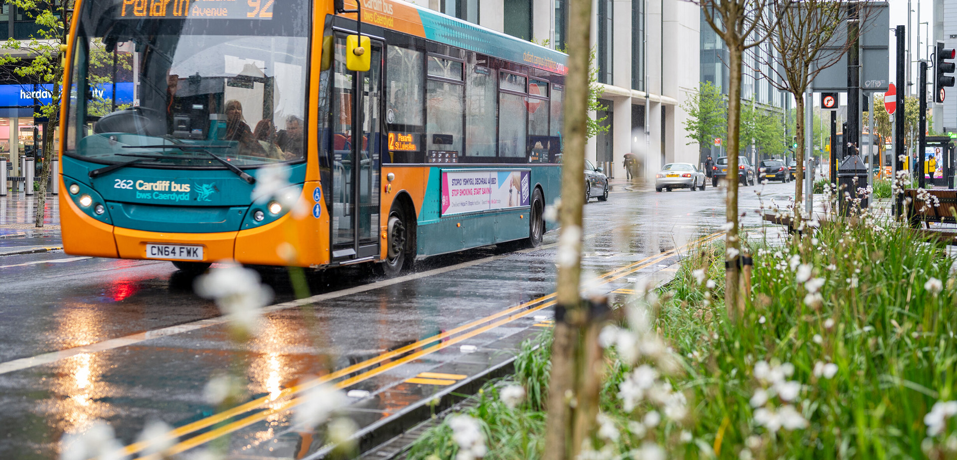
Sustainable SuDS With
Minimal Land Use

Slide 2
Our multifunctional SuDS solutions capture
Stormwater, removes pollutants, boosts biodiversity, amenity and creates enhanced urban spaces.

Slide 4
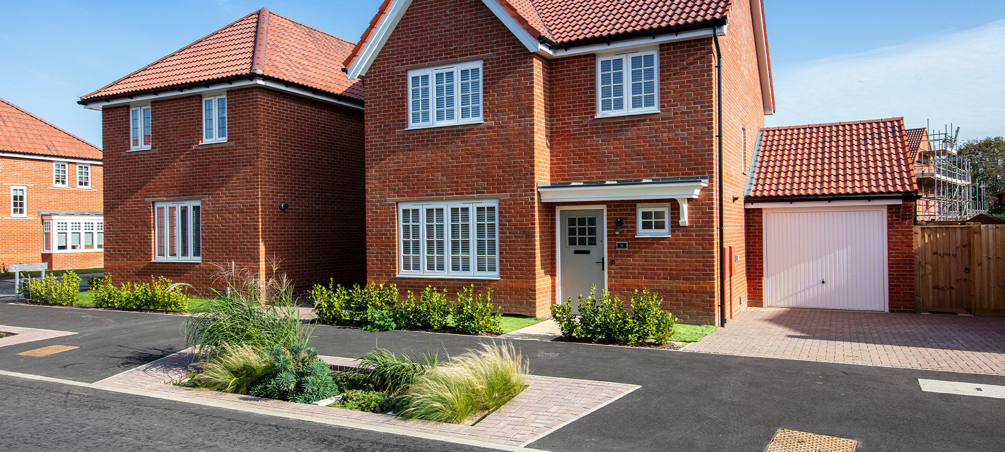
Why landscape and SuDS?
Why not combine the two?

Slide 5
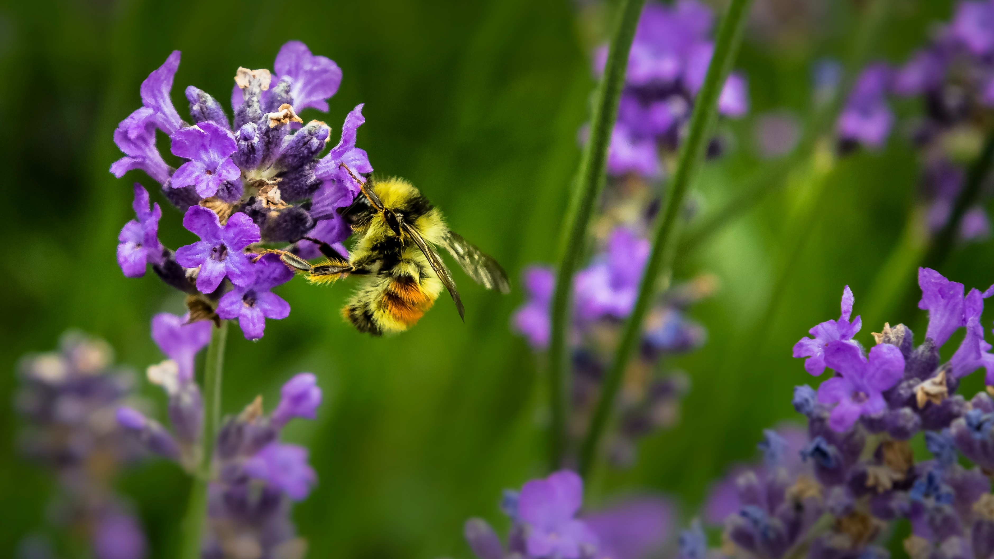
SuDS & Biodiversity

Slide 6
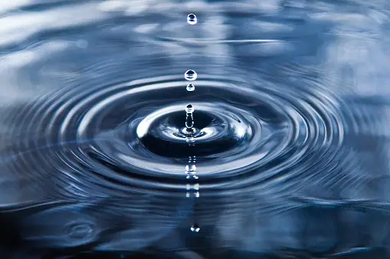
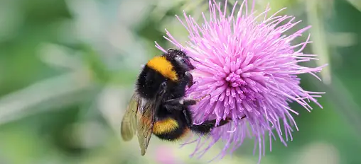
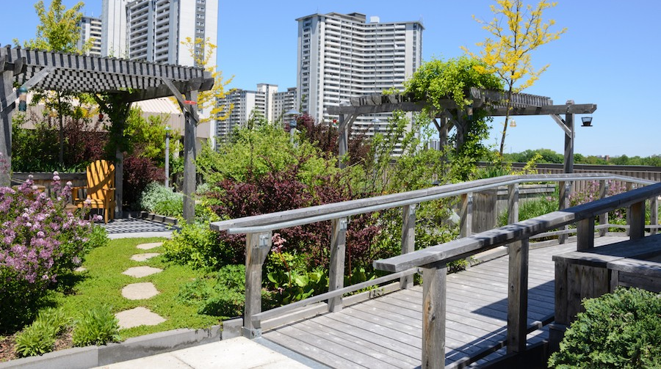
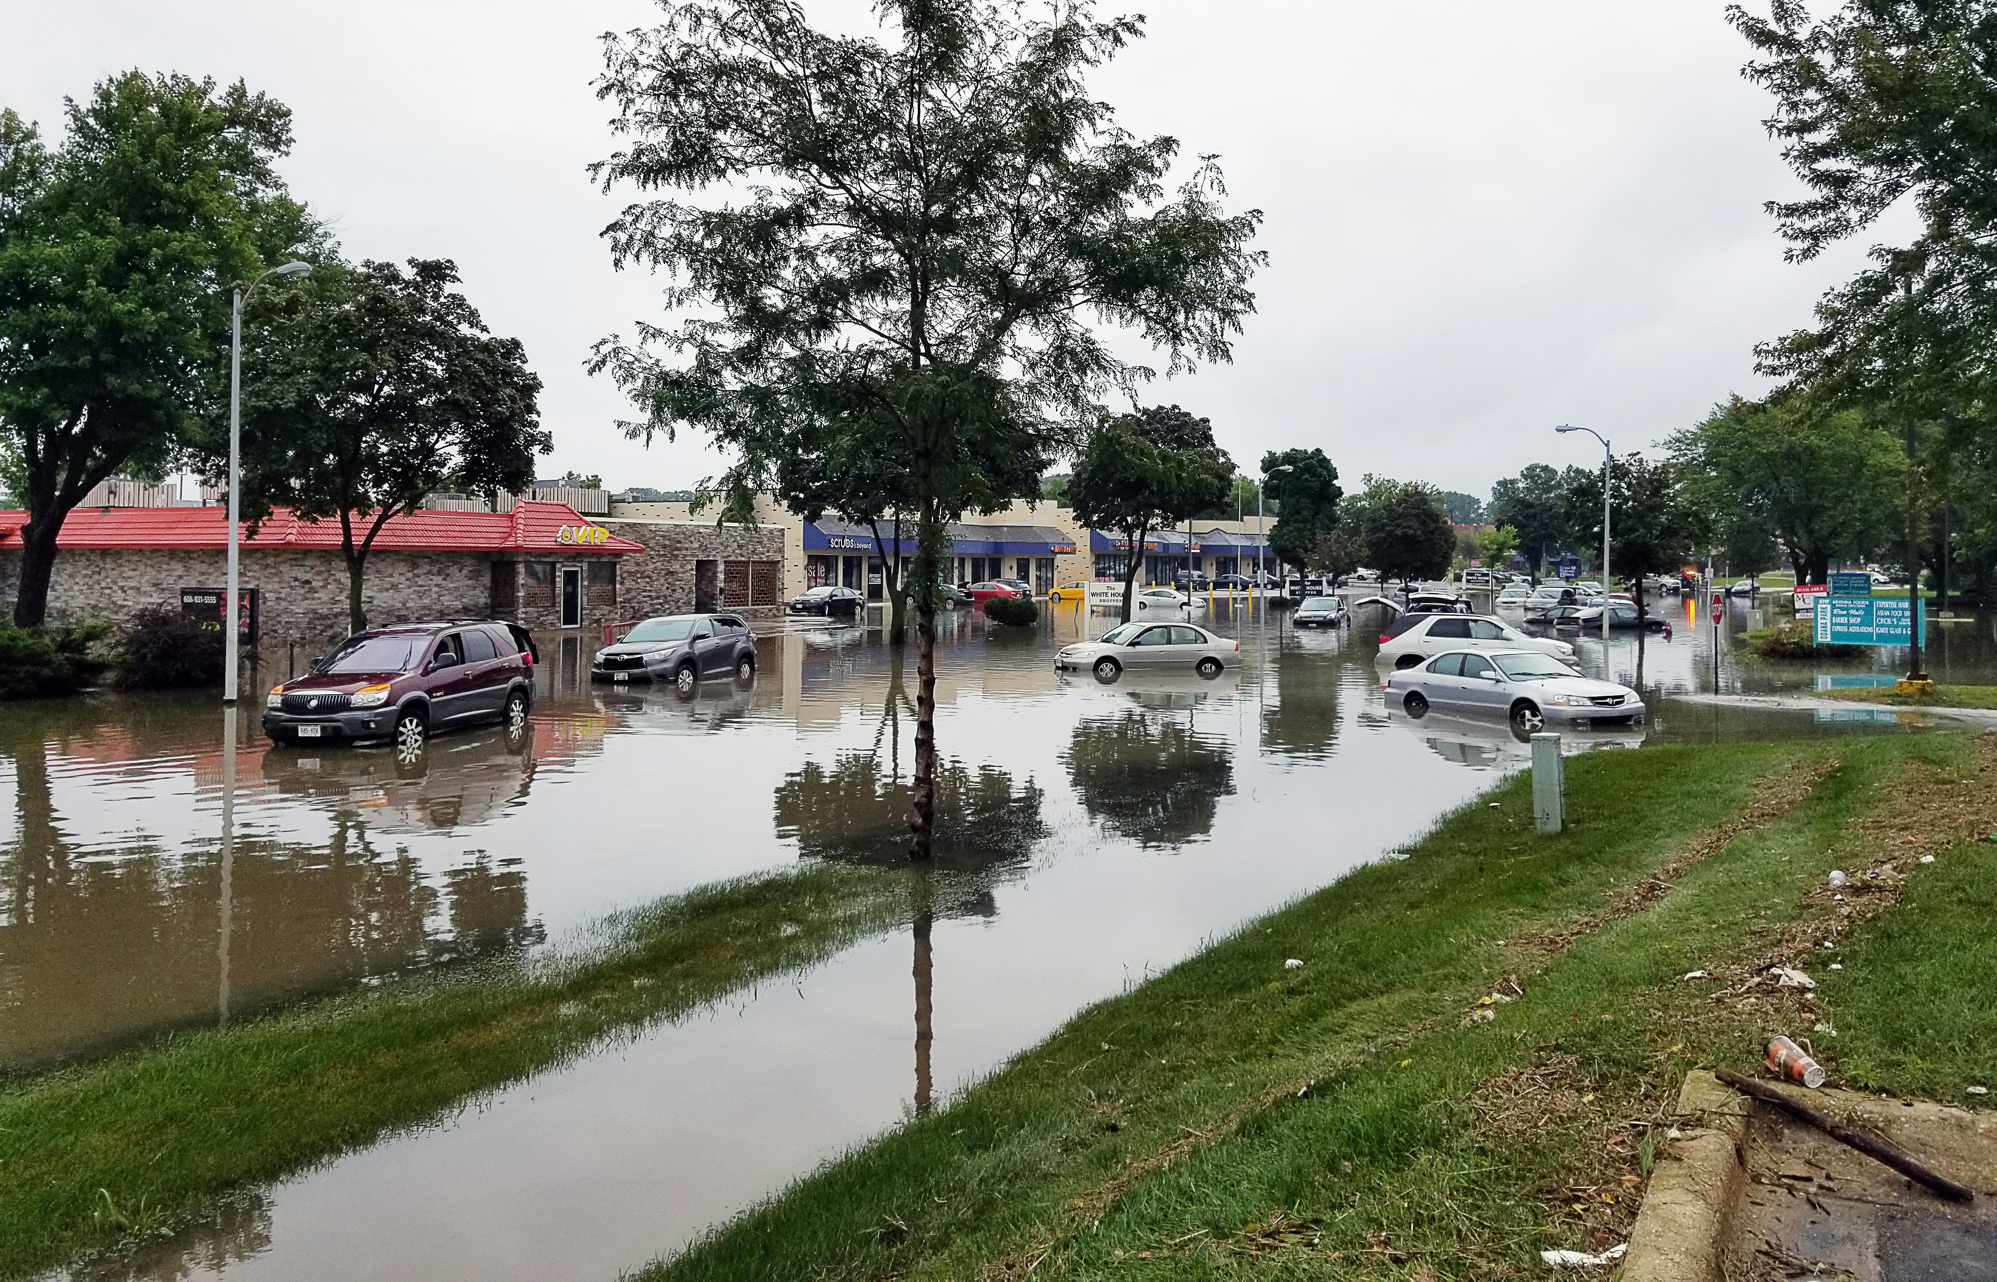
Environmental benefits of SuDS

Slide 7
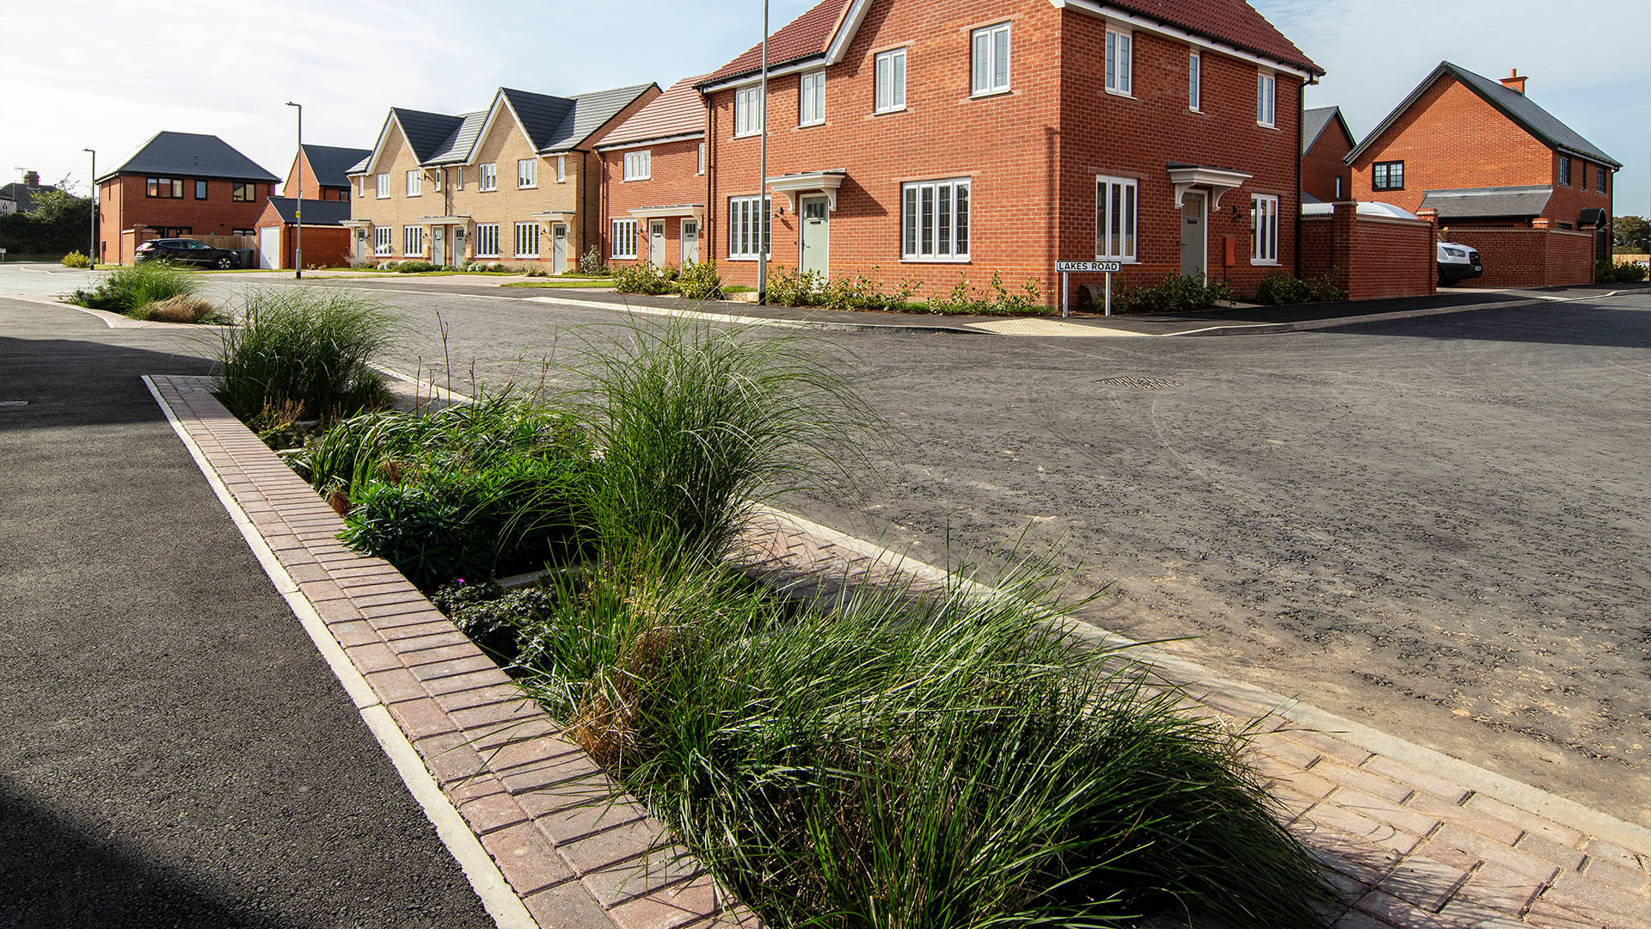
Felixstowe, Bloor Homes

Slide 8
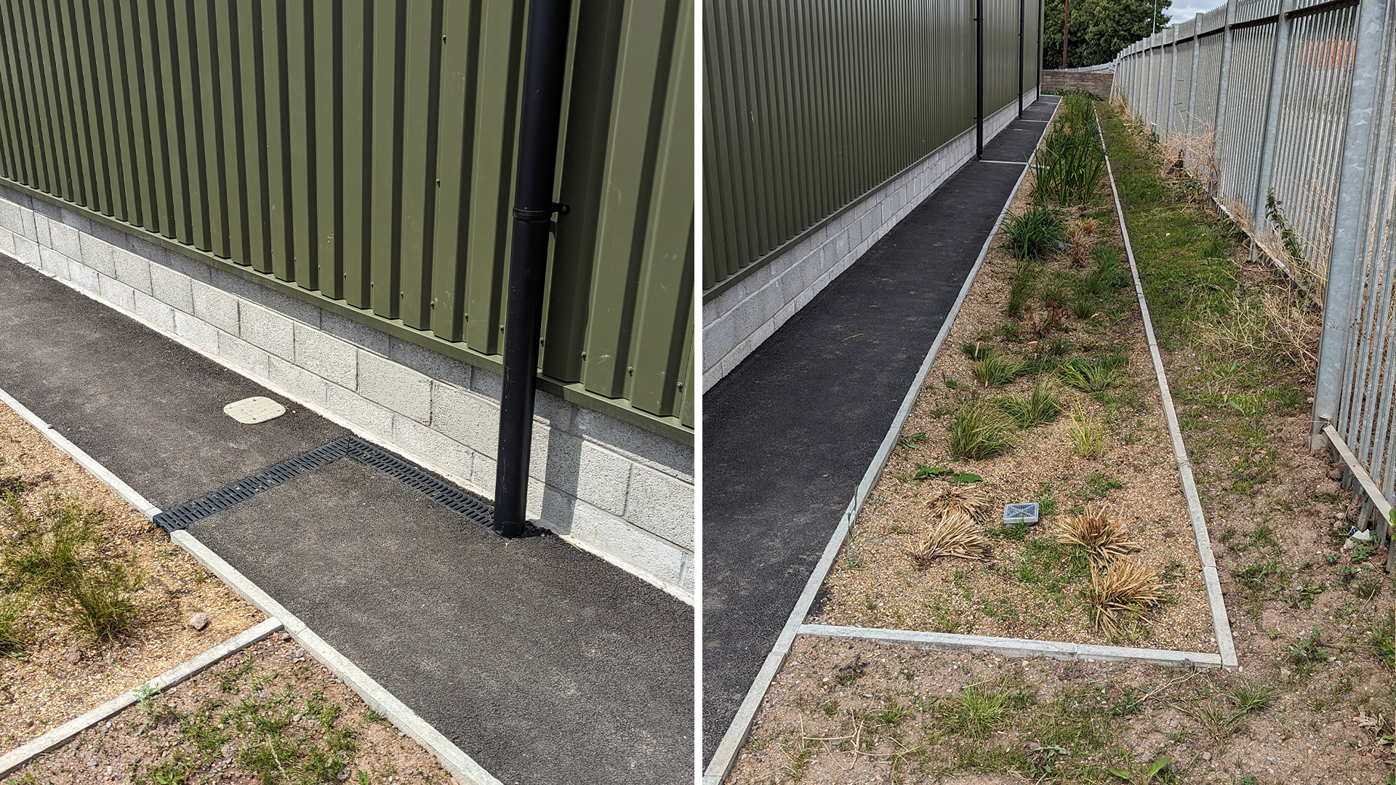
Cardiff Waste Transfer Station

Slide 9
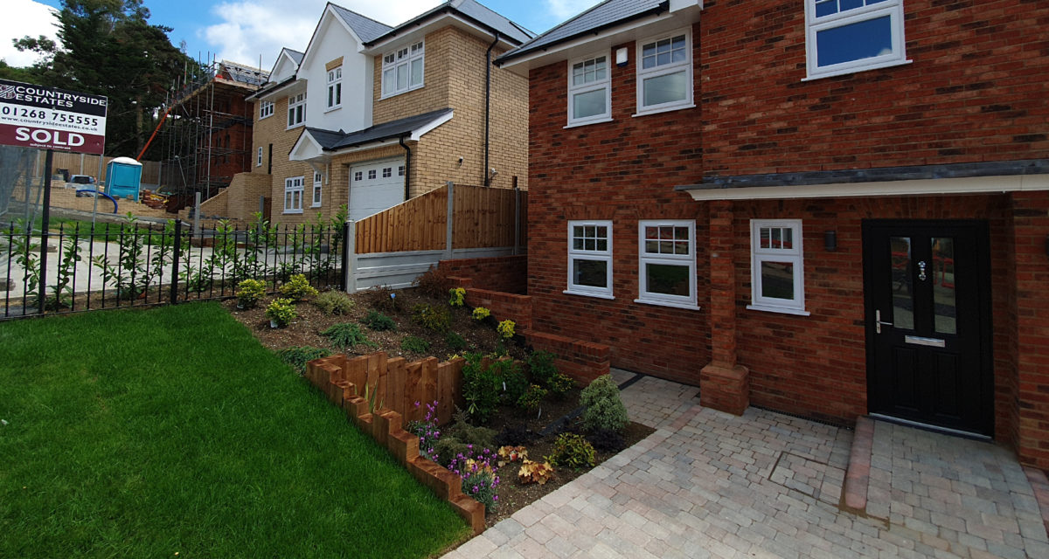
South Benfleet, Essex

Slide 10
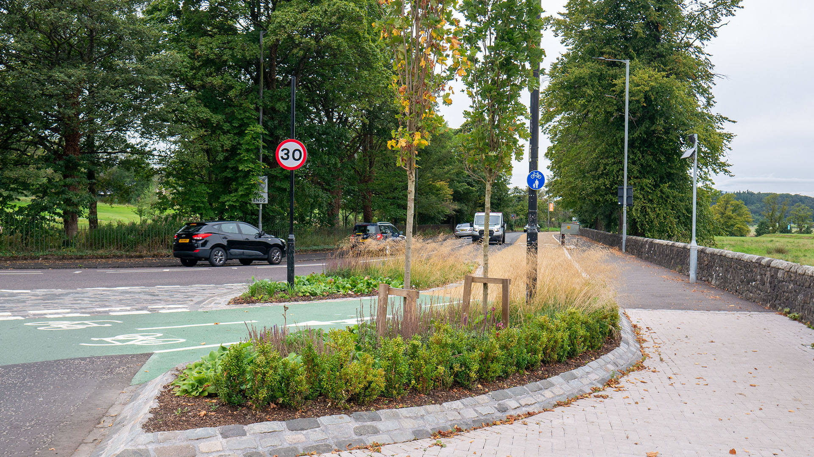
Walk, Cycle, Live, Stirling

Slide 11
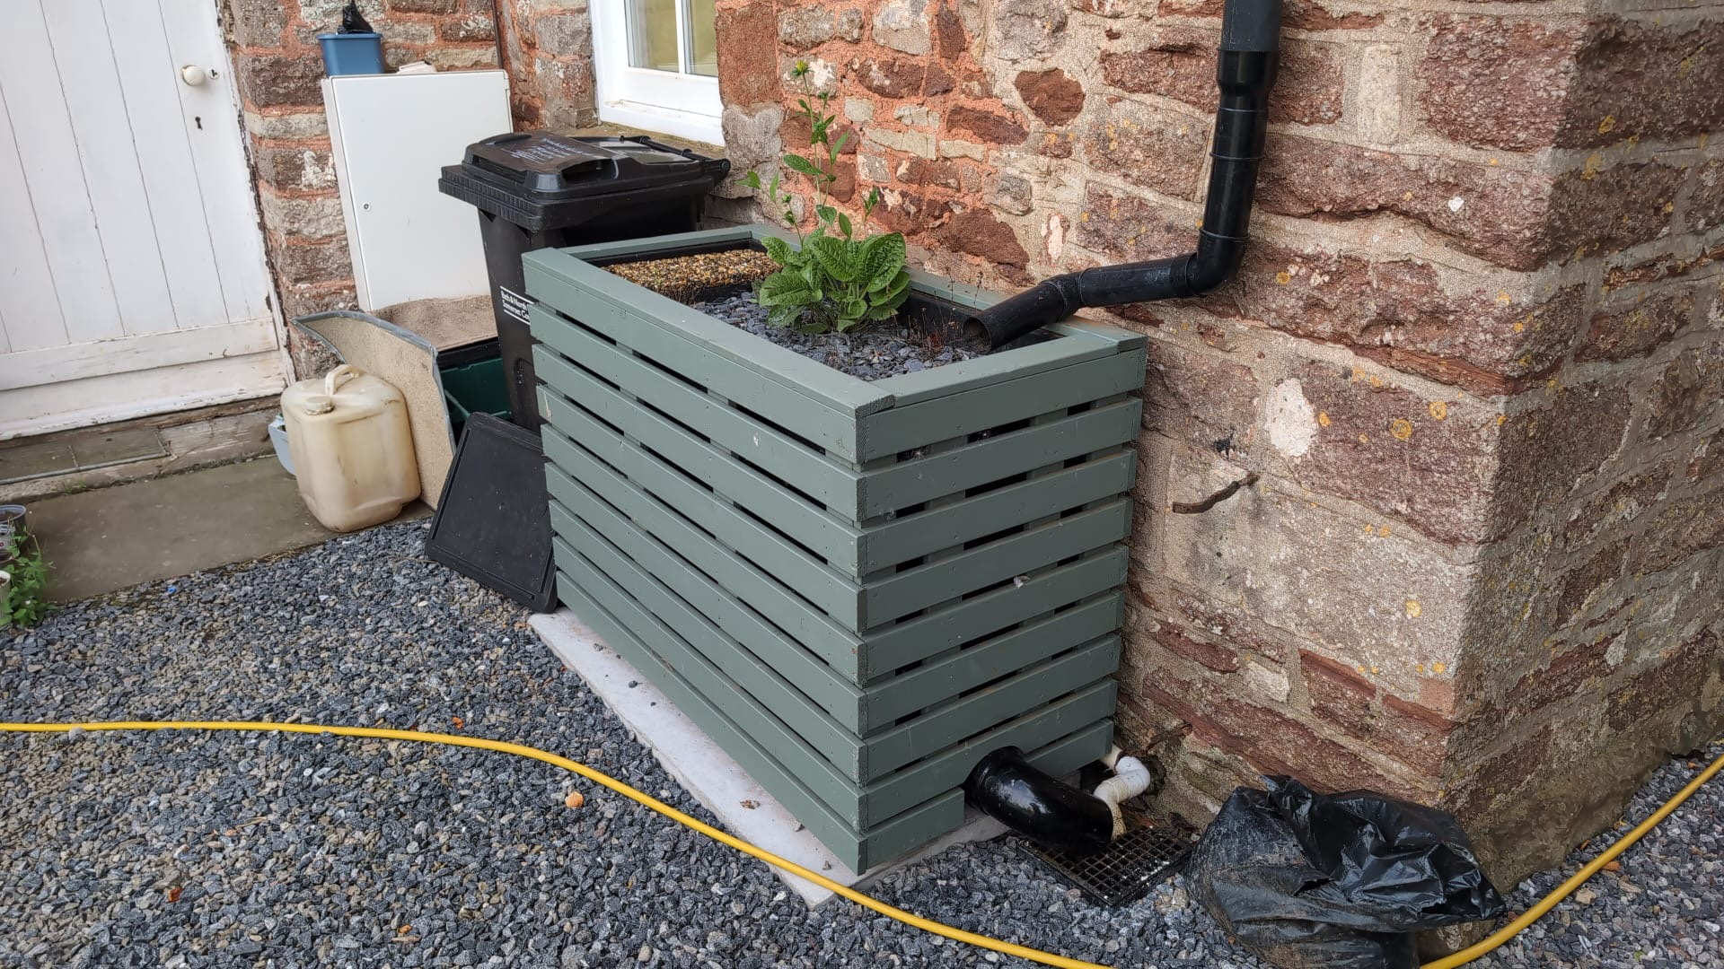
Bristol, Ubley, The Old Manor House

Slide 12
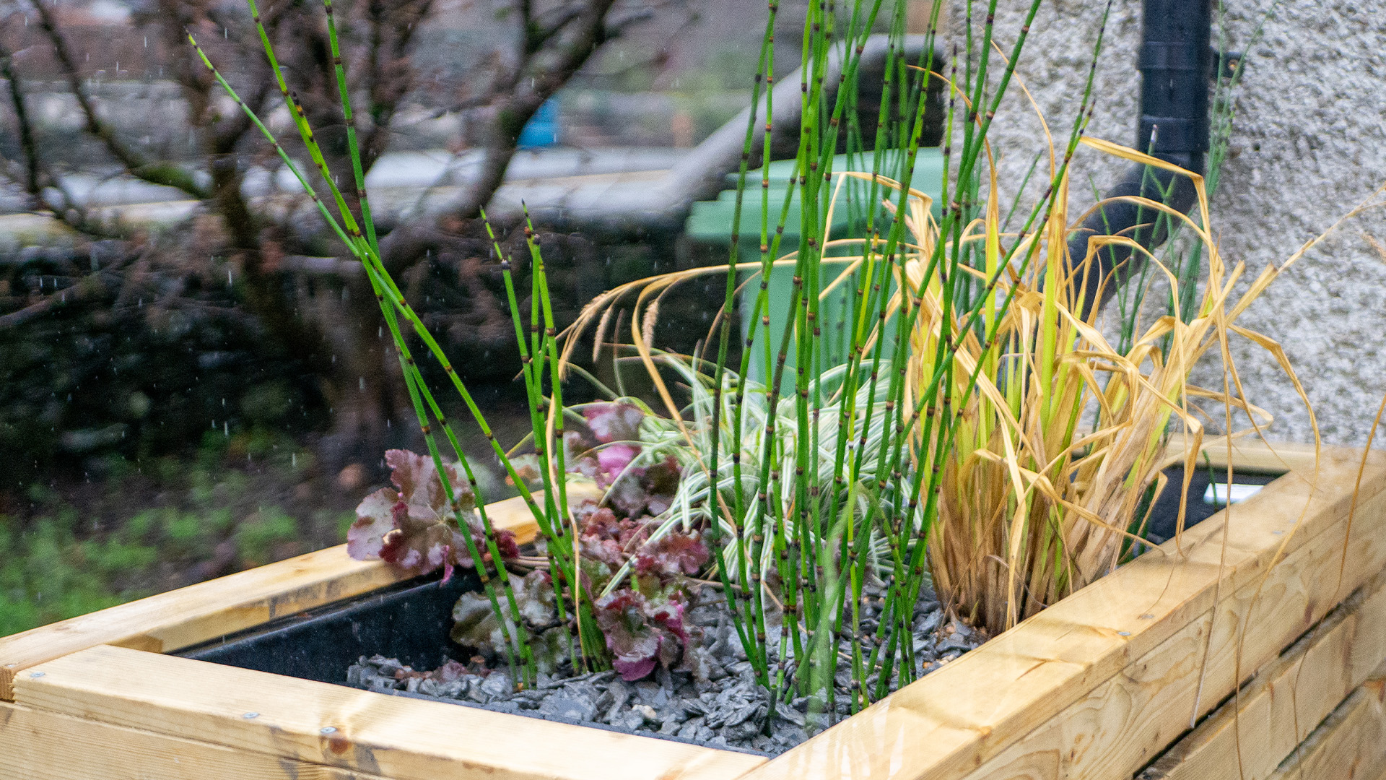
Staveley, Cumbria

Slide 15
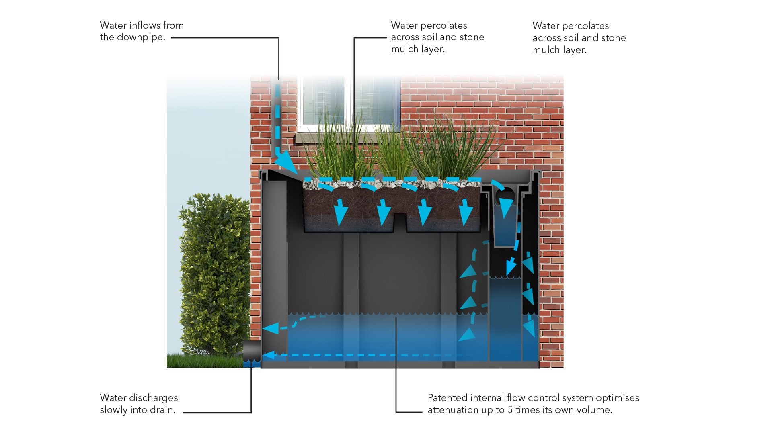
SuDSPod
Attenuation

Slide 16
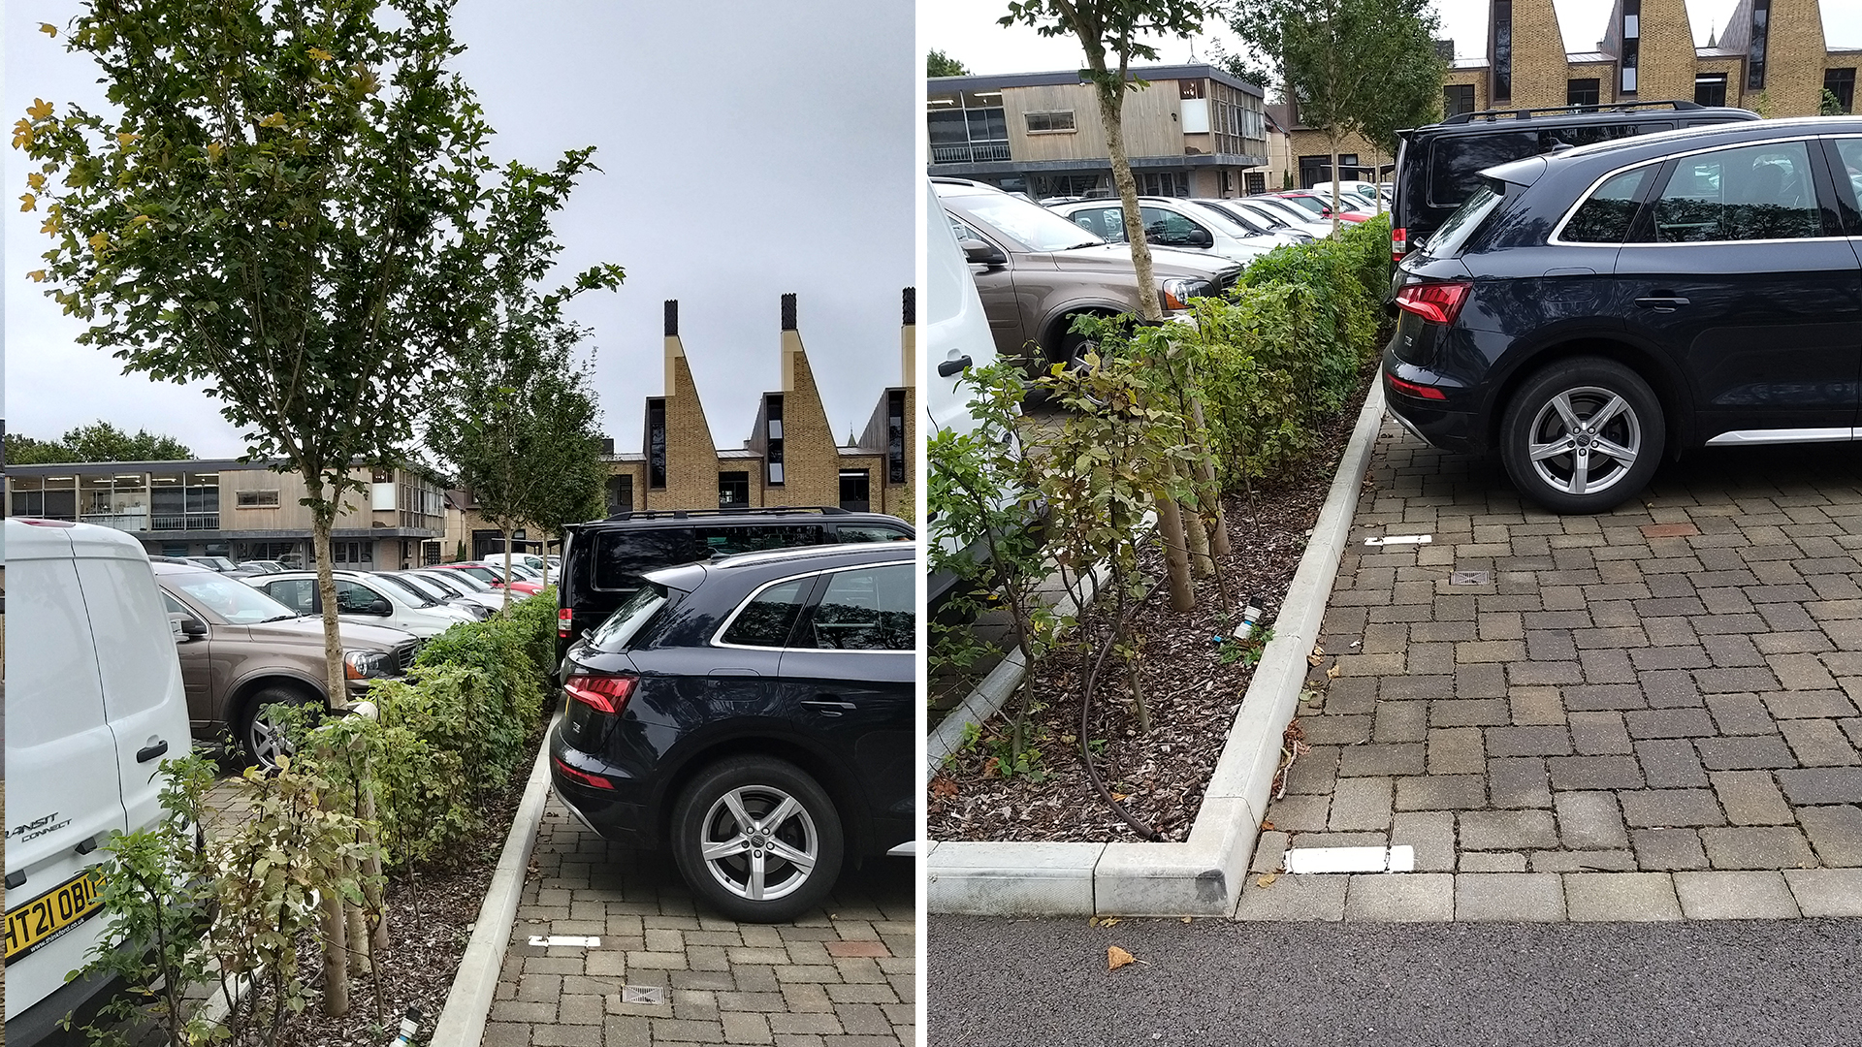
Charterhouse School

Slide 20
