Slide 1
Community Delivered SuDS
Thornville Street Rain Garden
Notes:
Who – photo – award - SuDS drain award winner

Slide 2
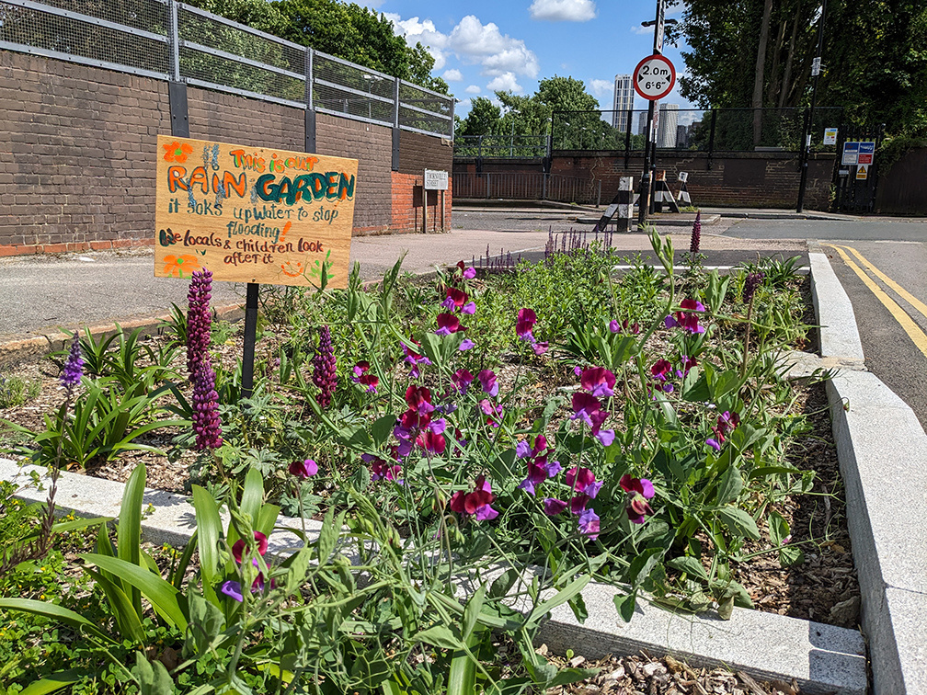
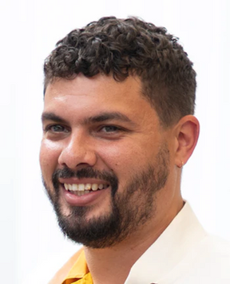
Who
Marcus Gayle MCIWEM C.WEM
Flood Risk Manager
London Borough Lewisham
e: Marcus.Gayle@Lewisham.gov,uk

Slide 3
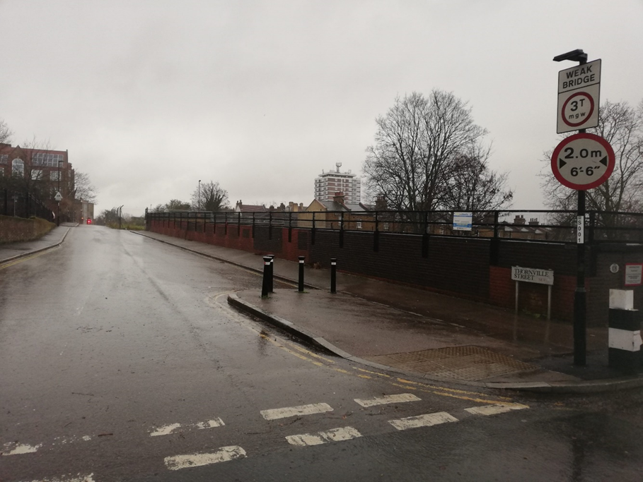
Thornville Street - 2022
THE PLANTER
Today’s talk
  Background
  Engagement
  Delivery
  Phase 2
2
Notes:
Or more of a project overview.
This project was a true community-driven effort to implement a SuDS scheme to improve their neighbourhood.
The residents were eager to transform an area of unnecessary hardstanding paving on an underused bit of public highway into a large community garden that also drains highway runoff.
We realised their vision through assisting with the funding bids and the co-design process, while also obtaining the necessary permissions from Lewisham Highways and Network Rail.
Since its implementation, the residents have organised a WhatsApp group to share the responsibilities of replanting, watering, weeding, and removing litter.
The project was funded by Lewisham Council and Thames Water, and the plants were generously donated by Sarah Raven.

Slide 4
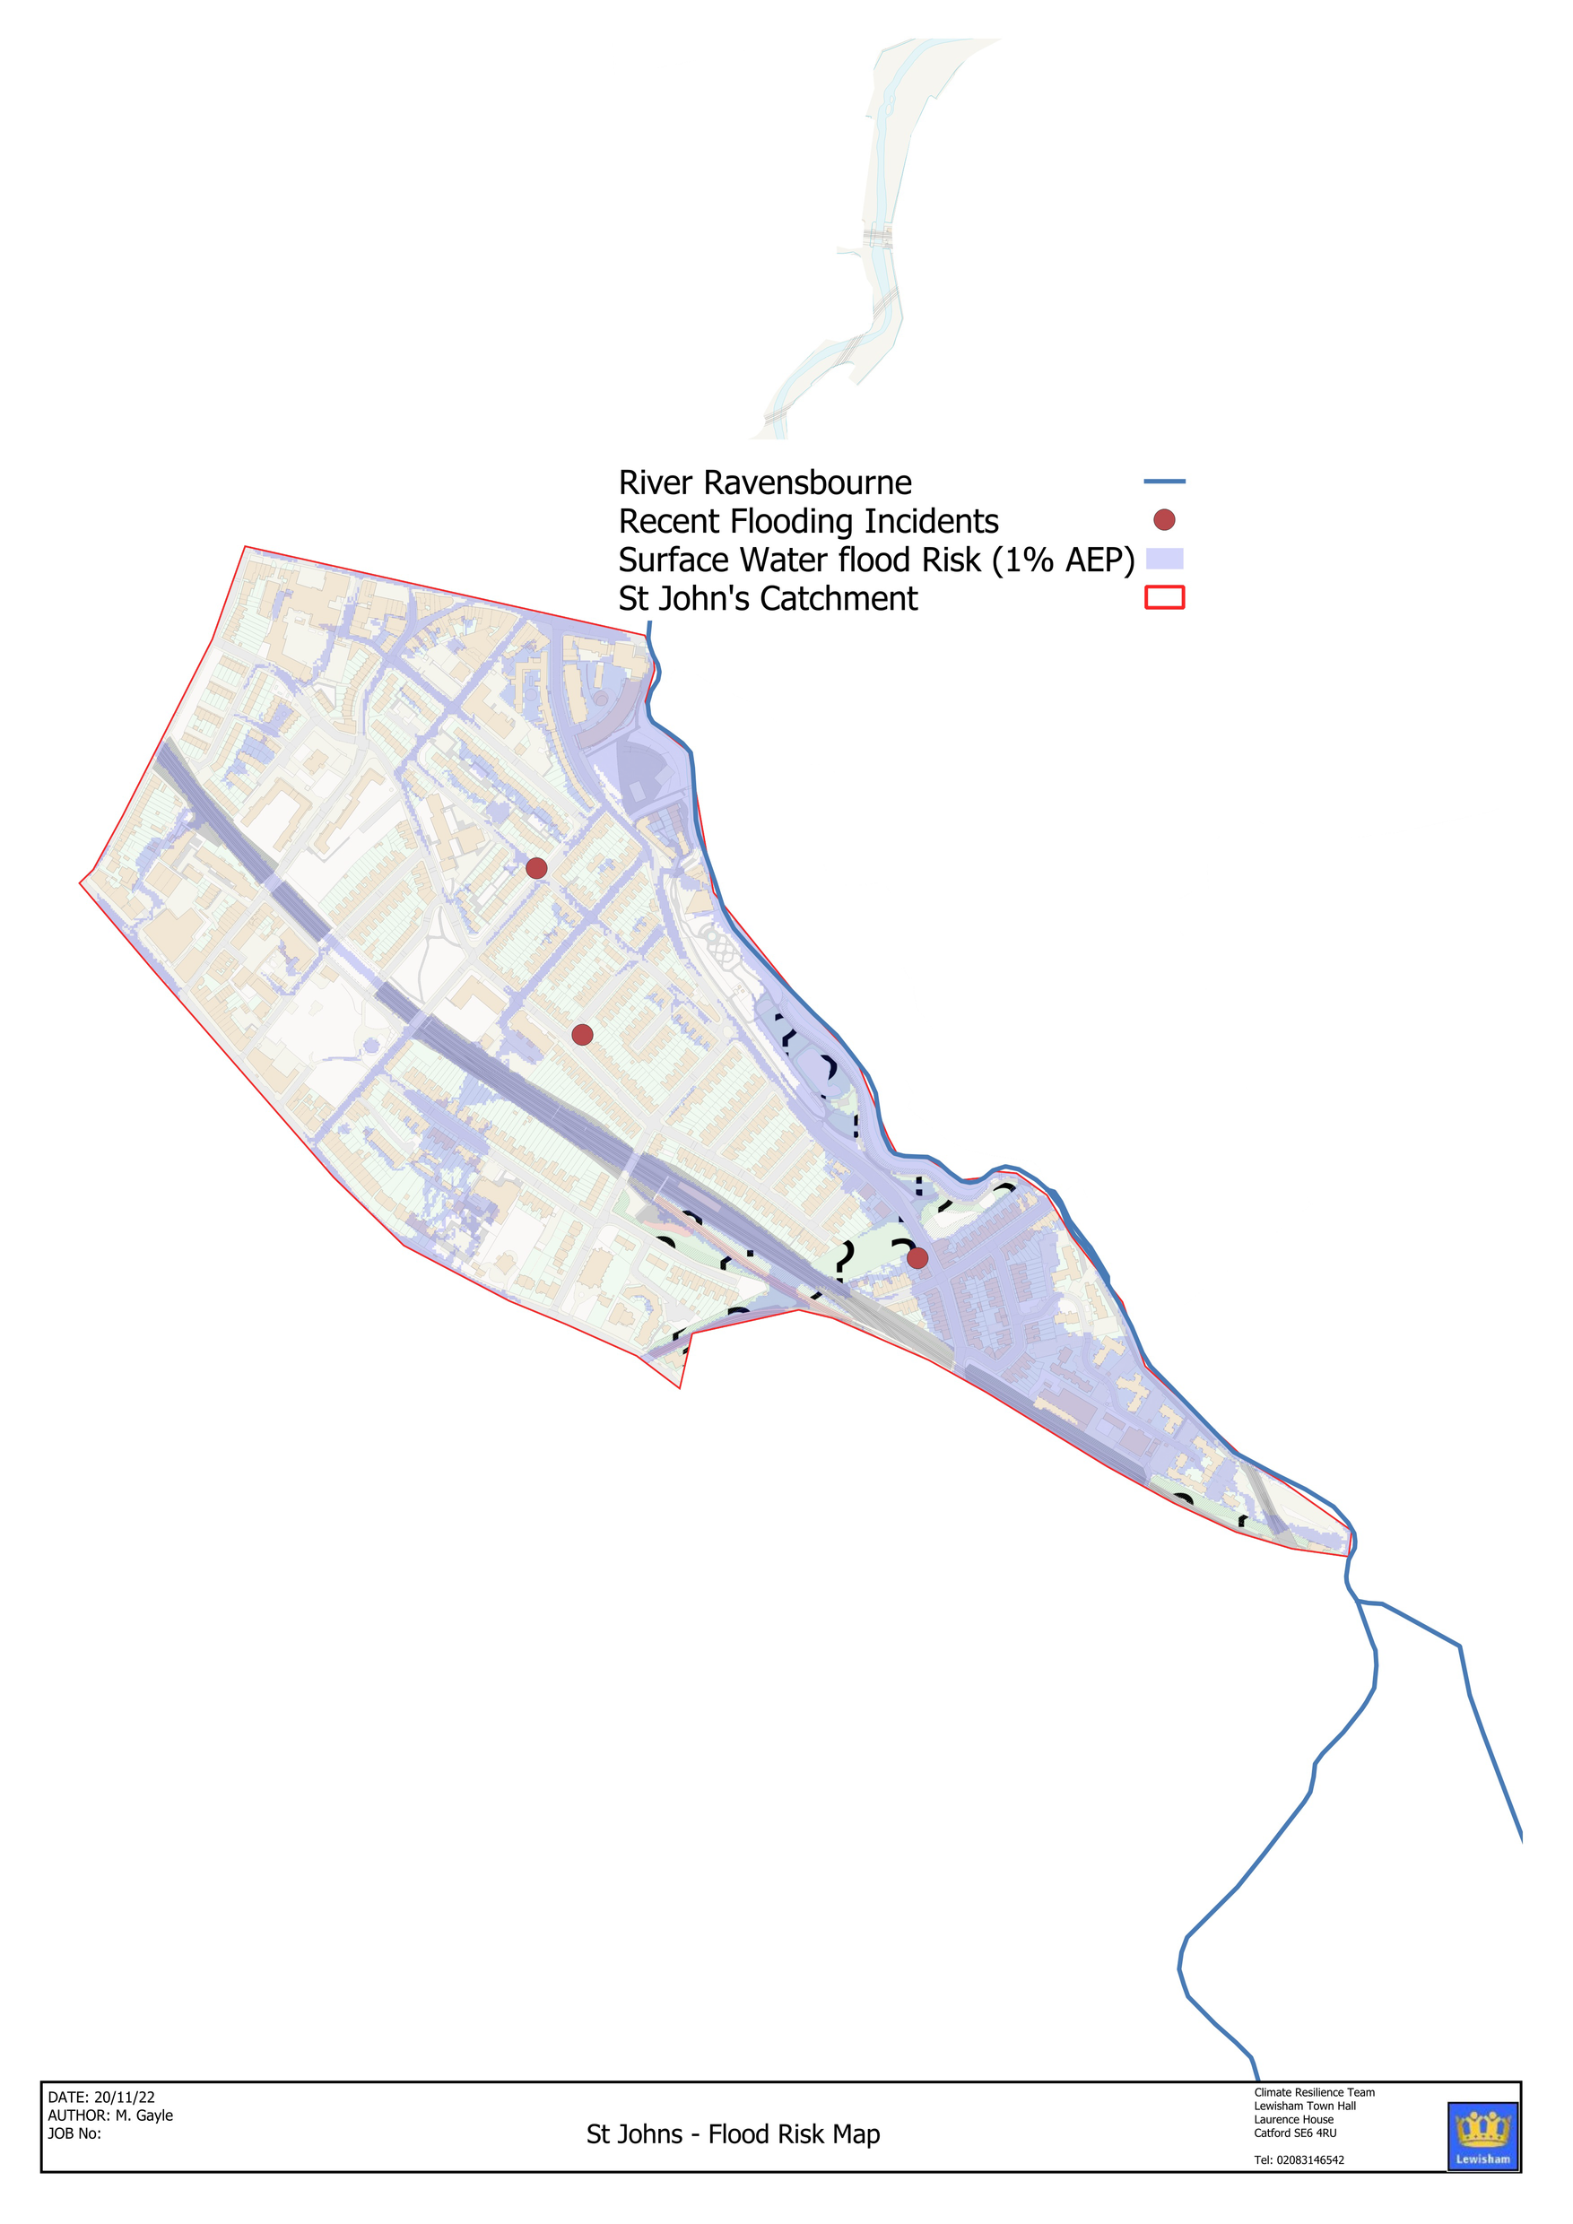
Objective 4: Resilient Communities
Local Flood Risk
Ambition:
Residents and businesses of Lewisham have access to appropriate data and information to understand flood risk in their area, how it is managed and by whom. Communities are empowered to act to protect themselves from flooding through individual efforts, partnerships and joint working.
Notes:
Lewisham stats 90000m2 per year – not possi – 5% of land area – London surface water strategy -

Slide 5
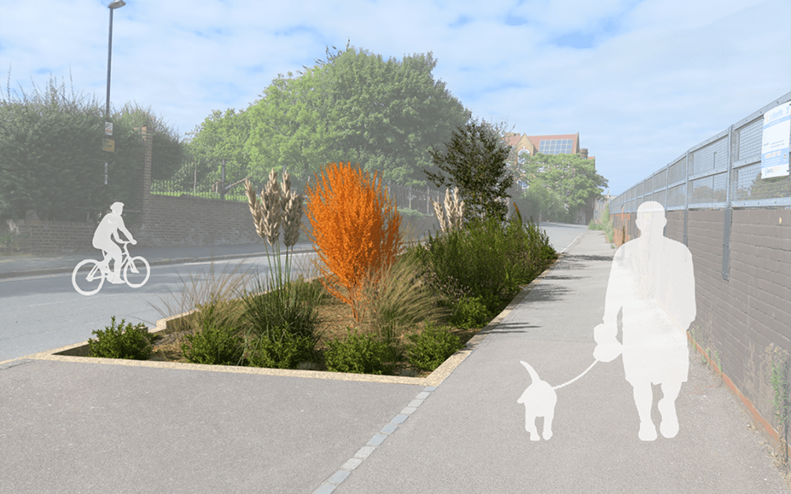
Community Engagement
Engagement
Gaining Statutory Approvals:
  Highways
  Green Scene
  Network Rail
  Thames Water
Notes:
Co-design the solution with St John’s society – create a vision to facilate wider engagement – we both presented at local group meeting to gather wider buyin for the scheme
Highways – design approval, street works application, Impact assessment, connection to drainage
Green Scene – maintenance provider
Network Rail – assess risk on retaining wall
Thames Water – signing of funding agreement

Slide 6
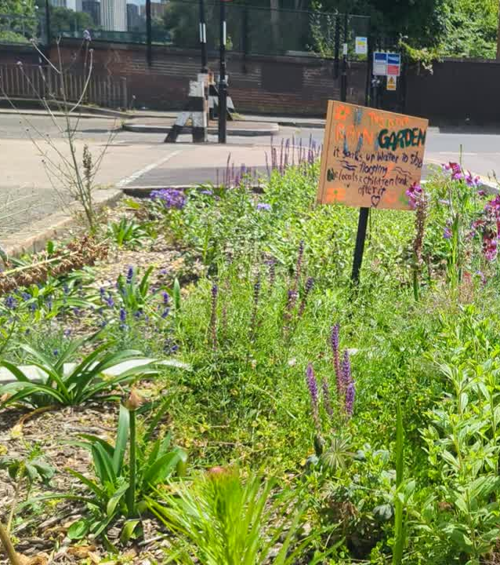
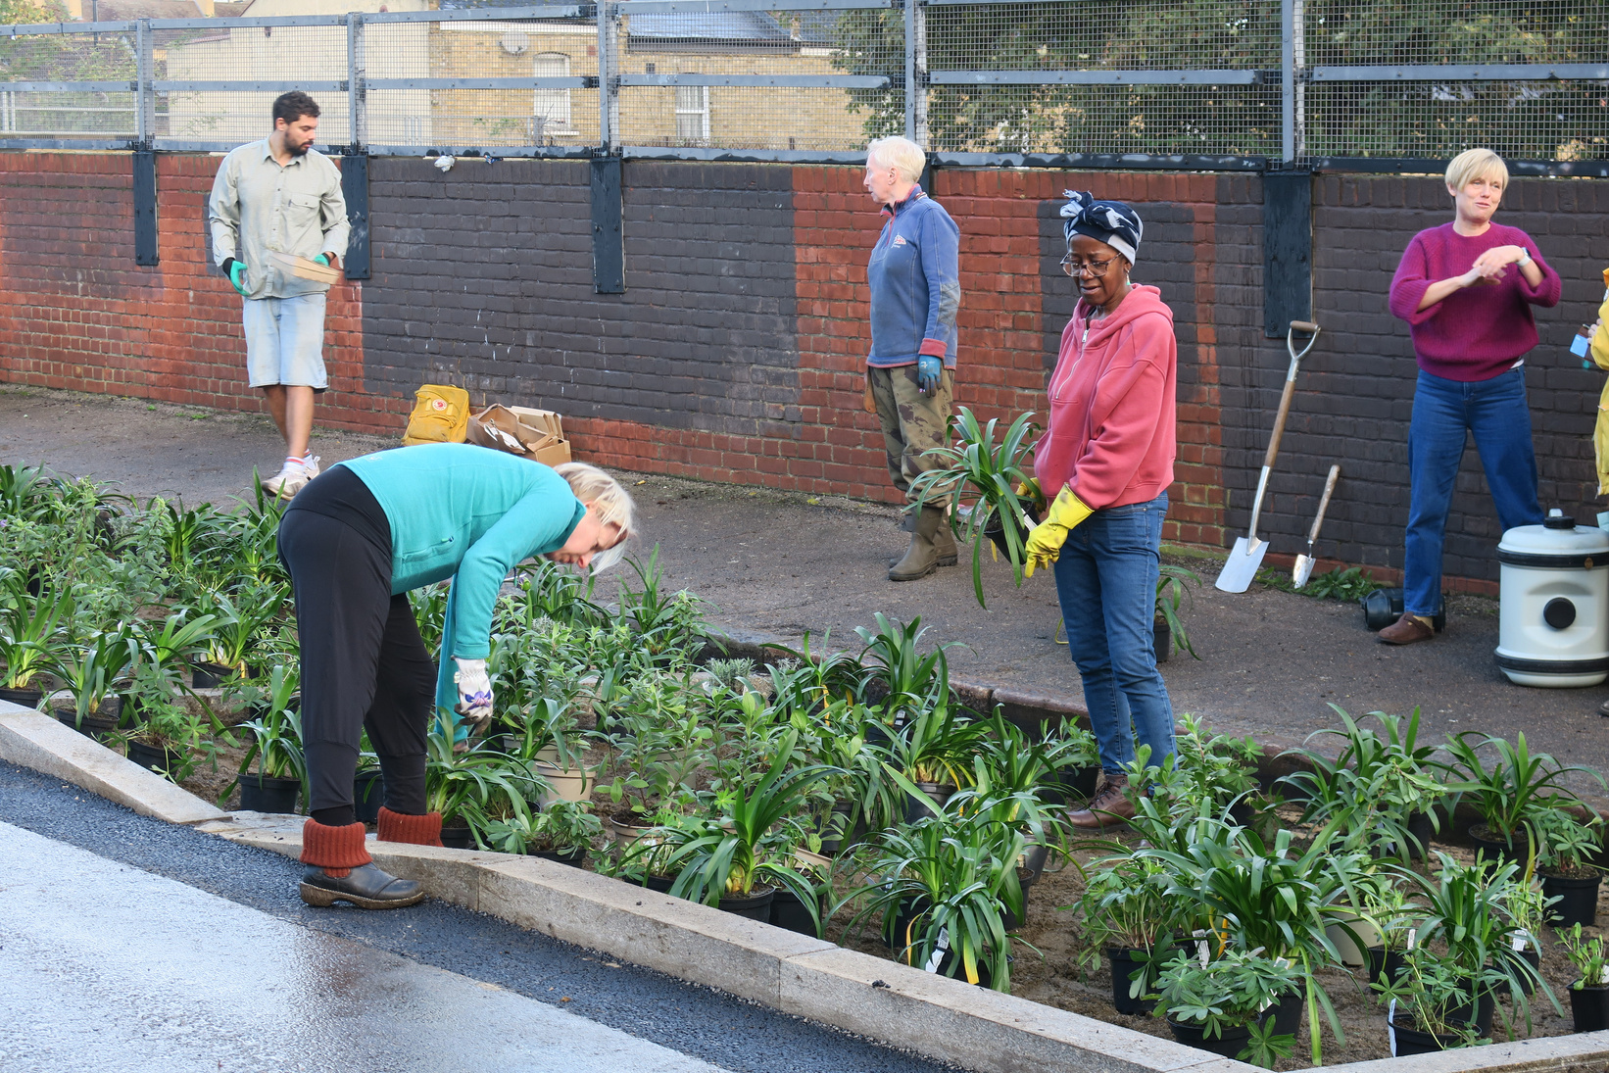
Thornville Street - 2024
Finished scheme
Planting
Notes:
Management community cohesion additional benefits – flood risk, water quality, biodiversity are a given

Slide 7
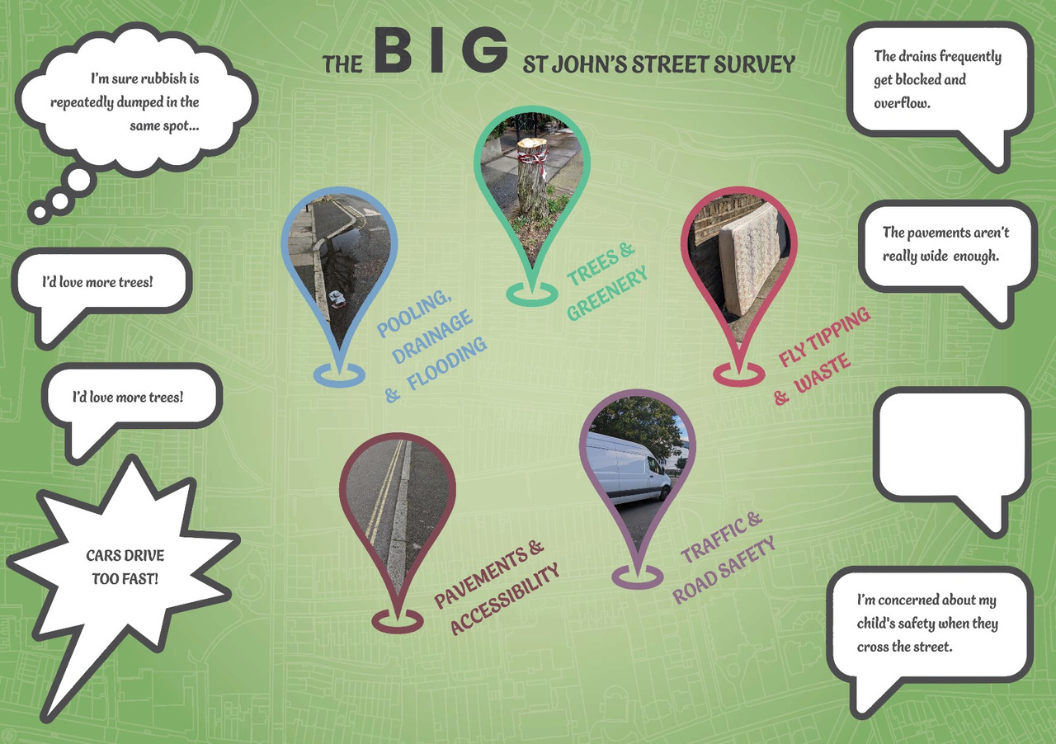
Phase 2
Delivery Process:
  Gather – collect data and assess risks
  Conceptualise – work with the community and key stakeholders to co-design solutions
  Validate and certify – understand the aggregated impact of the scheme and gain statutory approvals
  Deliver – construct interventions
  Maintain and monitor
more rain gardens
Notes:
Theme SUDS unlocking development - Community development - meeting the needs of the local residents - theme - unlocking developent retrofit - community building - roll out of SuDS feasilbe

Slide 8
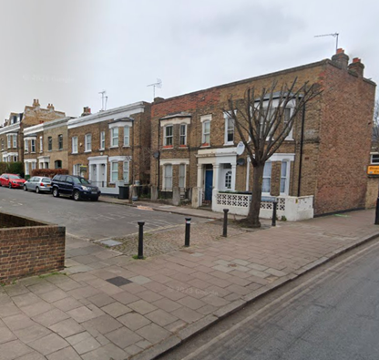
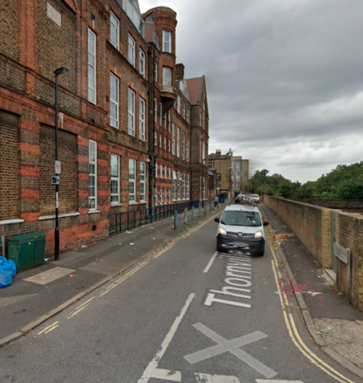
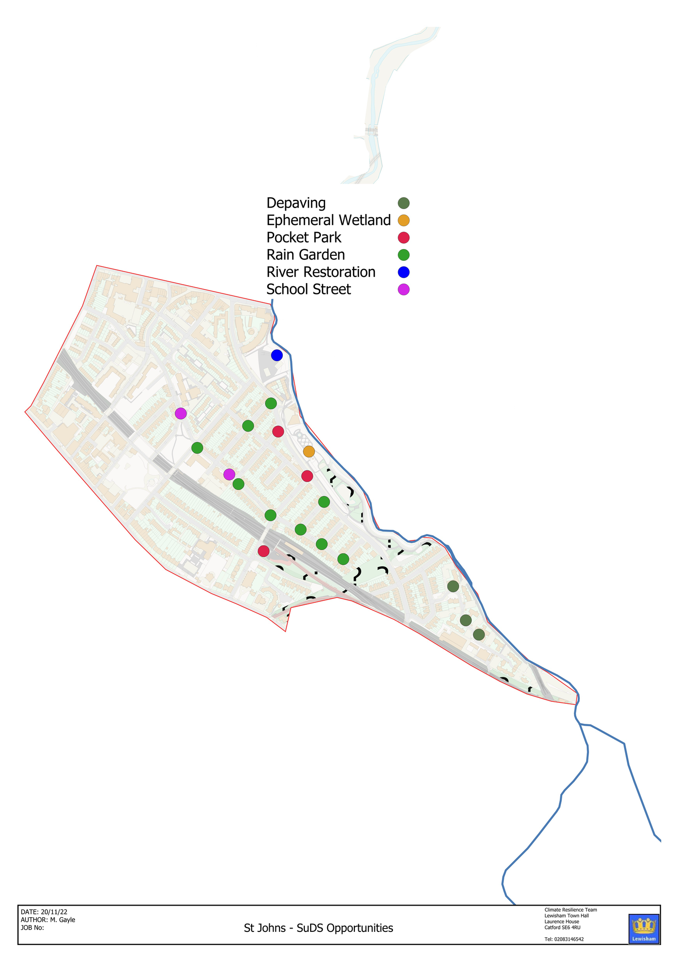
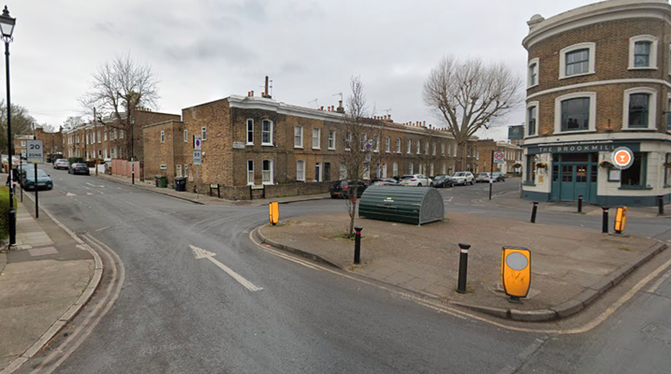
Public Realm
Phase 2
Opportunity mapping

