Slide 1
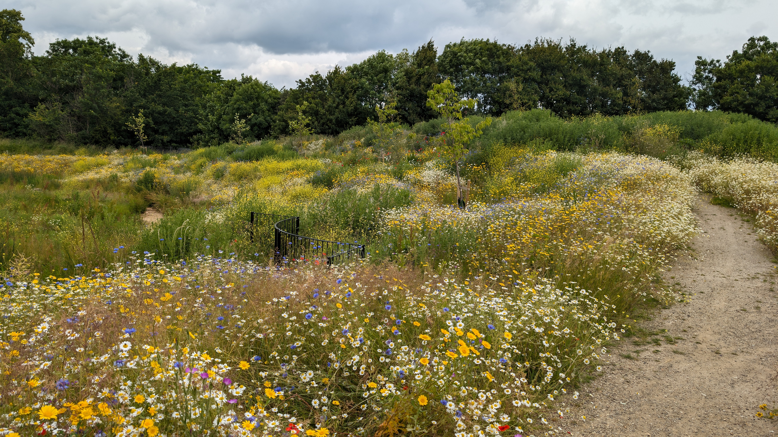
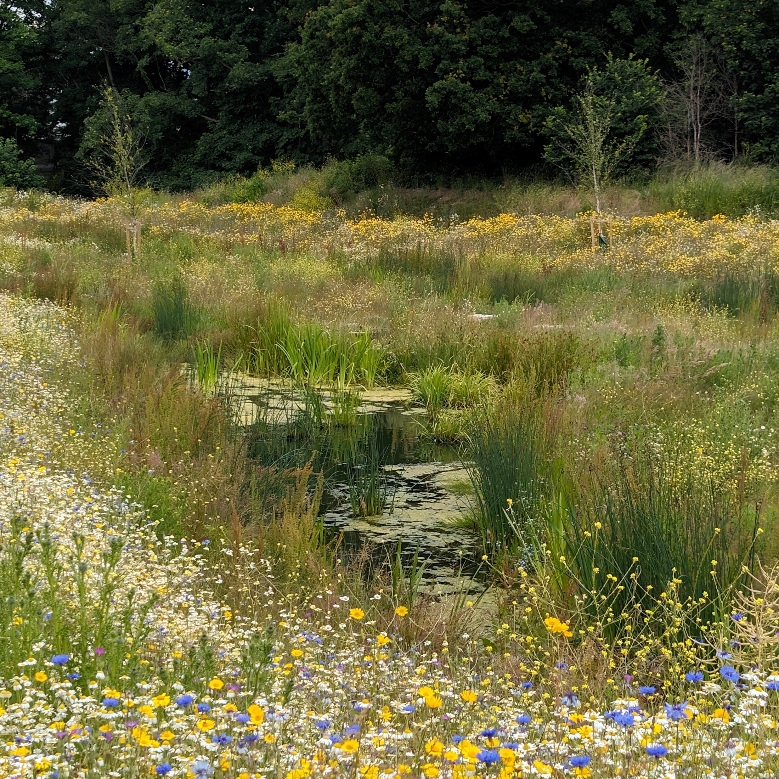
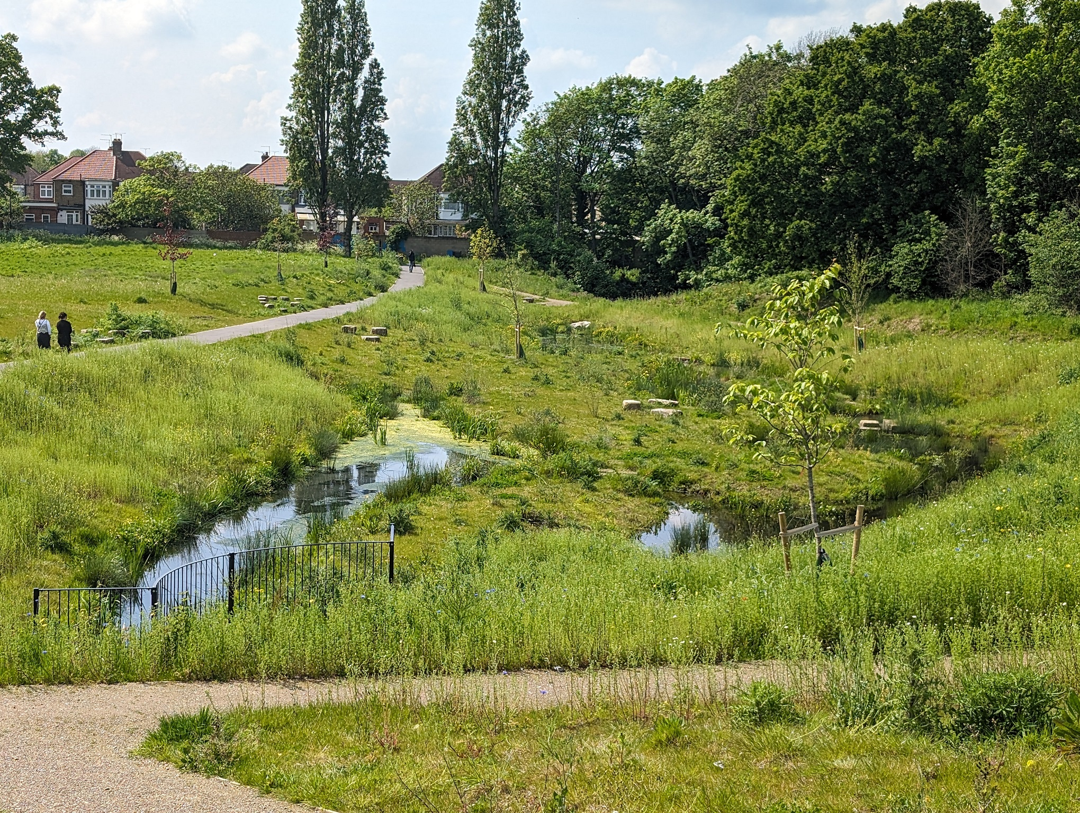
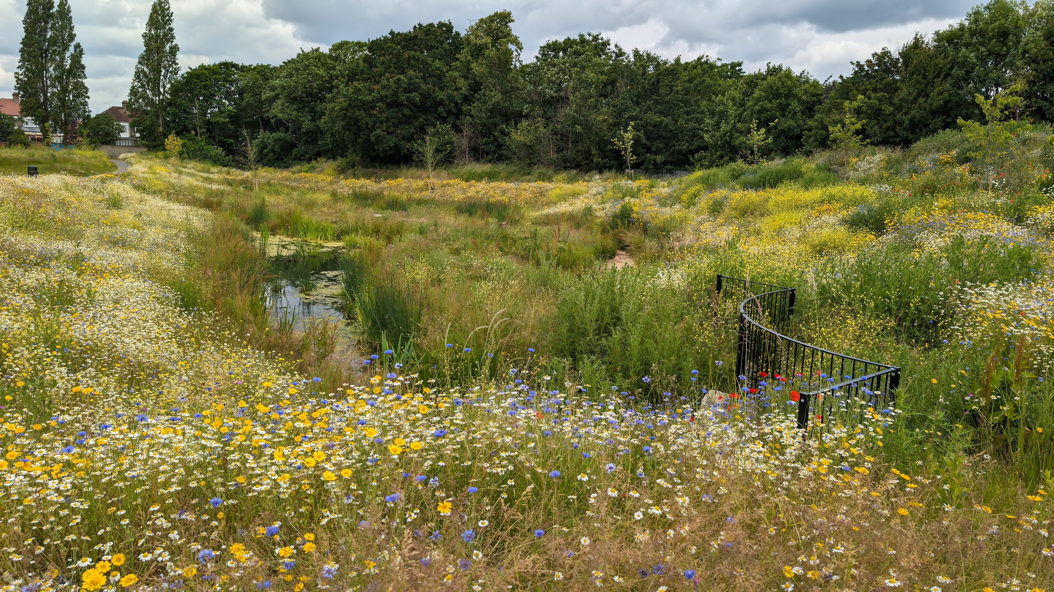
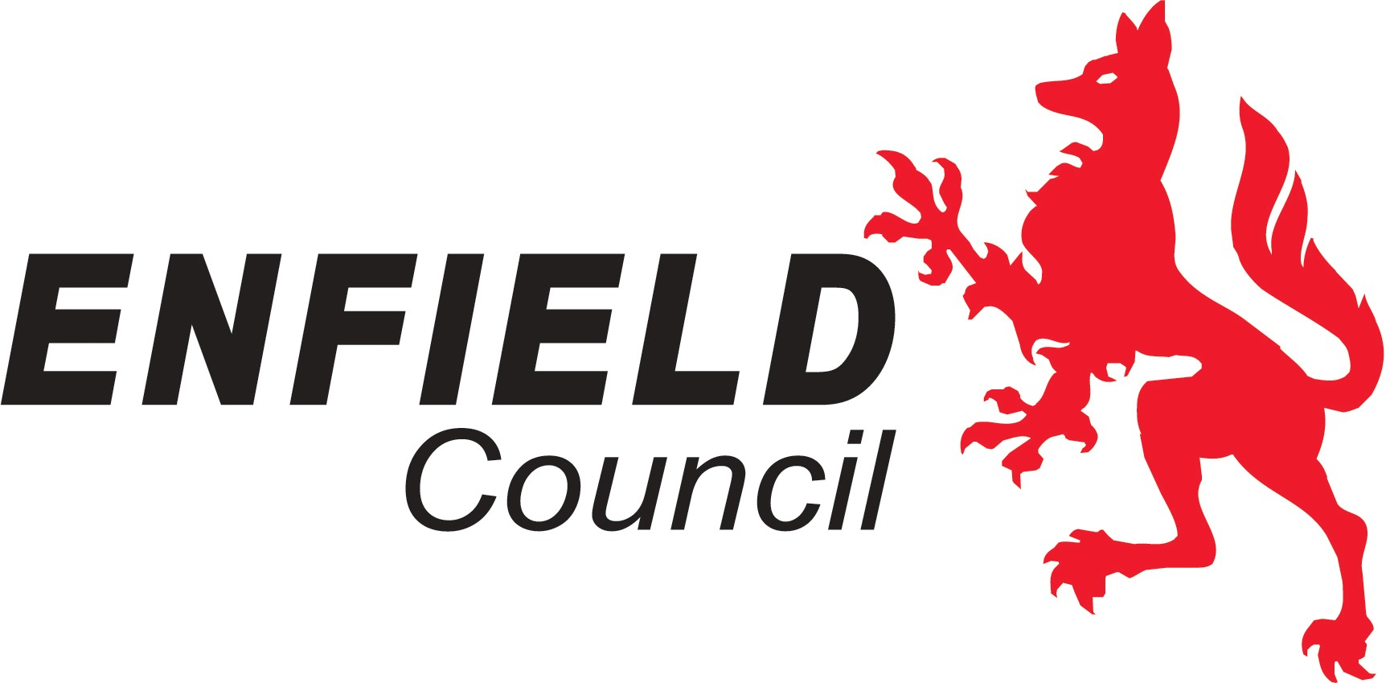
Wilbury Way Wetlands –
'Regeneration and Retrofit’ Susdrain 2024 Winner
MICHAEL SHOREY
SENIOR ENGINEER
ENFIELD COUNCIL

Slide 2
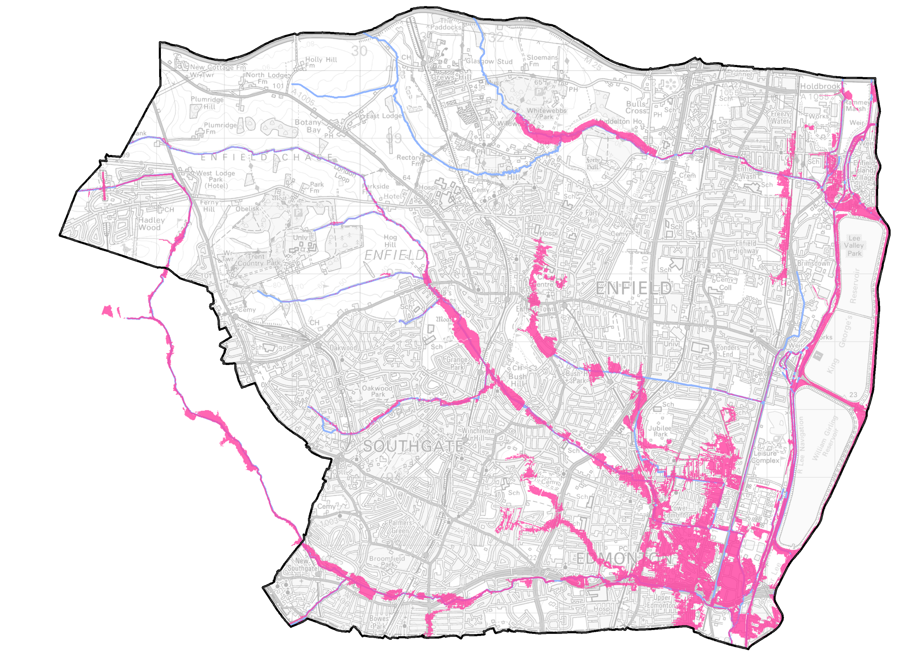
Enfield Context & Flood Risk Management:
North London Borough
340,000 population
Turkey Brook
100 km of rivers
600 km of roads
25,000 gullies
250+ rain gardens
13 wetlands
1 river restoration
1 beaver reintroduction programme
Salmons Brook
River Lee
Pymmes Brook
Wilbury Way Wetlands
Notes:
Between 2008 and 2019, the number of miles driven on Enfield's roads increased by 313,000,0007

Slide 3
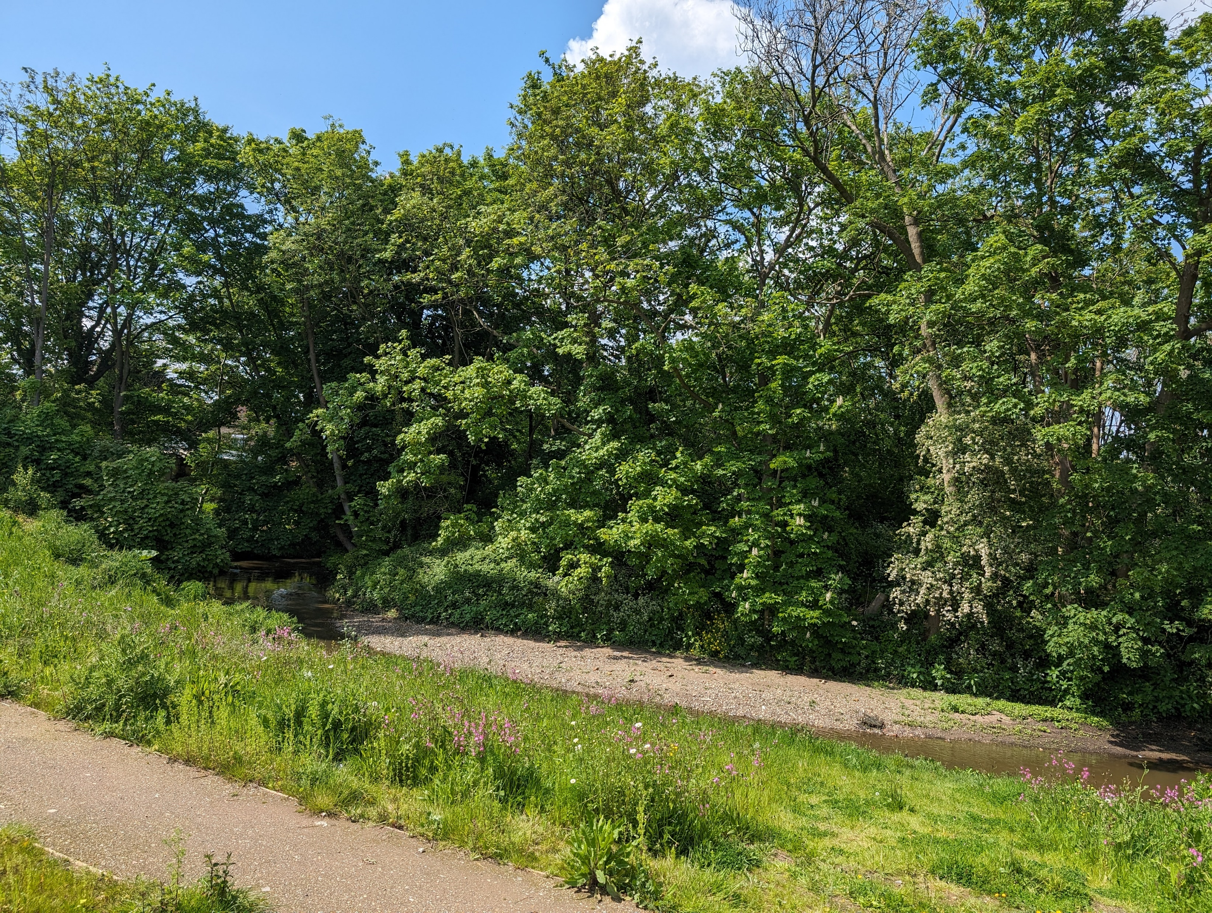
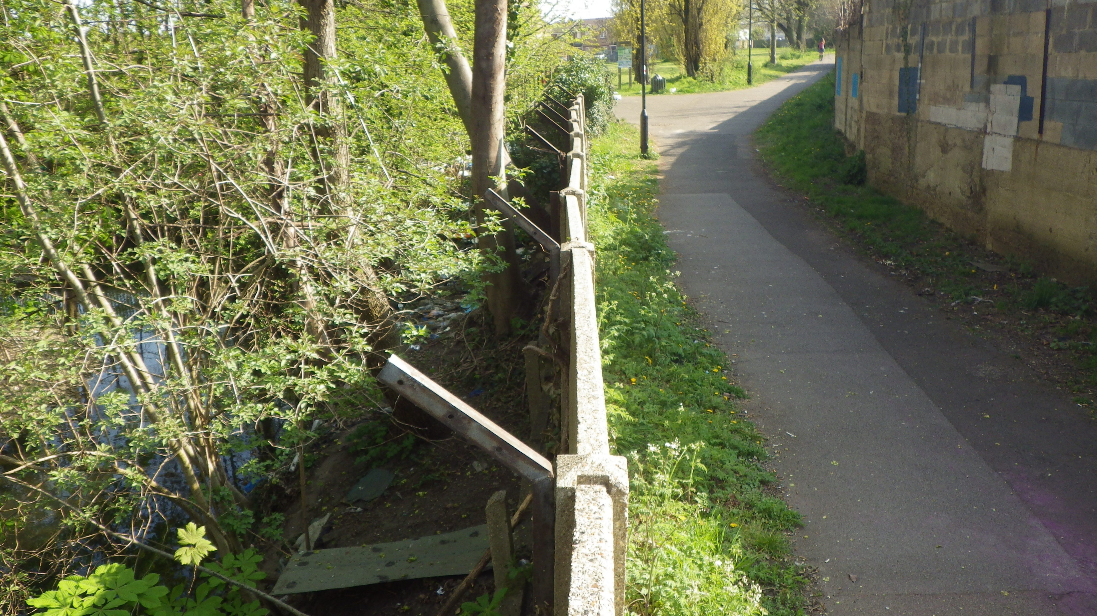
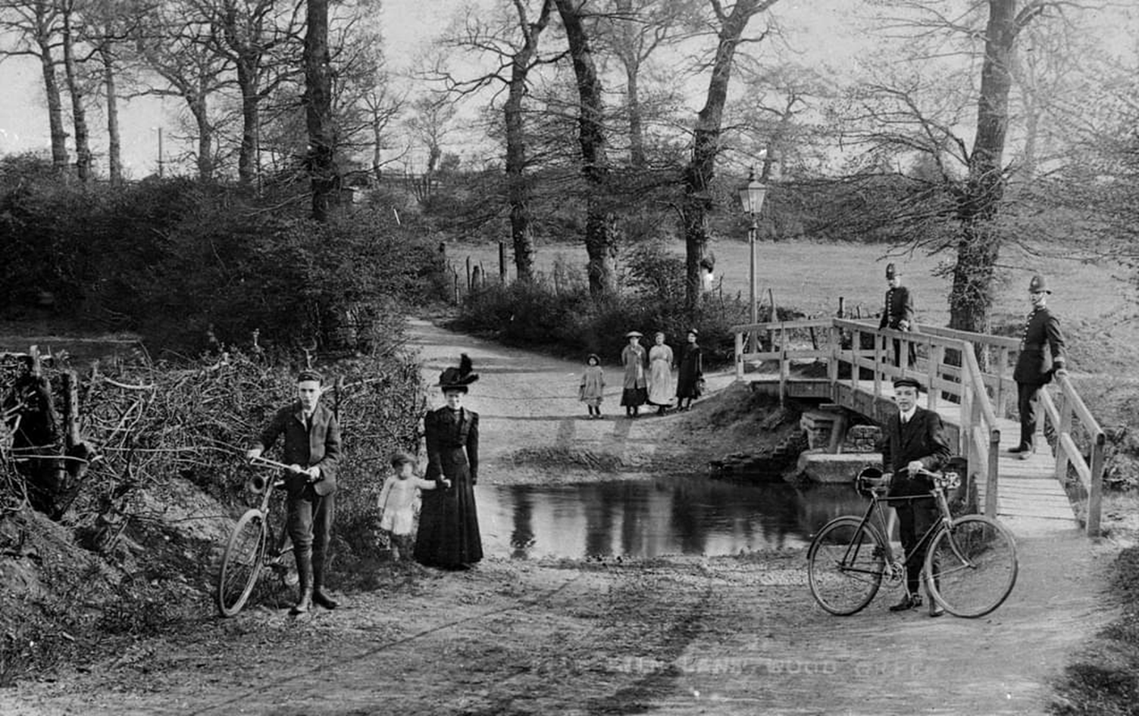
Location and Surroundings
Wilbury Way Open Space

Slide 4
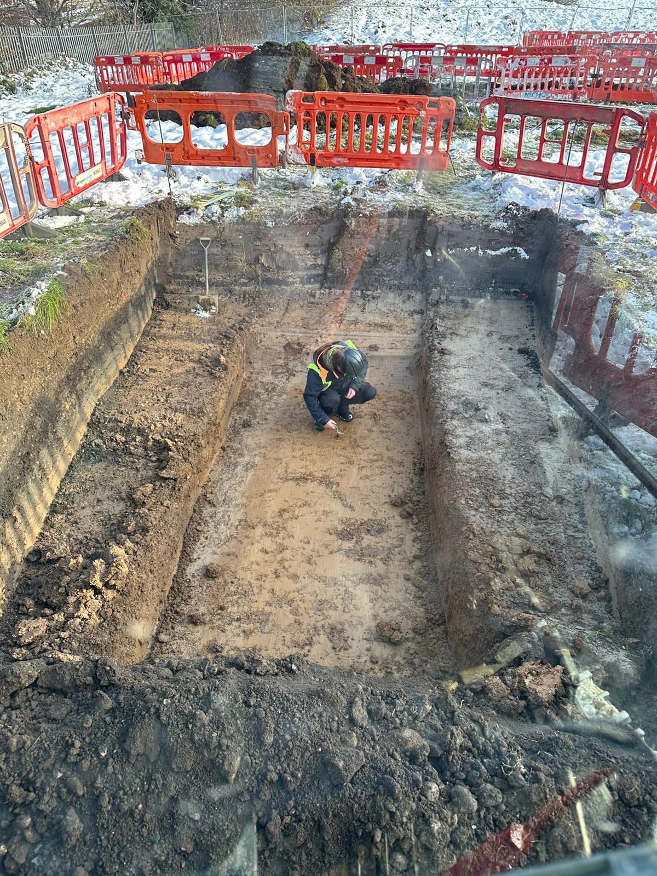
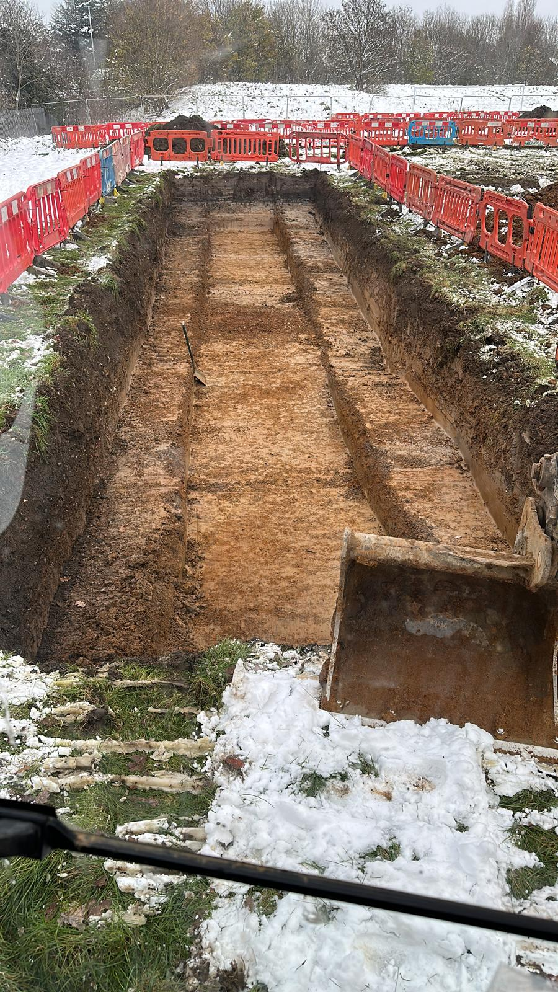
Construction Challenges - Archaeology

Slide 5
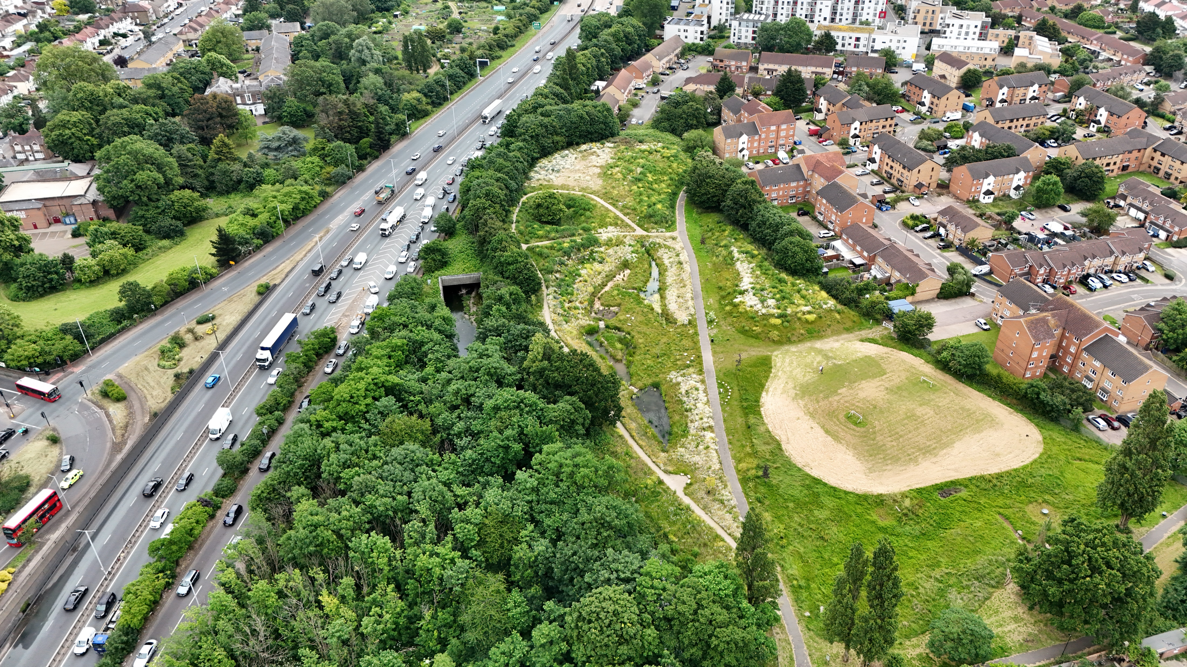
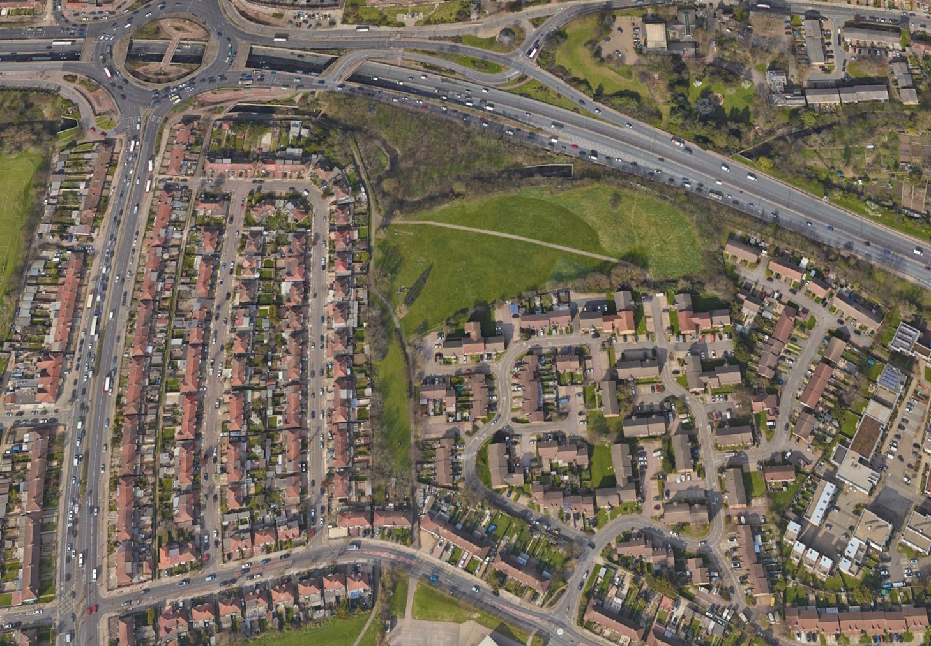
Utilizing Urban Green Space:
Wetlands and Recreation
Wilbury Way Open Space

Slide 6
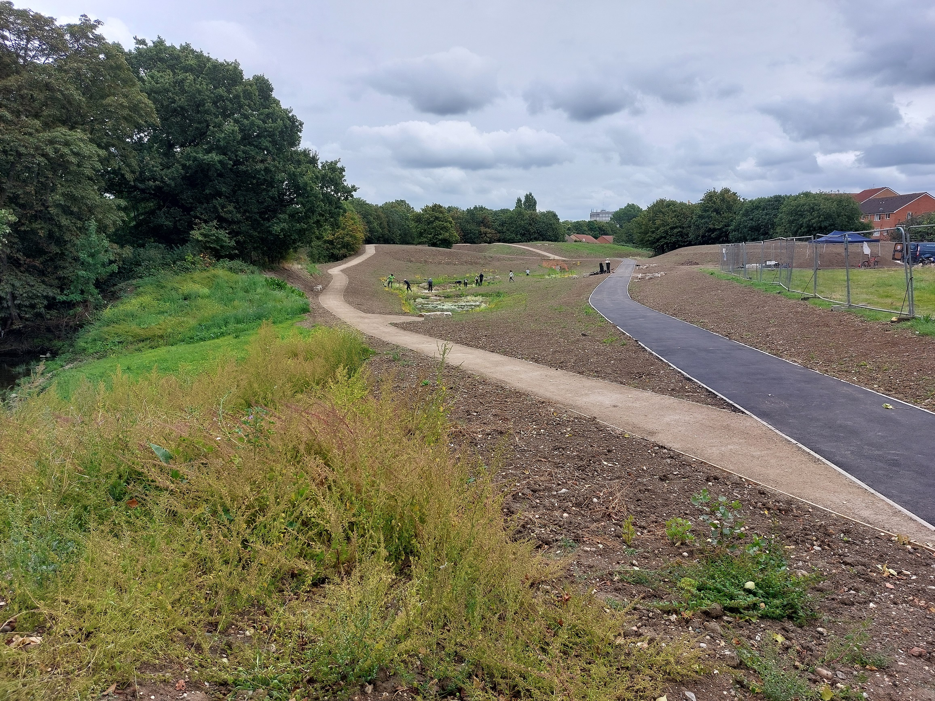
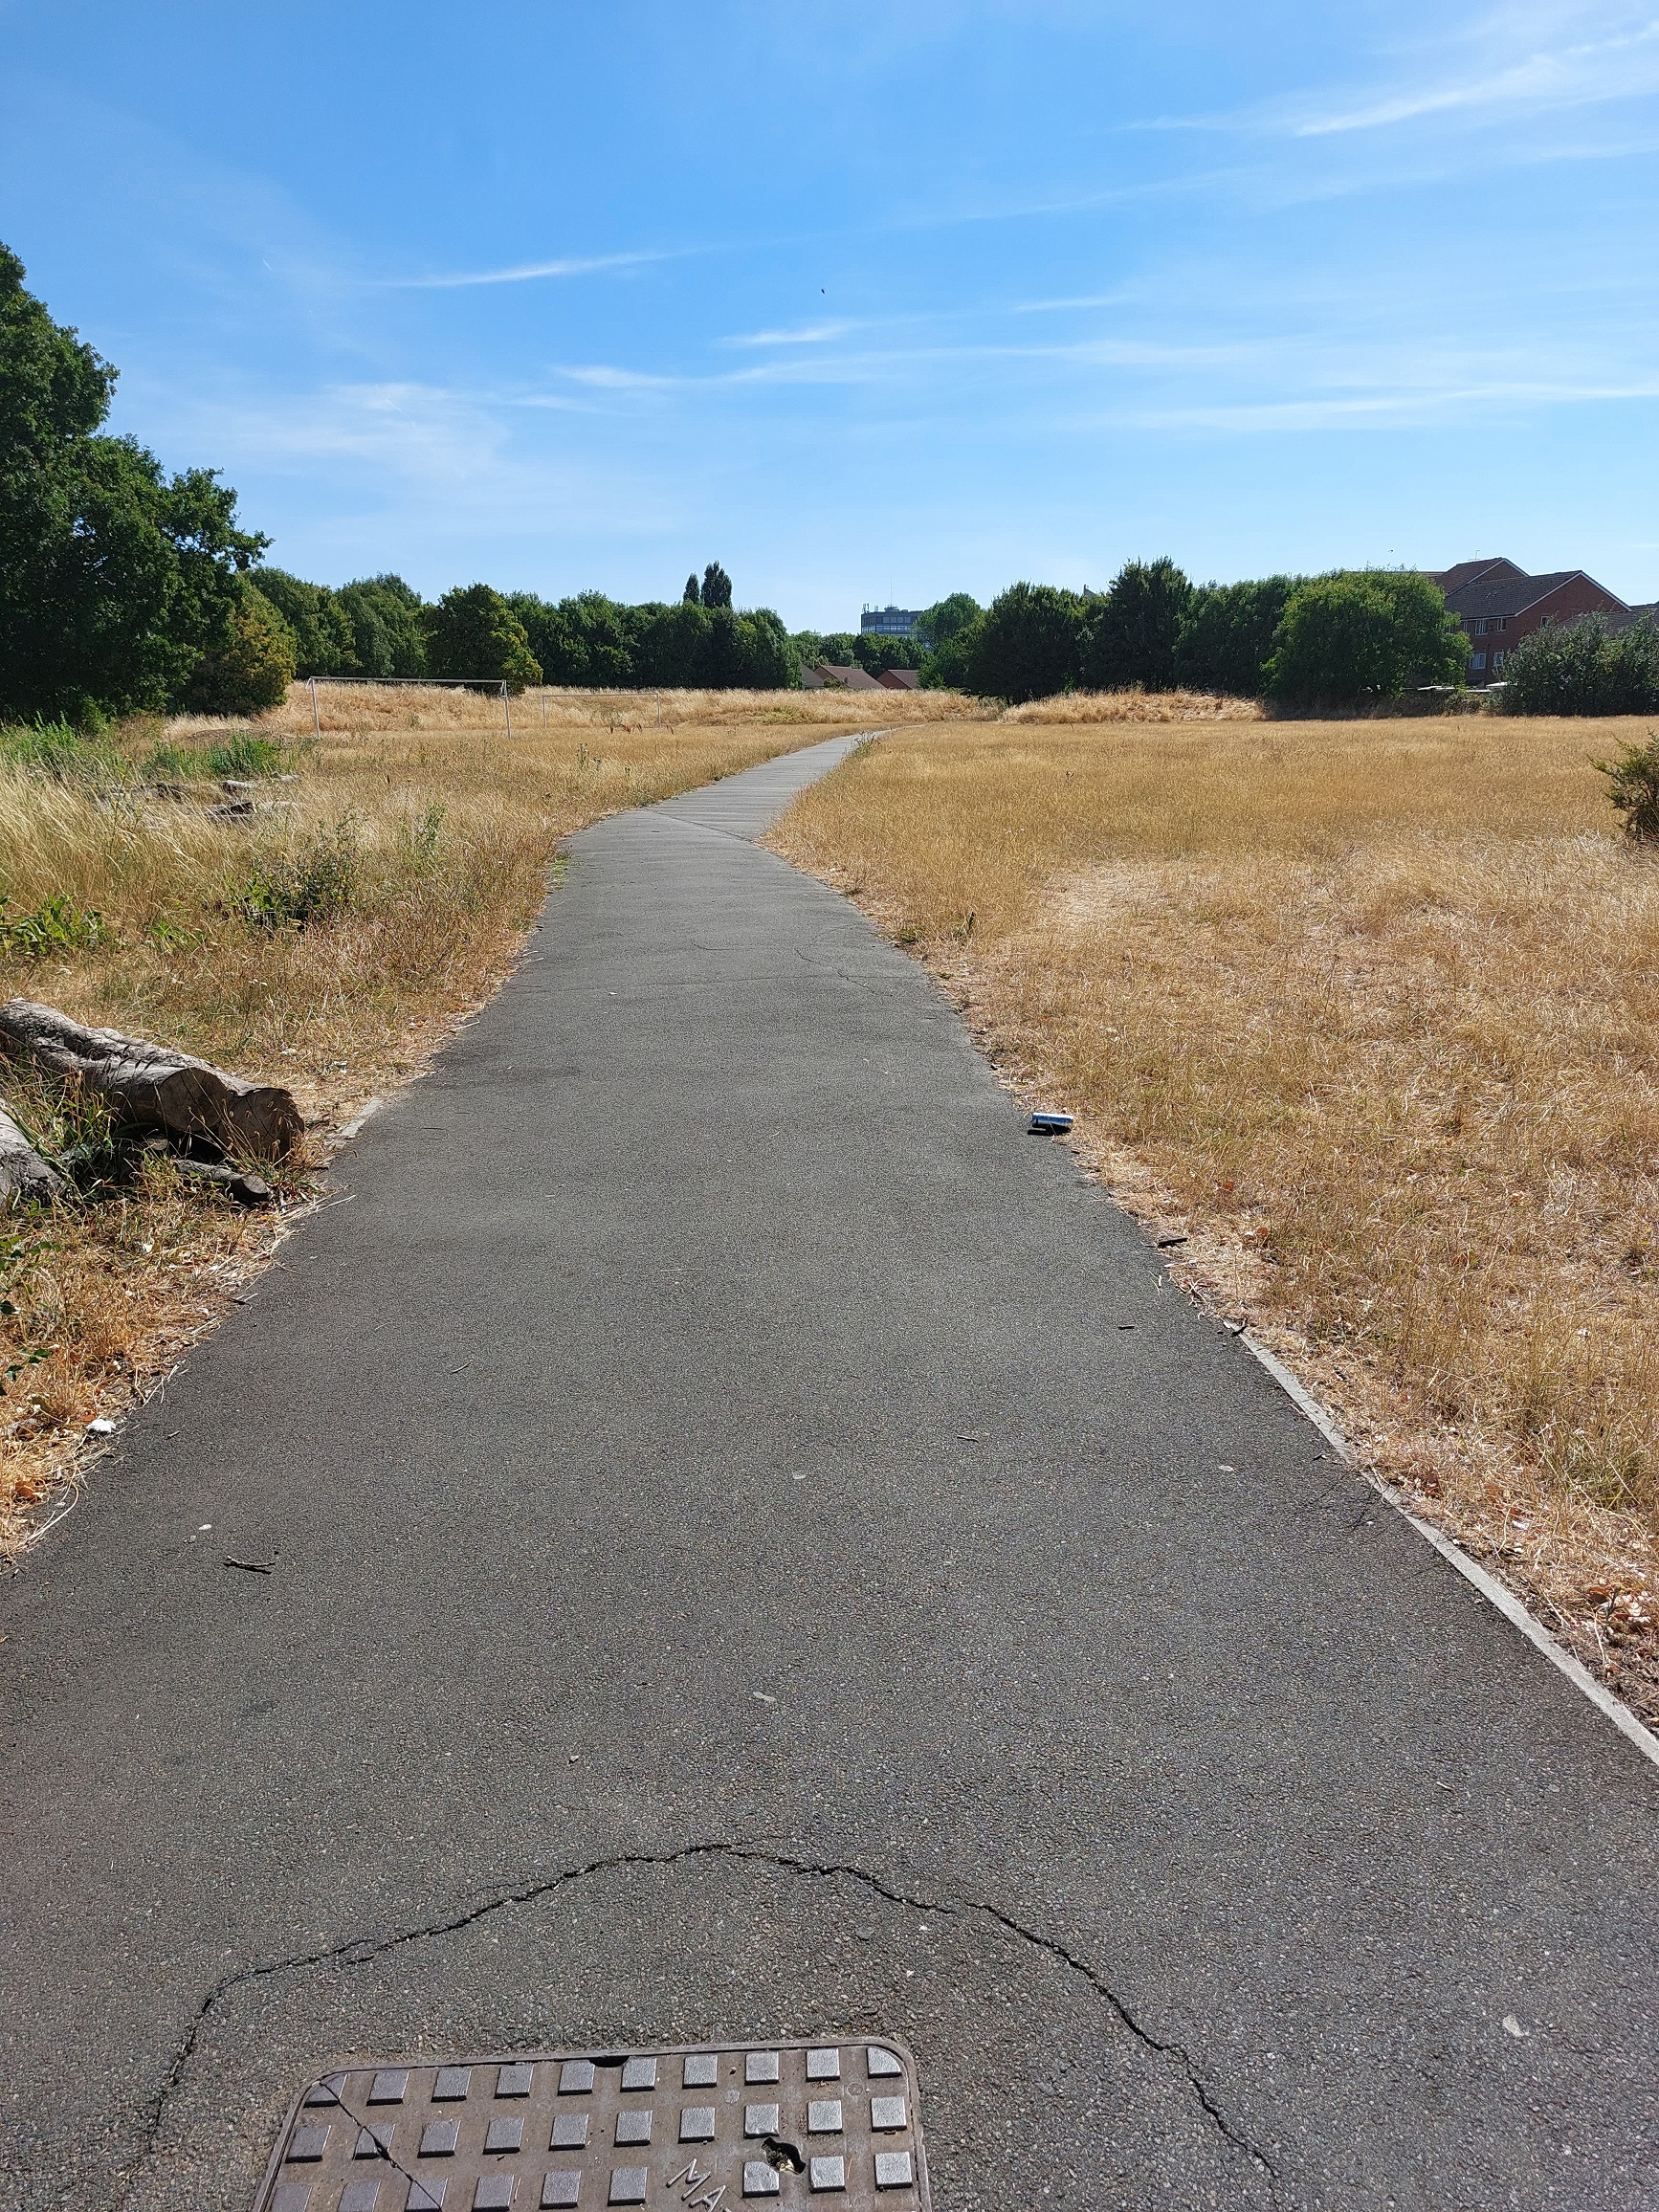
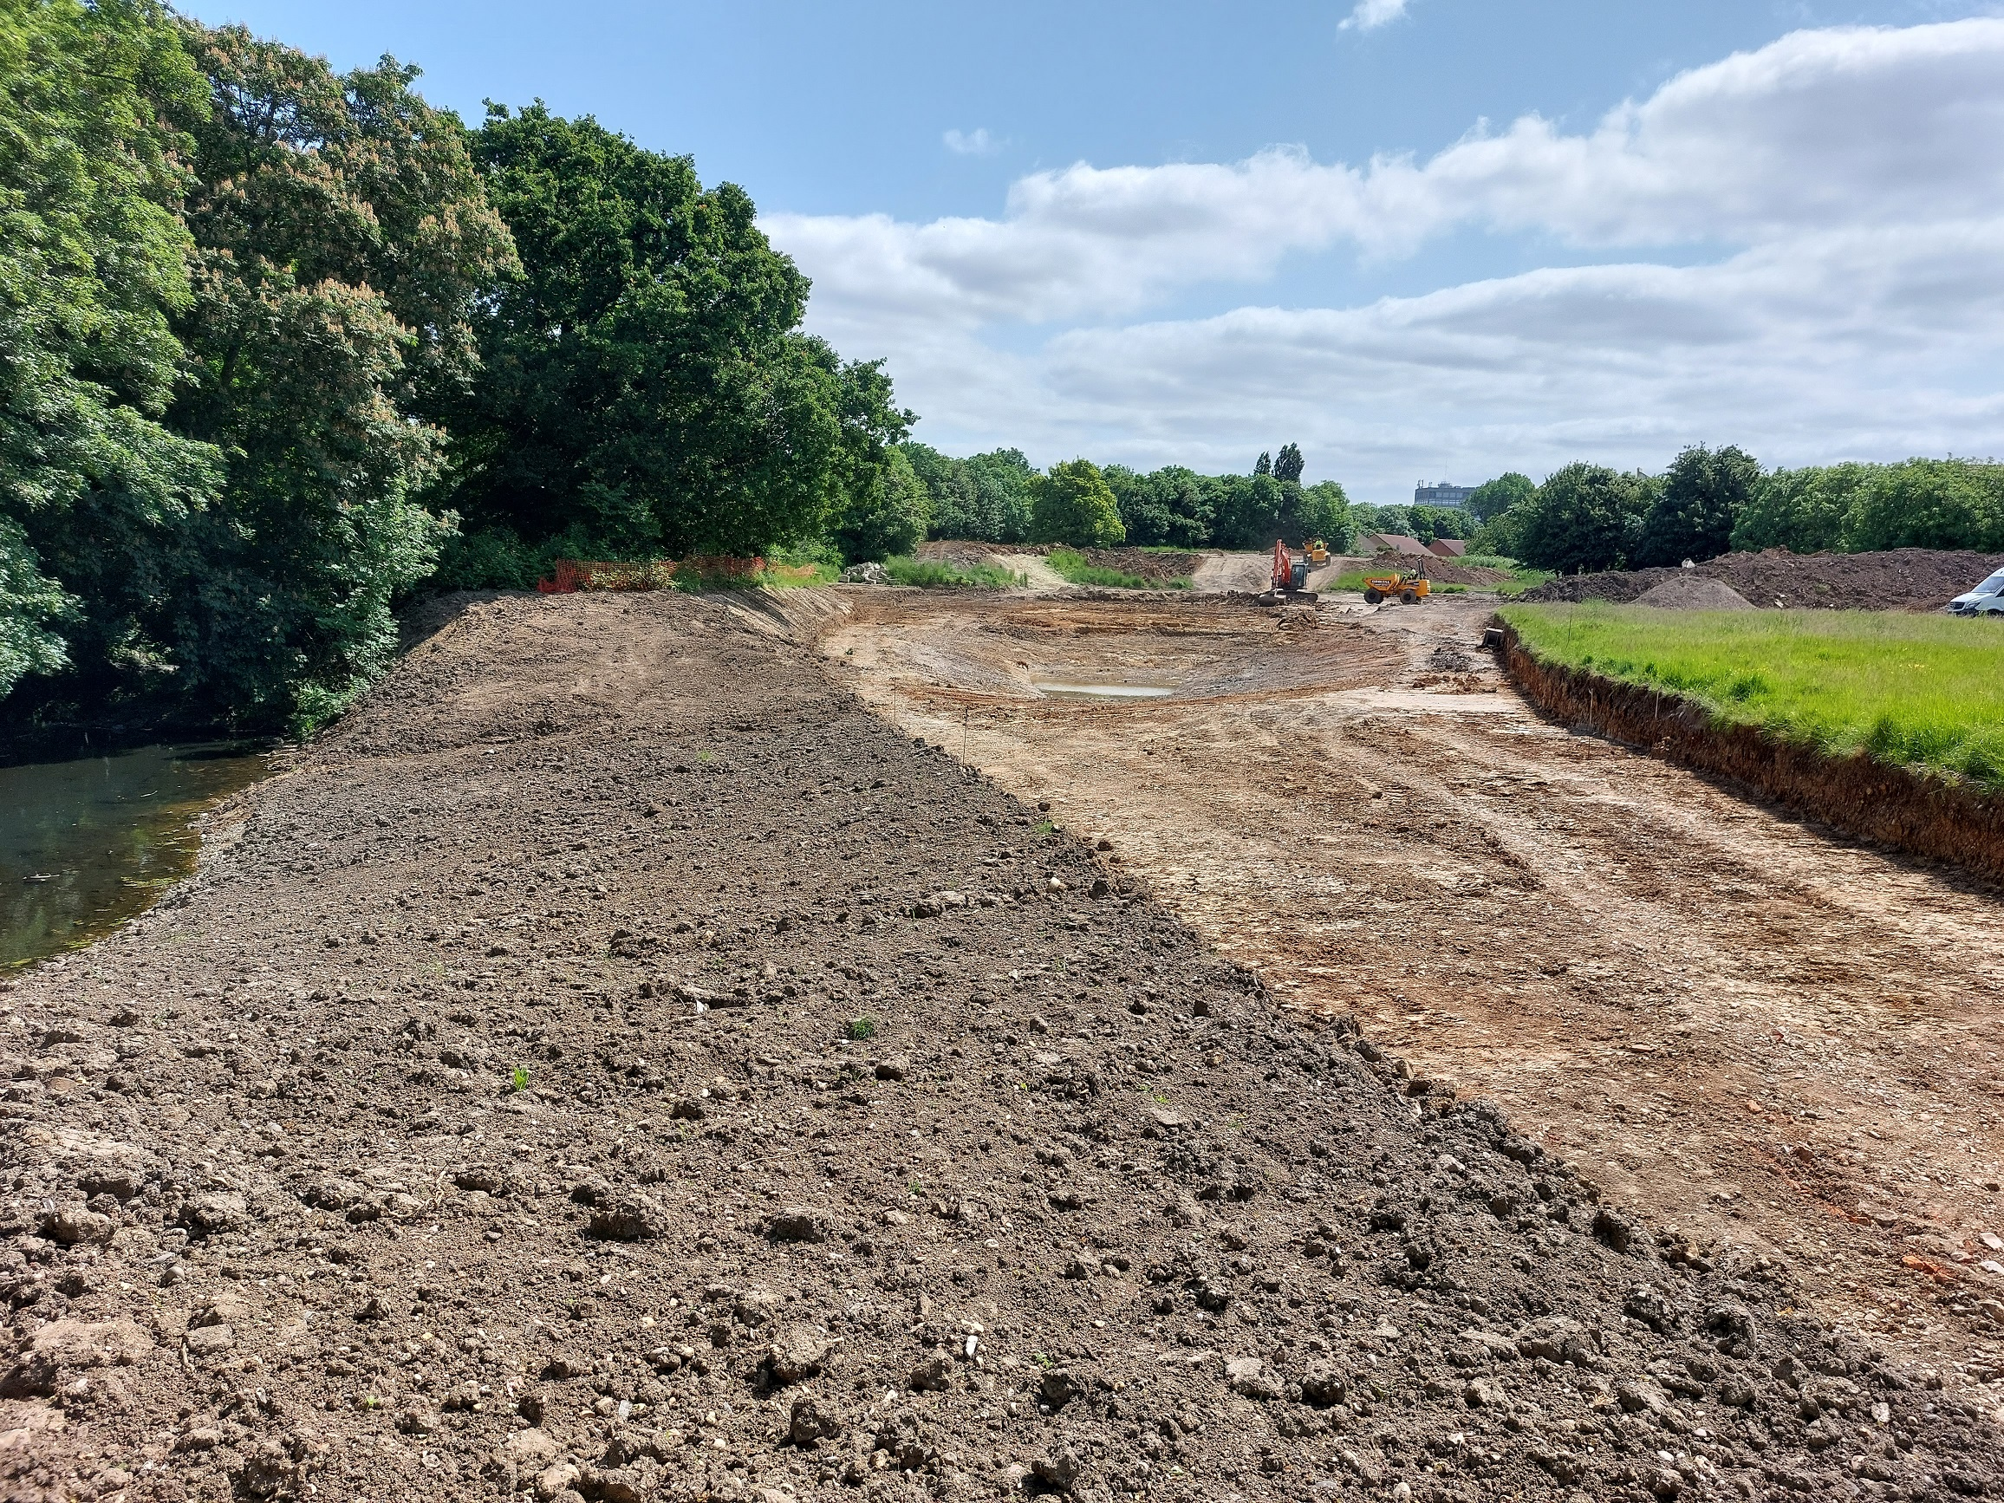
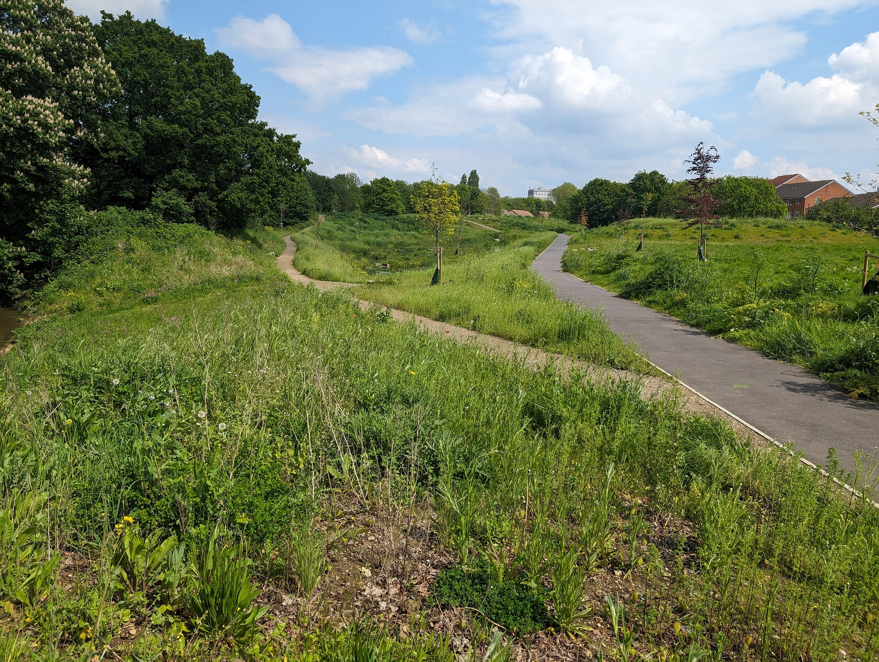
Construction Journey: Transforming the Site

Slide 7

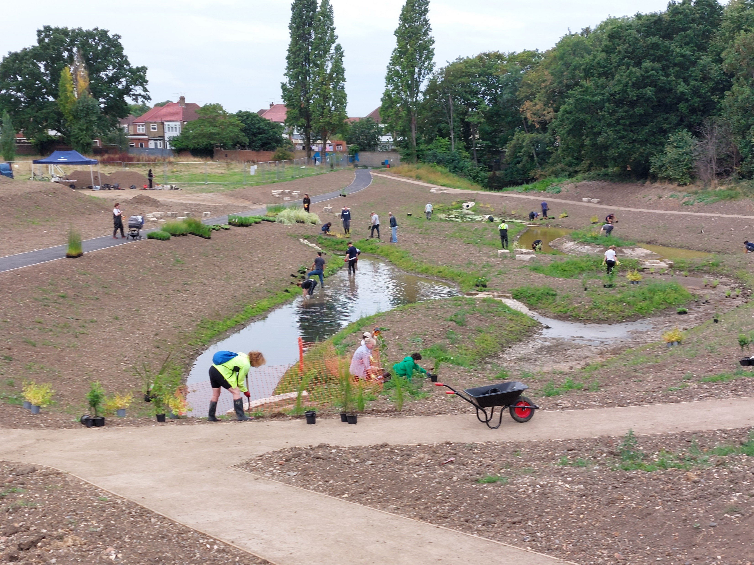
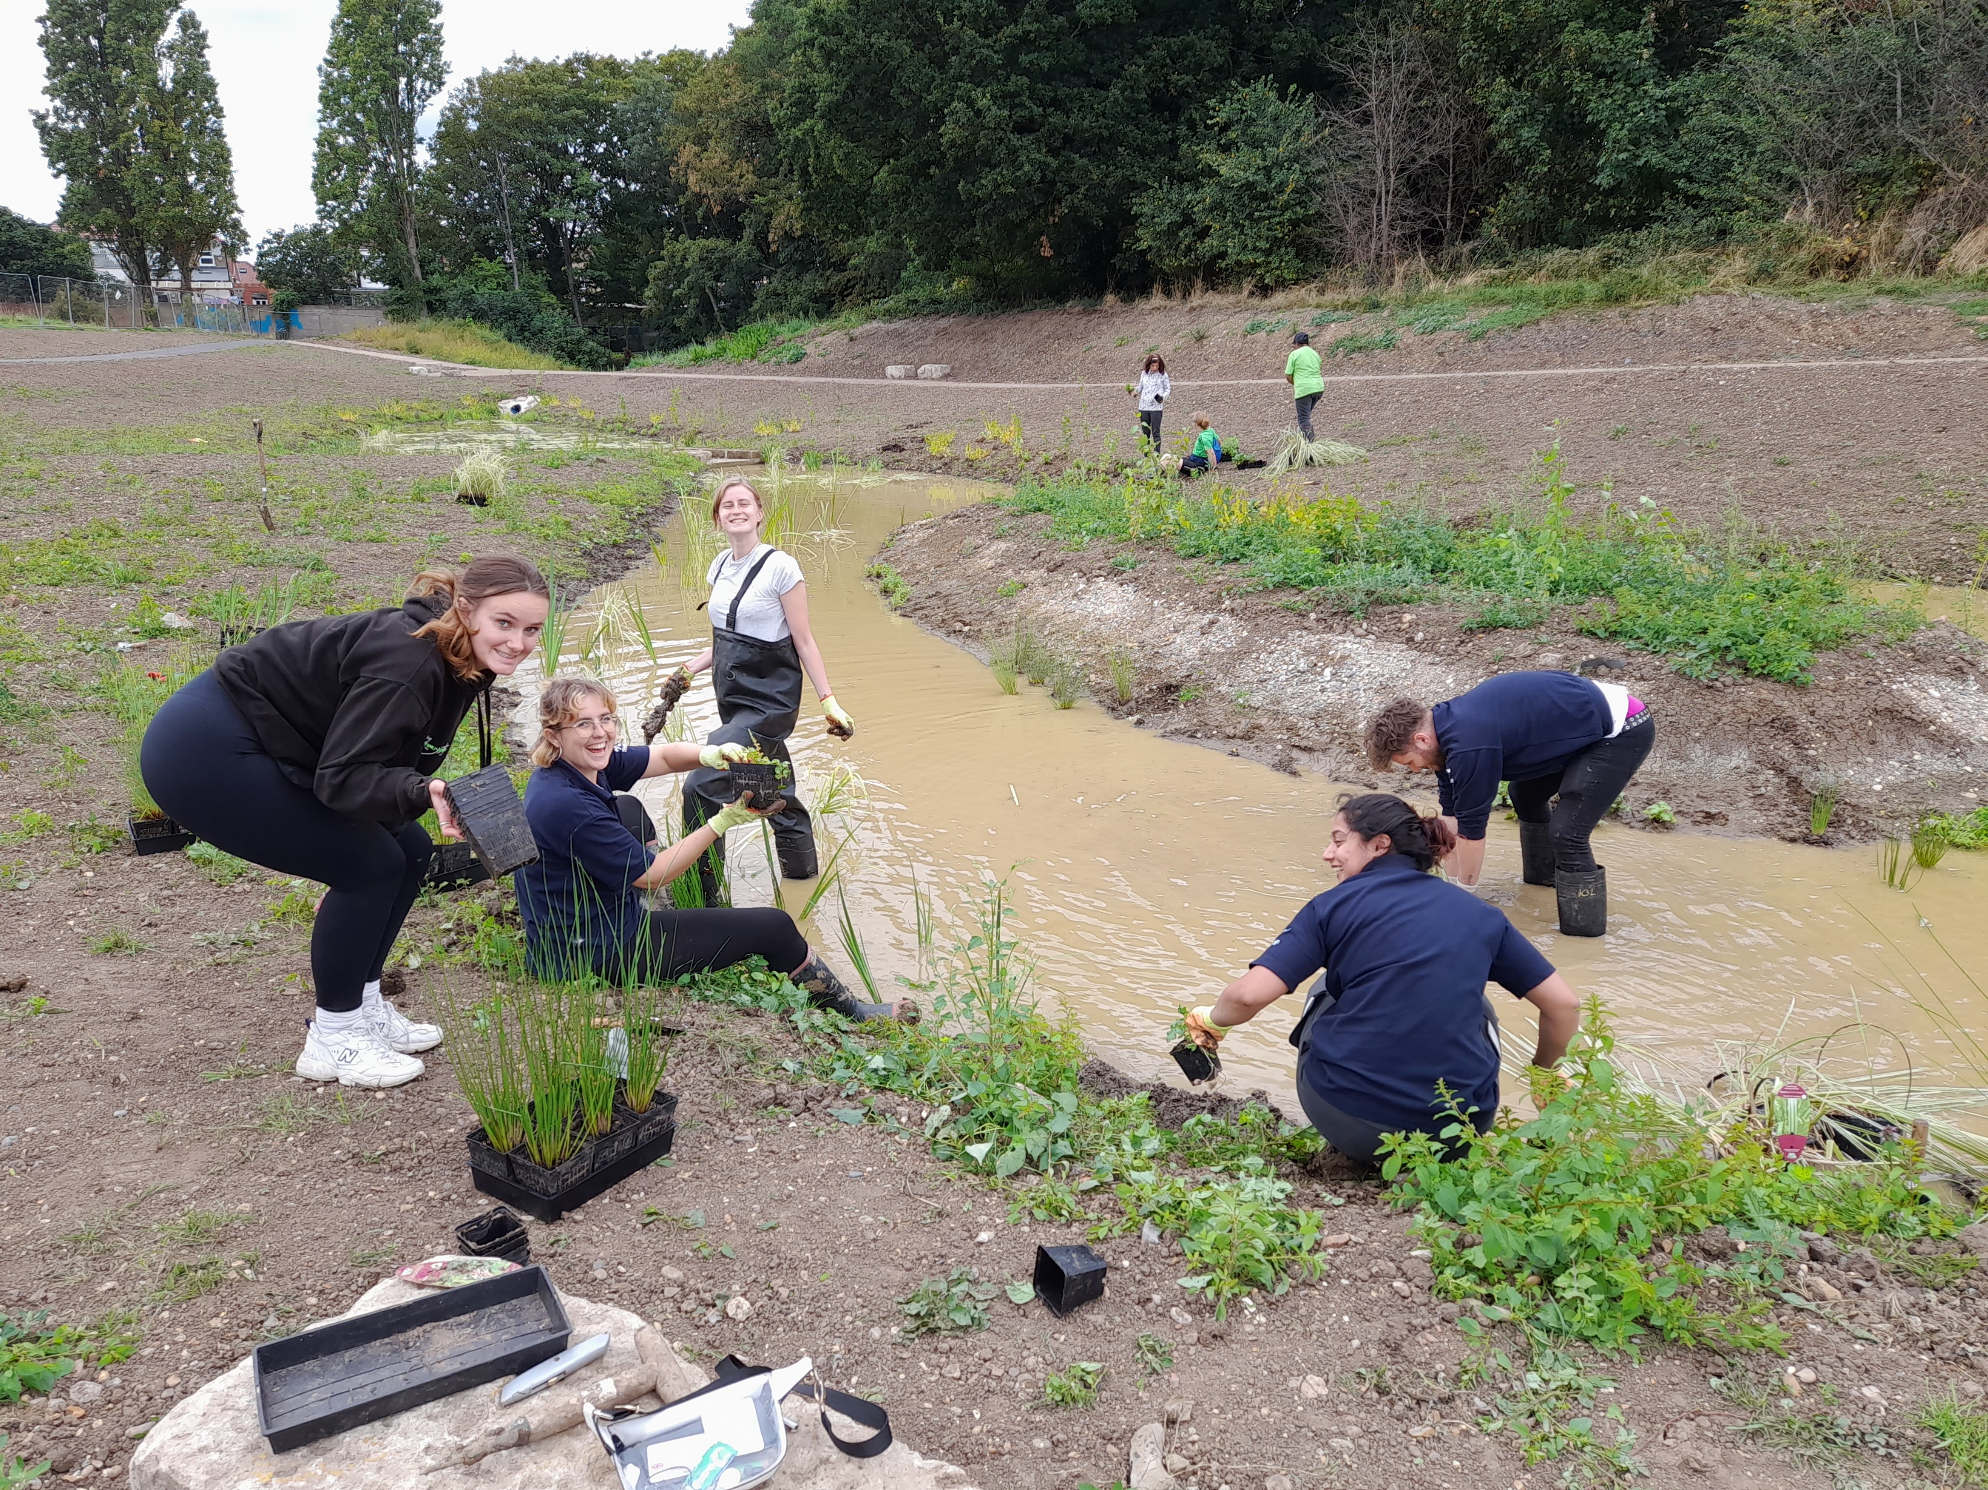
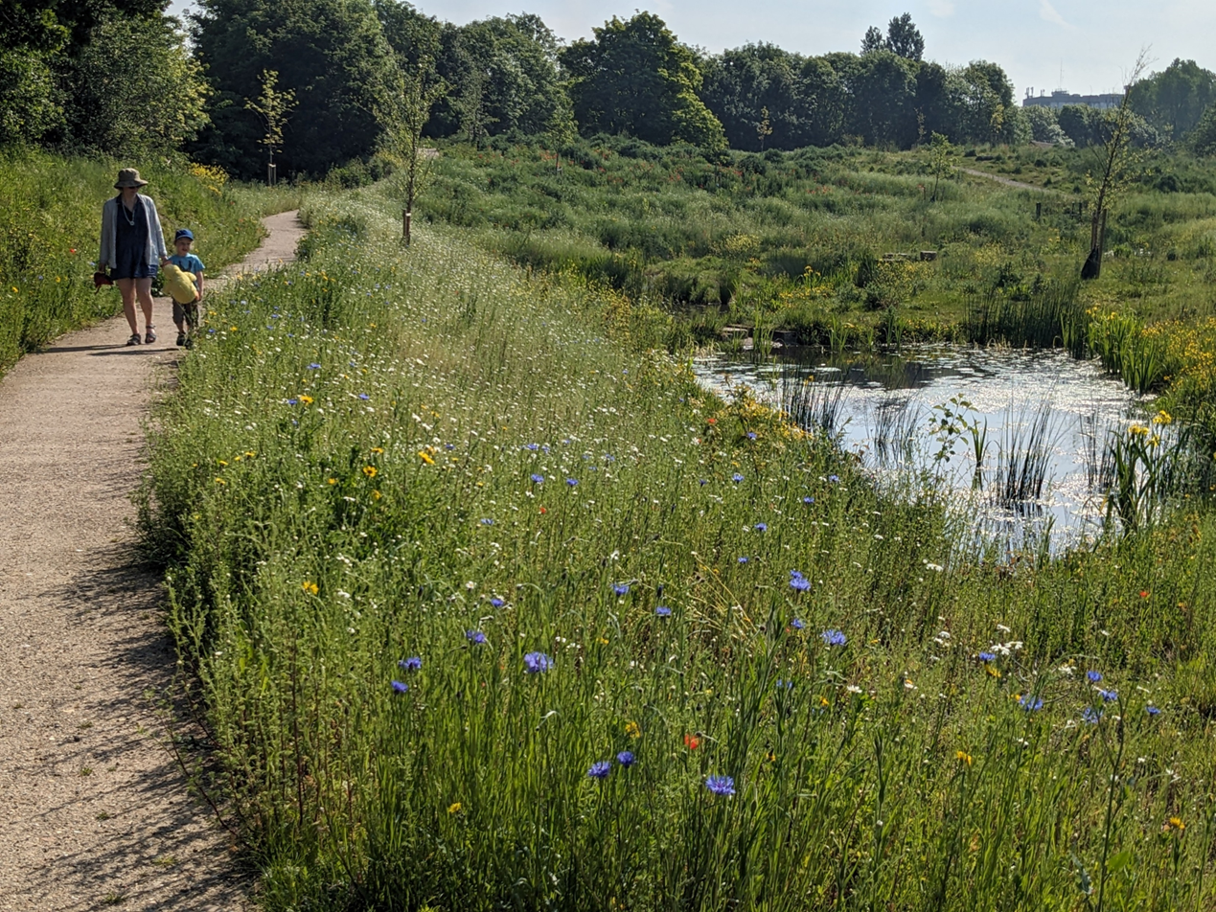
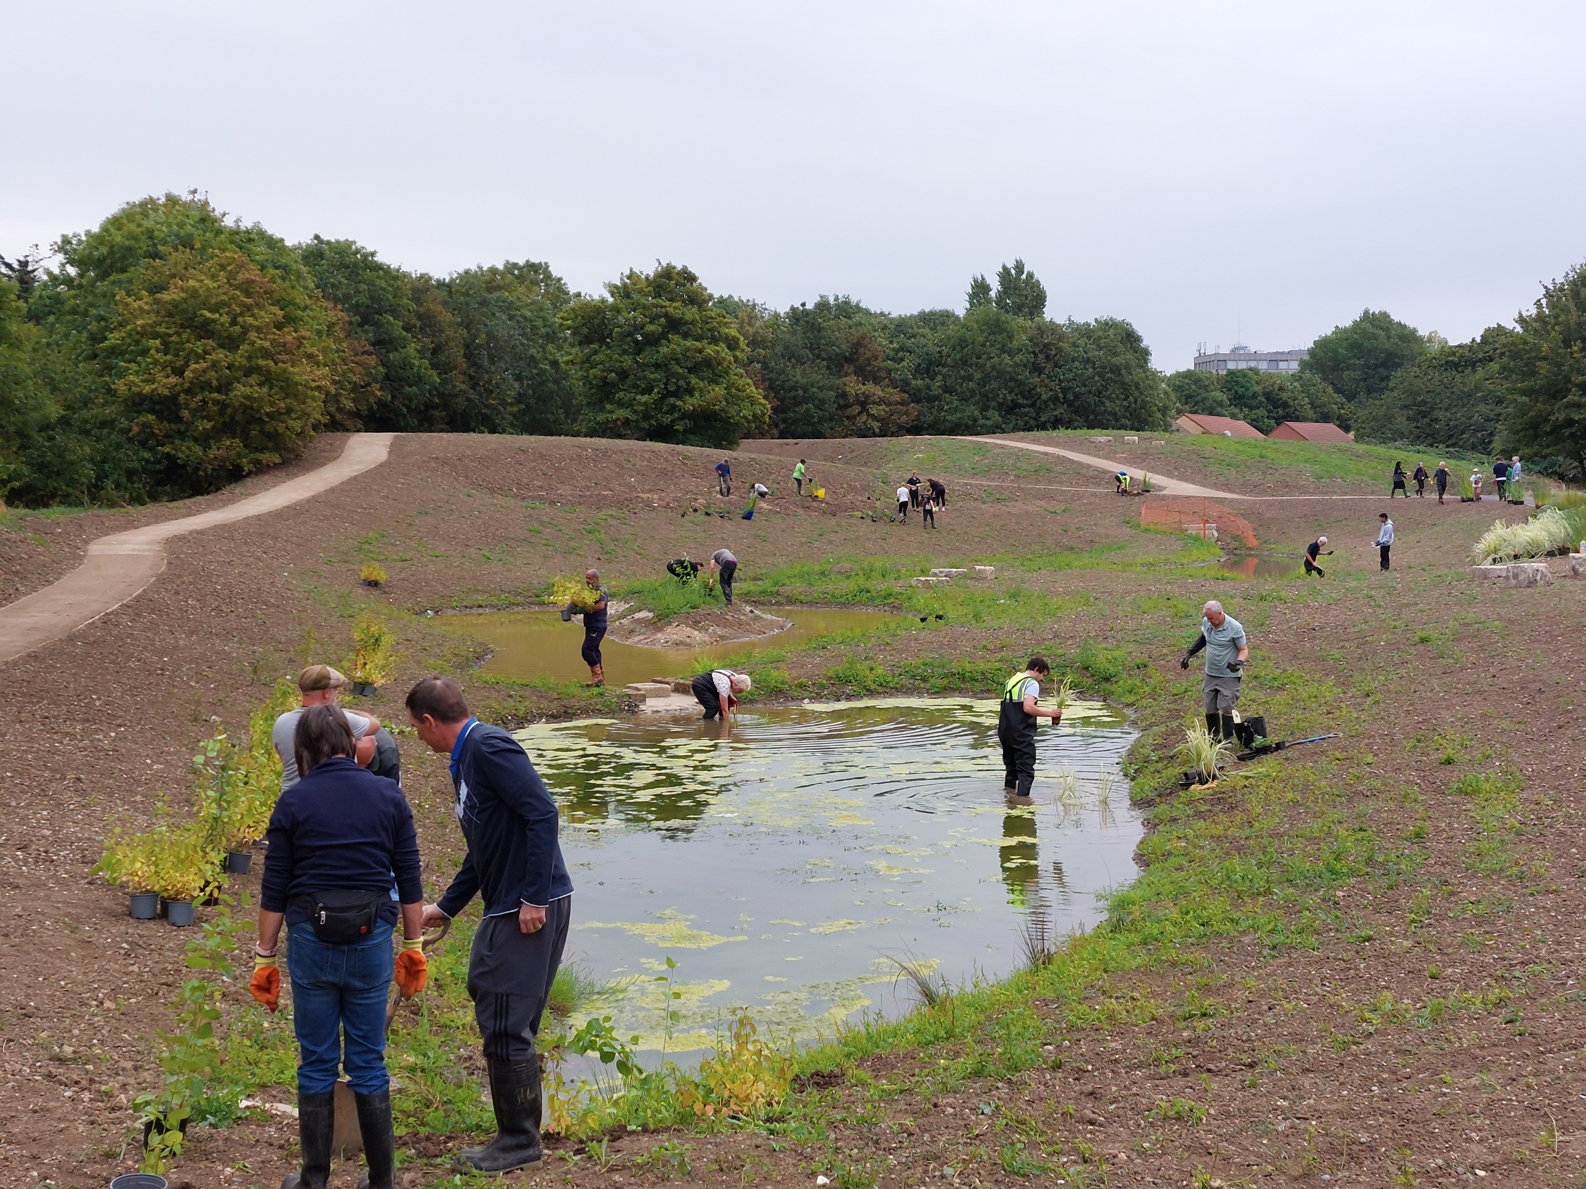
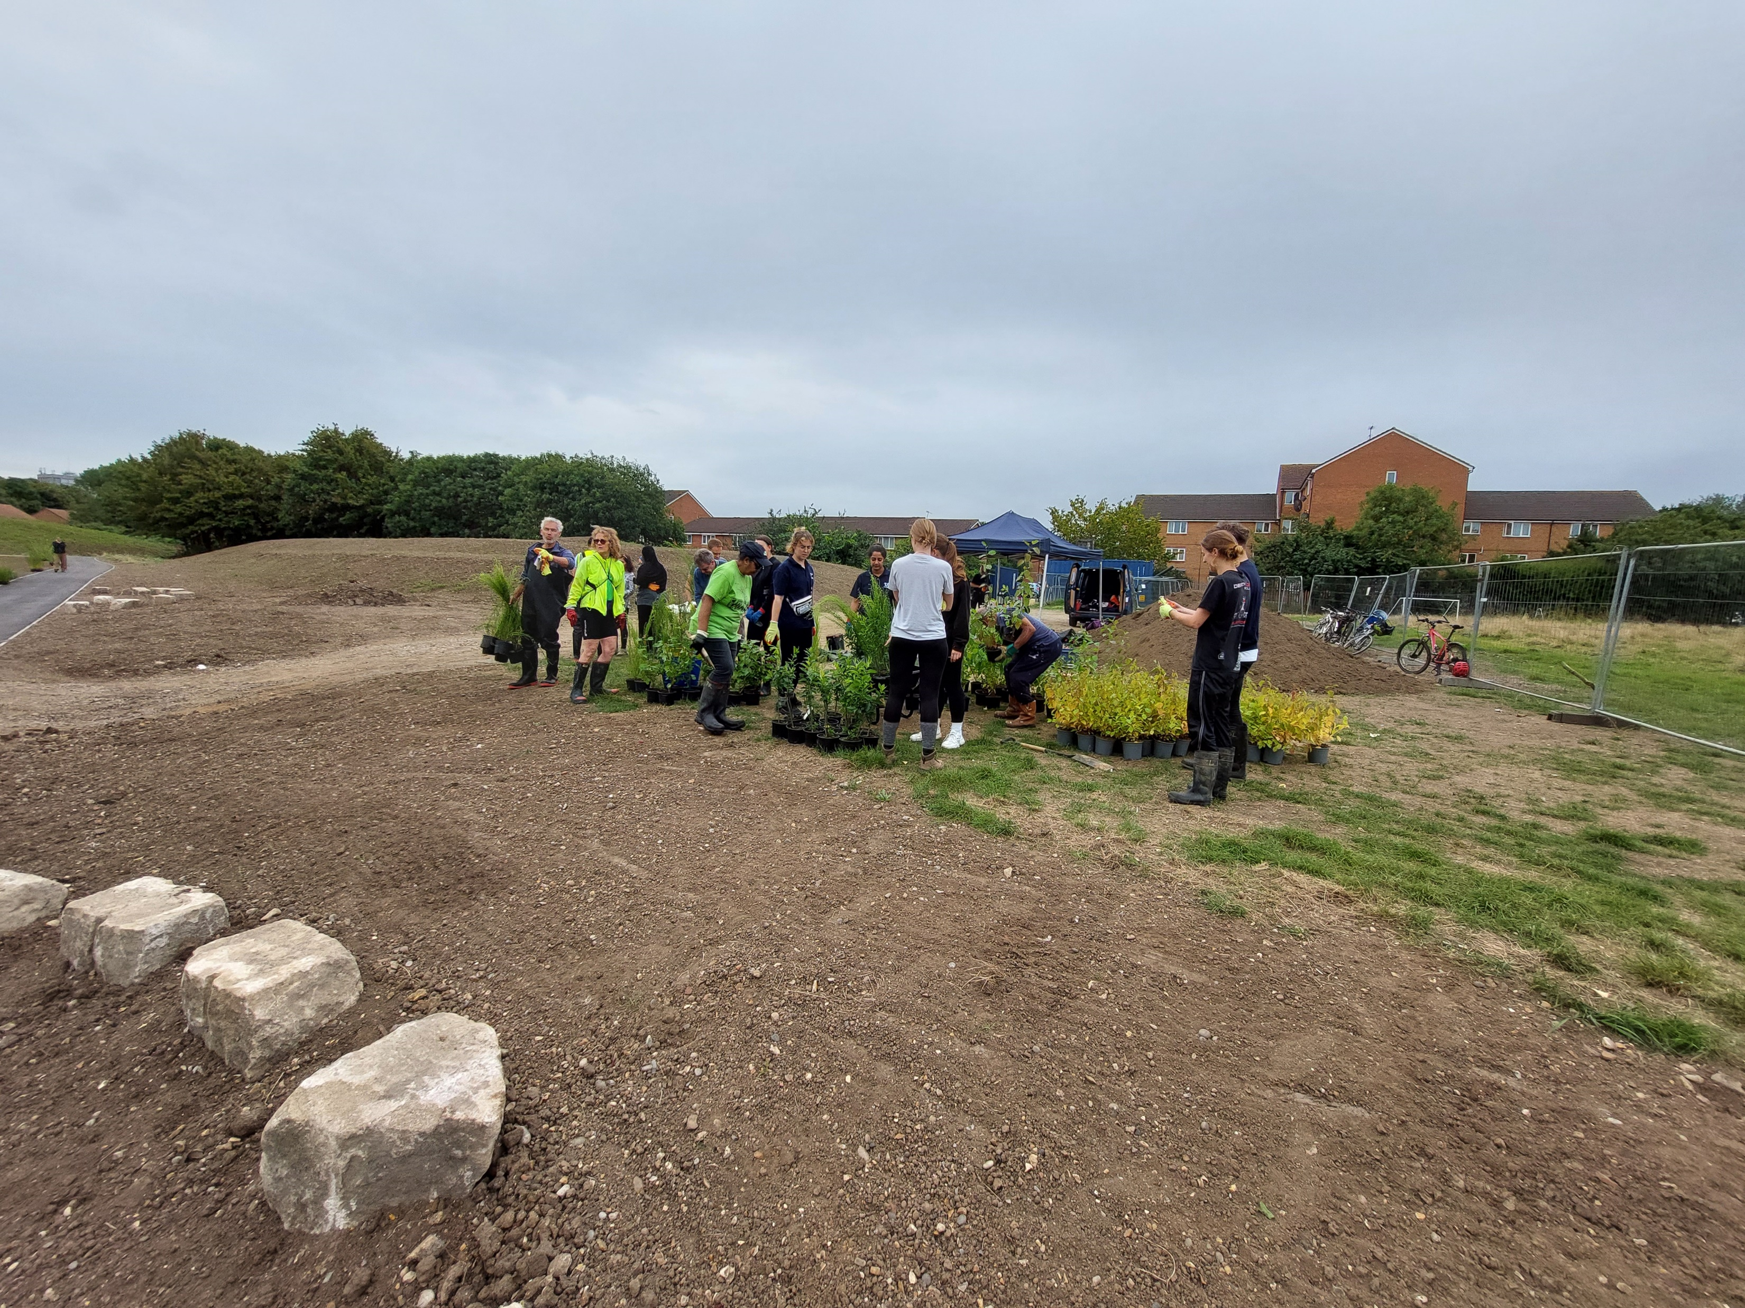
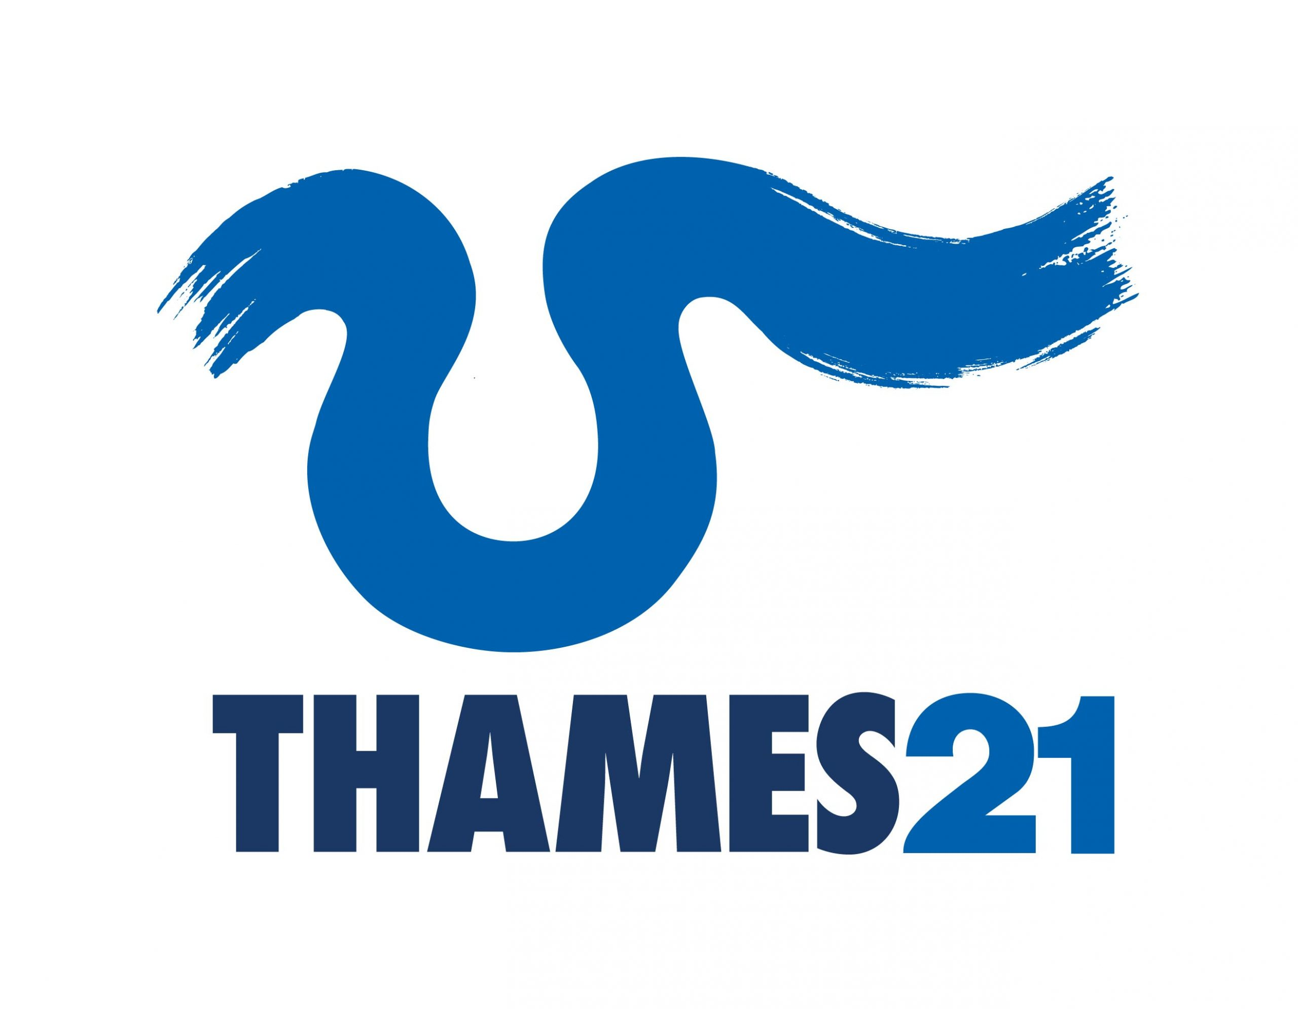
Community Engagement and Positive Outcomes

Slide 8


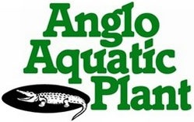



PROJECT TEAM
Project Engineer: Enfield Council - Michael Shorey
Landscape Architect: Enfield Council - Martin Jones
Main Contractor: A.H.Nicholls
Arboriculture: Gristwood & Toms
Botanical Supplier: Anglo Aquatics
Archaeologist: Enfield Archaeological Society
Drone Footage: REAM Partnership
Thames21: Community Engagement/Planting Event

