Slide 1
Unlocking Brownfield Sites with SuDS – FloodEx
27/11/2024

Slide 2
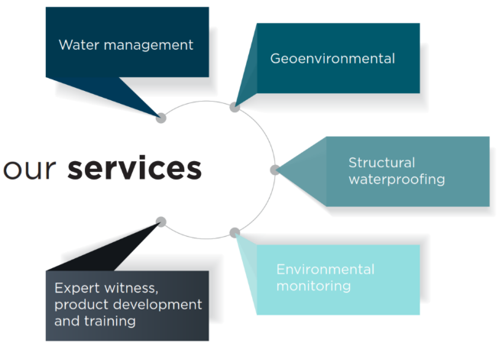
About EPG
Established in 1998, the Environmental Protection Group (EPG) is a leading geoenvironmental engineering consultancy with a team of industry-leading experts. We provide;
Innovative, future-proofed solutions
Comprehensive, solutions-focused designs
Cost effective solutions
We integrate traditional engineering expertise with inventive ideas; evolved from our active participation in research and development into technologies and engineering guidance that are shaping the future.

Slide 3
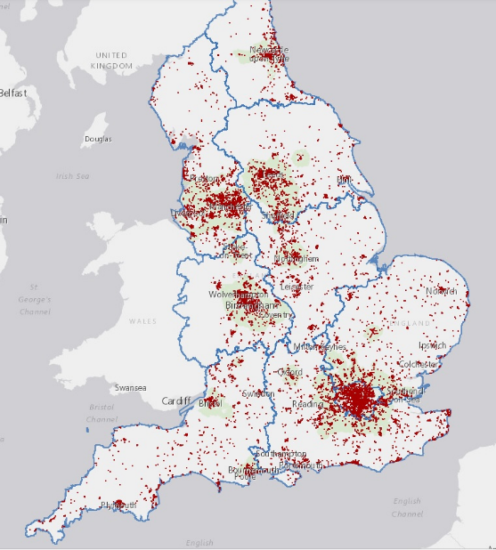
What Is Brownfield Land
Brownfield land refers to previously developed land that is no longer in use, often left vacant or derelict. These sites may have been used for industrial, commercial, or residential purposes.
8% of UK land area is considered Brownfield. Not all brownfield site are contaminated. Circa 40% of brownfield sites have contamination.
In 2022, it was identified that potentially 1.2million homes can be situated on brownfield land.

Slide 4
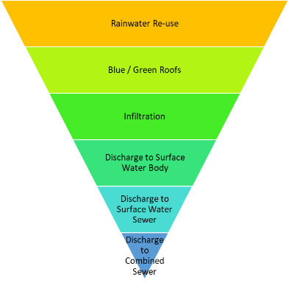
SuDS
Managing surface water runoff in a manner that achieves maximum benefits and creates high quality places
Mimics natural drainage
The systems should be as shallow as possible
Can use infiltration to the ground or be based on attenuation (ie no or limited infiltration)
Should always look for some low level infiltration to achieve “interception” (no runoff from development for majority of rainfall events up to 5mm)
SuDS and contaminated land are ideal partners
But successful design requires co-operation and good communication between designers, contaminated land risk assessors and remediation contractors

Slide 5
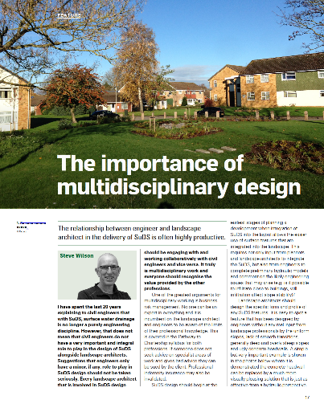
SuDS Design is Multi Disciplinary
Civil Engineers
Landscape architects
Master planners
Ecologists
Geotechnical engineers/geologists
Geoenvironmental engineers
Remediation specialists
Landscape – Journal of the Landscape Institute, Winter 2023/24

Slide 6
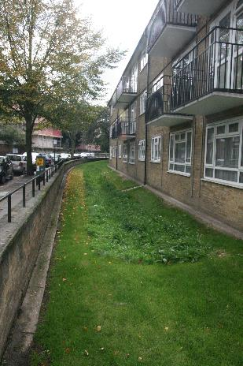
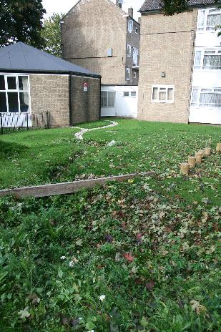
Myths abut SuDS
SuDS cannot be used on
contaminated sites
Sloping sites
High density development or urban sites
Flat sites
Sites with high groundwater
Small sites
SuDS are expensive
SuDS need a lot of land take
Cannot use infiltration close to buildings (<5m)

Slide 7
Where can we use SuDS
Everywhere
SuDS can be designed into all sites
Not all benefits may be fully realised – SuDS is not the only thing developers have to consider
Multi functional spaces and pervious surfaces allow use in high density developments
Most schemes end up using a combination of landscape and engineered features (and pipes!)
Manual explains how to design SuDS into contaminated, high density, sloping, flat, small and other sites
Use rigorous engineering analysis and judgement
Can infiltrate up to 1m from buildings (with correct design and assessment)

Slide 8
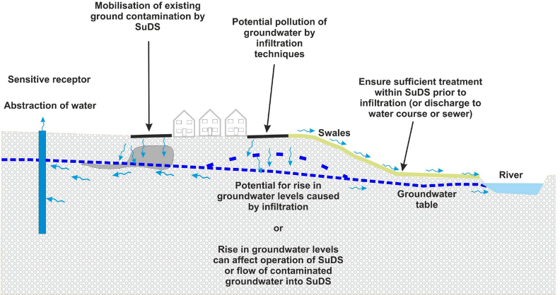
Brownfield design considerations
Is it Contaminated???
Groundwater protection – mobilising contamination in the ground or pollution from the surface water runoff
Effect of contaminants on materials used in SuDS (plastic geomembranes and plastic storage tanks)
Integration of SuDS and remediation design
Infiltration tests and interpretation

Slide 9
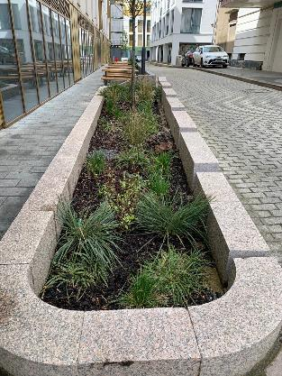
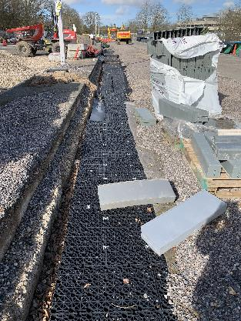
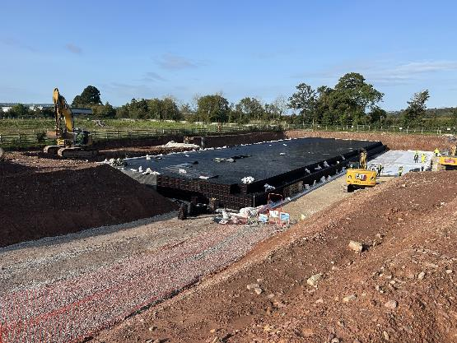
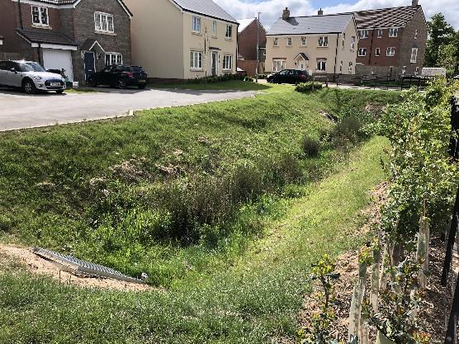
SuDS
Not SuDS

Slide 10
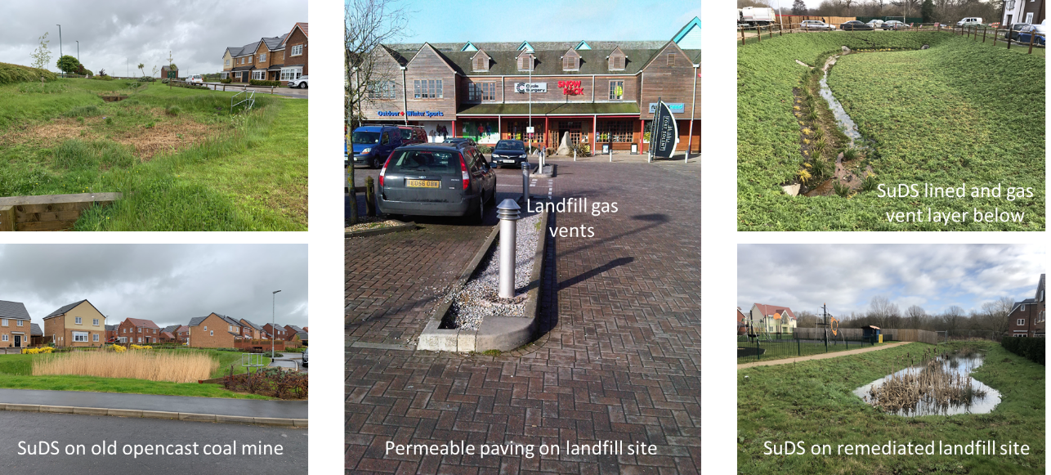
SuDS on Brownfield sites

Slide 11
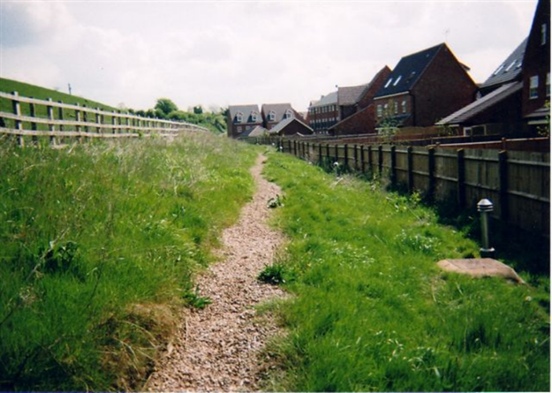
Infiltration on Brownfield Sites
It is often possible to infiltrate on contaminated sites
Identify locations and depth of contamination
Consider leachability
Can infiltration be used in some areas to avoid contamination?
Can infiltration be used below contamination?
Will contamination be removed as part of remediation?
Will infiltration mobilise contamination?

Slide 12
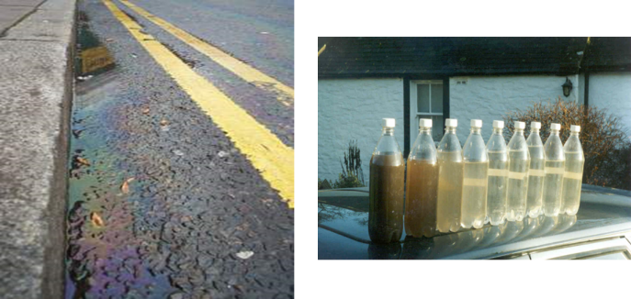
Infiltration from SuDS Groundwater Risk Assessment
Surface water runoff is polluted
Sufficient treatment in the SuDS required to reduce it prior to infiltration
Advice on design of SuDS for pollution removal is provided in the SuDS Manual
In some cases detailed risk assessment may be required
Based on standard groundwater risk assessment and modelling methods
EA R&D Report P2 – 174
Guidance on requirements for prior investigation (including requisite surveillance of groundwater) for activities authorised under the groundwater regulations

Slide 13
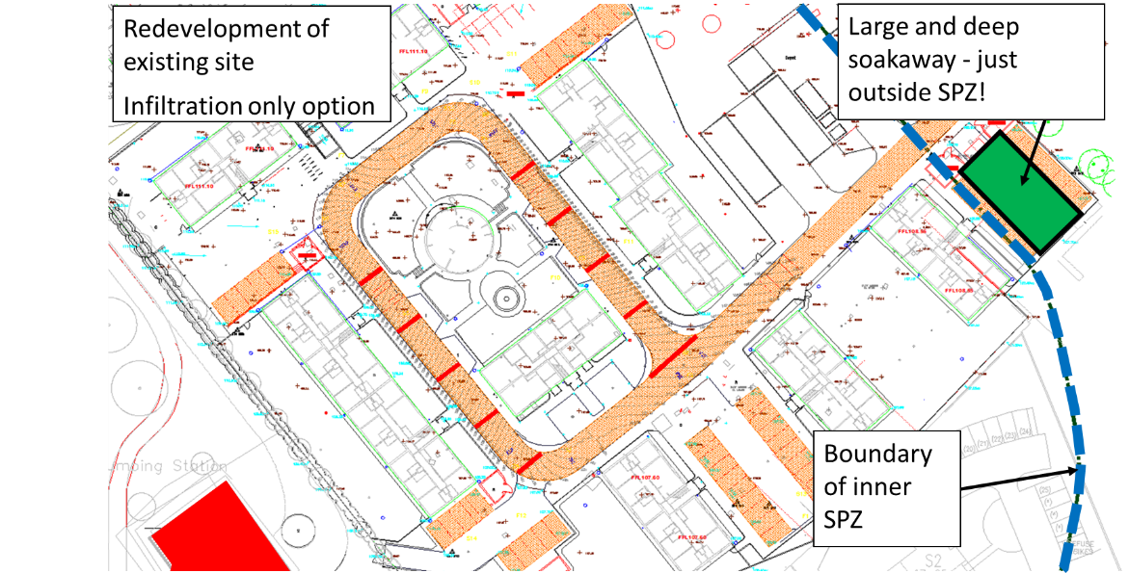
Original infiltration design

Slide 14
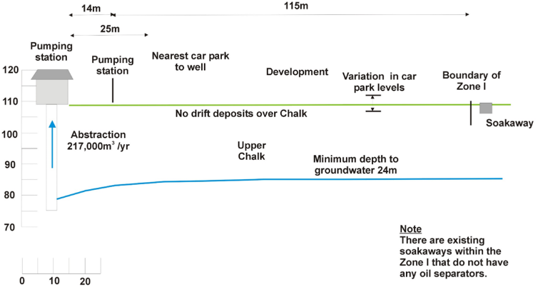
Permeable Paving lower Risk to Groundwater
The permeable pavements are within Zone 1 of the supply borehole but do not concentrate rainwater flows to the ground – flow is dispersed.
PP treats pollution and infiltrates through weathered putty chalk whereas there was no treatment prior to soakaway
The soakaway is just outside zone 1 but concentrates all the runoff from the site into one discharge point at depth directly into fractured chalk.

Slide 15
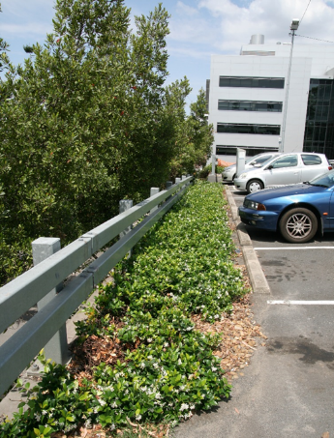
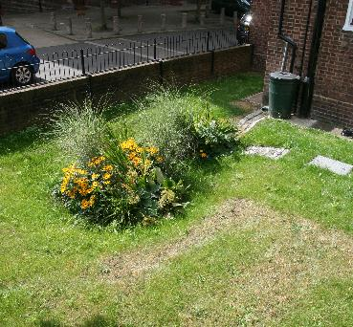
Summary
Good SuDS can contribute to re wilding brownfield sites
Well designed SuDS should be as shallow as possible
This minimises the excavation of contaminated soils
SuDS and biodiversity is not just at ground level – think about the roofs
Infiltration is possible on some brownfield sites
Good engineering skills required – a rule book approach will limit what you can do
Infiltration 1m from building
Infiltration behind a retaining wall

Slide 16
Thank you, any questions

